Slide 1

Destination Management
Plans
Name
Date
Notes:
Hello
We are here today to introduce you to Destination Management Plans and to help you understand how this simple tool can help: -
Realise more effective use of resources (both people and financial) that can result in better value for money
A distinctive place to live, work and visit
And
Higher levels of visitor satisfaction, which in turn can lead to a thriving, vibrant and growing visitor economy.
First lets get an overview before we go into things in more detail.

Slide 2

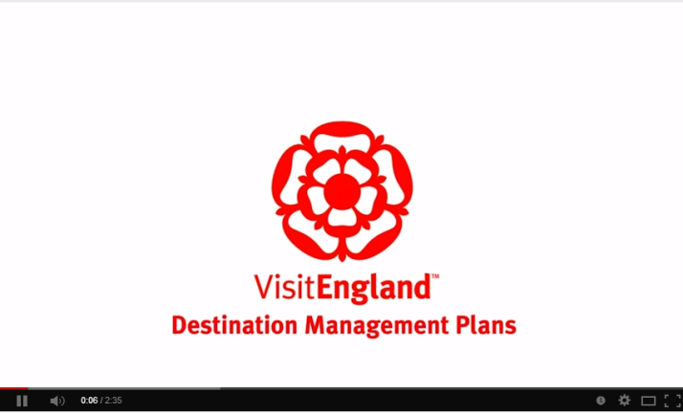
Video presentation
Destination Management Plans
A video presentation, available on YouTube, provides a comprehensive overview of DMP development.
View here
(Right-click and select
Open Hyperlink)
Notes:
Note: You can use this video presentation to help explain destination management plans when working with stakeholders. The YouTube link is: http://www.youtube.com/watch?v=WDAVGdBEd_Y&list=UUHThpChMs9OfEuNrPJb3hMg

Slide 3
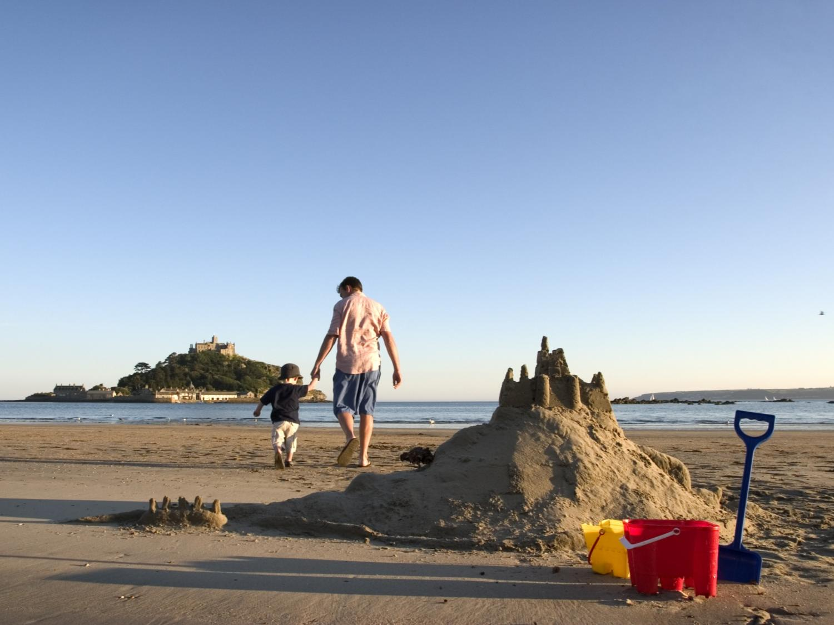

Destination Management Plans
Destination Management?
Notes:
What exactly do we mean by destination management?
This is important as its the underlying principle of all Destination Management Plans

Slide 4

VisitEngland’s Definition
Destination Management Plans
Destination Management is...
...a process of leading, influencing and coordinating the management of all the aspects of a destination that contribute to a visitor’s experience, taking account of the needs of visitors, local residents, businesses and the environment.
Notes:
Here’s VisitEngland’s definition...

Slide 5
Or to think of it another way...
Destination Management Plans
Destination Management
Visitor Experience
Developing the destination
Selling the destination
Common Vision
Clean, tidy, safe, inviting and welcoming places
Partnership
Destination Management Plan
Accessible destinations
Understanding Performance
Product development and investment
Co-ordinated, holistic and focused marketing
Information provision
Understanding destination SWOT
Distinctiveness
Notes:
A more user-friendly description would be that it includes all of these elements together.
More specifically...
Destination image, branding and promotion
Appeal and appearance, access, infrastructure and visitor services including public realm
Product mix – development needs and opportunities.
Working structures and communication
However destinations are complex beasts, so all of these do and indeed need to interact and function together for the destination to be successful. They are the responsibility of multiple organisations in the public and private sector
Just as the key areas need to interact and function together so do the organisations, businesses, public sector and other stakeholders within the destination.
The role of Destination Management is to lead and coordinate this activity they don’t and probably can’t be responsible for all of these facets. Other businesses and public sector bodies or agencies will be needed and often better placed to deliver these different aspects of the visitor journey.
So how can we ensure this happens in a way to benefit the destination and gain more from the visitors it receives?

Slide 6
Destination Management Plans?
Destination Management Plans
Over a stated period of time
With defined roles
With identified actions
With apportioned resources
With measures and monitoring
A shared statement of intent to Manage a Destination...
“
“
Notes:
A Destination Management Plan... should reflect all of these aspects that make up destination management in the slide previous.
A Destination Management Plan (or DMP) is the equivalent of a strategy and action plan for the Visitor Economy within a destination.
Effectively it prescribes; the what, the why, the when, the who, and the how in terms of management of tourism in the destination.
Importantly it provides a structure, a direction and outlines how the vision for growth and objectives for the visitor economy can be achieved.
It can help define a destination’s competitive advantage

Slide 7

What does a DMP do?
Destination Management Plans
Notes:
A DMP exists to provide a clear direction and framework for the visitor economy in the destination.
More specifically it addresses some of the inherent issues within the visitor economy and the management of tourism.
In a nutshell it actually provides:
strategic direction and focussed activity for up to 5 years
Prioritised actions within an annual rolling programme
Identifies responsibility and resources for their delivery
Tailored to the locality – takes into account all the local issues and opportunities (not a cookie-cutter solution).

Slide 8

A DMP Should Deliver...
Destination Management Plans
Things that actually happen...
Less wasted effort and money
A better experience for the visitor and wider benefits
A clear way to assess and monitor the impacts of tourism
Maintenance of distinctiveness
Notes:
Which is great but to translate it into actual benefits for the man in the street it means...
Having a solid plan makes things happen, in enables doing rather than just talking...
Sets out how interests can work together towards a shared goal and by doing so it will cut down on waste and focus resources
It will improve the experience for the visitor and their satisfaction with the place. It therefore contribute to increased spend, duration, frequency of visits etc, and bring benefits beyond the front line (jobs, supply chains, service industry etc...)
Help us to understand, manage and monitor the effects of tourism and activities on a destination
It will help to sustain the things we value, transport infrastructure, retail offer, natural environment, culture & heritage etc (in short maintaining the assets that make a place distinctive )

Slide 9

Myth busting...
Destination Management Plans
A DMP is not...
A magic bullet
A Business Plan
Doesn’t need to be expensive
Doesn’t need to be complicated
MYTH
Notes:
So if we are convinced of the case for DMP’s...
What else do we need to consider before embarking on one?
Time to perhaps bust a couple of myths along the way..
A DMP will not solve all of your problems or meet all of your aspirations right now, and it should not try to!
Rather its better to start with a few key issues and stakeholders to begin with and grow from there.
In some places developing the trust between the partners in the Destination can take time, particularly if this is a brand new way of working for them.
Understanding of the dynamics and ensuring the plan reflects this, is key
Whilst it will likely be compiled by and govern the actions of a destination organisation it is not a business plan.
Or rather it is a business plan for a destination that needs to be created with the businesses and stakeholders as opposed to an internal plan for any one organisation.
Equally it is not a marketing plan.
It will require some expertise and understanding to develop but it does not necessitate excessive cost.
DMP’s can be compiled by officers, volunteer stakeholders or appointed consultants
Whilst plans for destinations could contain a myriad of complexities, a DMP needs to be usable not encyclopaedic.
Therefore it doesn’t need to be a lengthy process – it can take as little as 4 mths but it depends on the size of the destination.

Slide 10
Myth busting...
Destination Management Plans
A DMP is...
Written with business not for businesses
A process that requires engagement
Integral to local decision making process (e.g. planning)
A process that needs leadership
MYTH
Notes:
A DMP is however
Not just for the public sector – private, third and voluntary sectors all have a role (as do wider partners). Equally its as applicable for a large city as its is for a small village.
Because it is for the destination the destination needs to be involved in its preparation, therefore engagement is key to promote ownership & support
A DMP should be embedded in the local decision making processes from planning to transport or even decisions on investment in to the visitor economy. It is fundamentally something that does not stand alone (or stand still).
Regardless of the approach the DMP process will need strong leadership as it develops and as it is implemented. The concept is dynamic and requires regular monitoring, review and revision through its lifespan

Slide 11
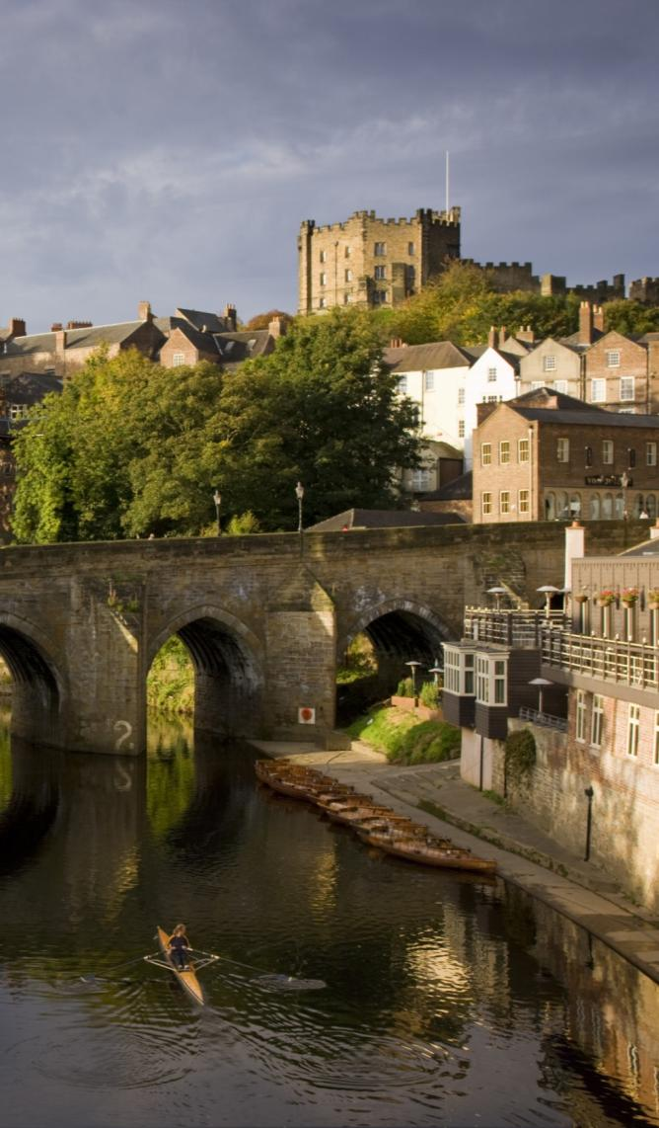

In Practice
Destination Management Plans
“
The Durham Tourism Management Plan provides agreed destination development focused priorities for all organisations involved with the Durham visitor economy. It converts visitor research and industry experience into meaningful actions and targets, which can be delivered by both private and public sector stakeholders.
Craig Wilson – Visit County Durham
“
Notes:
But don’t just take our word for it
A number of destinations across England have already created a DMP

Slide 12


In Practice
Destination Management Plans
“
The Greater Manchester DMP is a key tool in helping us engage with our members and stakeholders, enabling us to collectively set out priority actions and shared responsibilities across the whole destination to achieve our visitor economy growth targets.
Paul Simpson – Visit Manchester
“
Notes:
And this is Visit Manchester’s view of the value of their DMP.

Slide 13
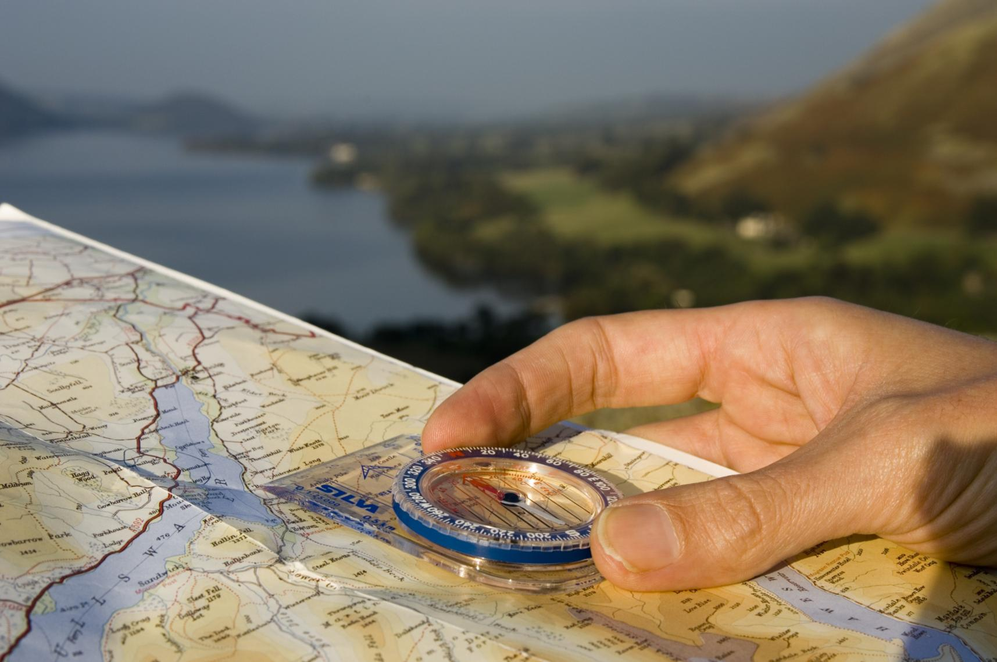
Destination Management Plans
How to do it...
Notes:
So that's the case and the reality, but how can we create one, and ensure we do so effectively?
Bottom-line it needs to be clear, relevant, used and importantly deliver the change and benefits you aspire to.

Slide 14

The Five Key Steps
Destination Management Plans
Agreeing to Plan Together
Gathering the Evidence
Setting the Direction
Identifying the Action
Measuring Progress
Notes:
In order to do that VE have developed a series of guiding principles based on their experience and the experience of other destinations already developing DMPs
Five clear steps that all good DMP’s should address and work through
*At this stage either a quick run-through of the stages to just tease the content OR add in the optional slides which cover the steps in more depth*
Firstly its about laying the foundations, agreeing the scope, getting the right people involved, and in short planning the plan
Second DMP’s need to be based on evidence rather than assumptions. Evidence that will need to be gathered and collated to provide a solid base for setting objectives and action
The core of a DMP is setting the direction clearly, this includes articulating the vision, agreeing aims & priorities and setting measurable objectives.
The direction informs the actions, but these need to be prioritised, specific and you need to clearly outline who will do them and when.
Finally a DMP needs to be measurable, both in itself and how it is addressing the overall aspirations but also in how the specific actions are contributing towards that.

Slide 15
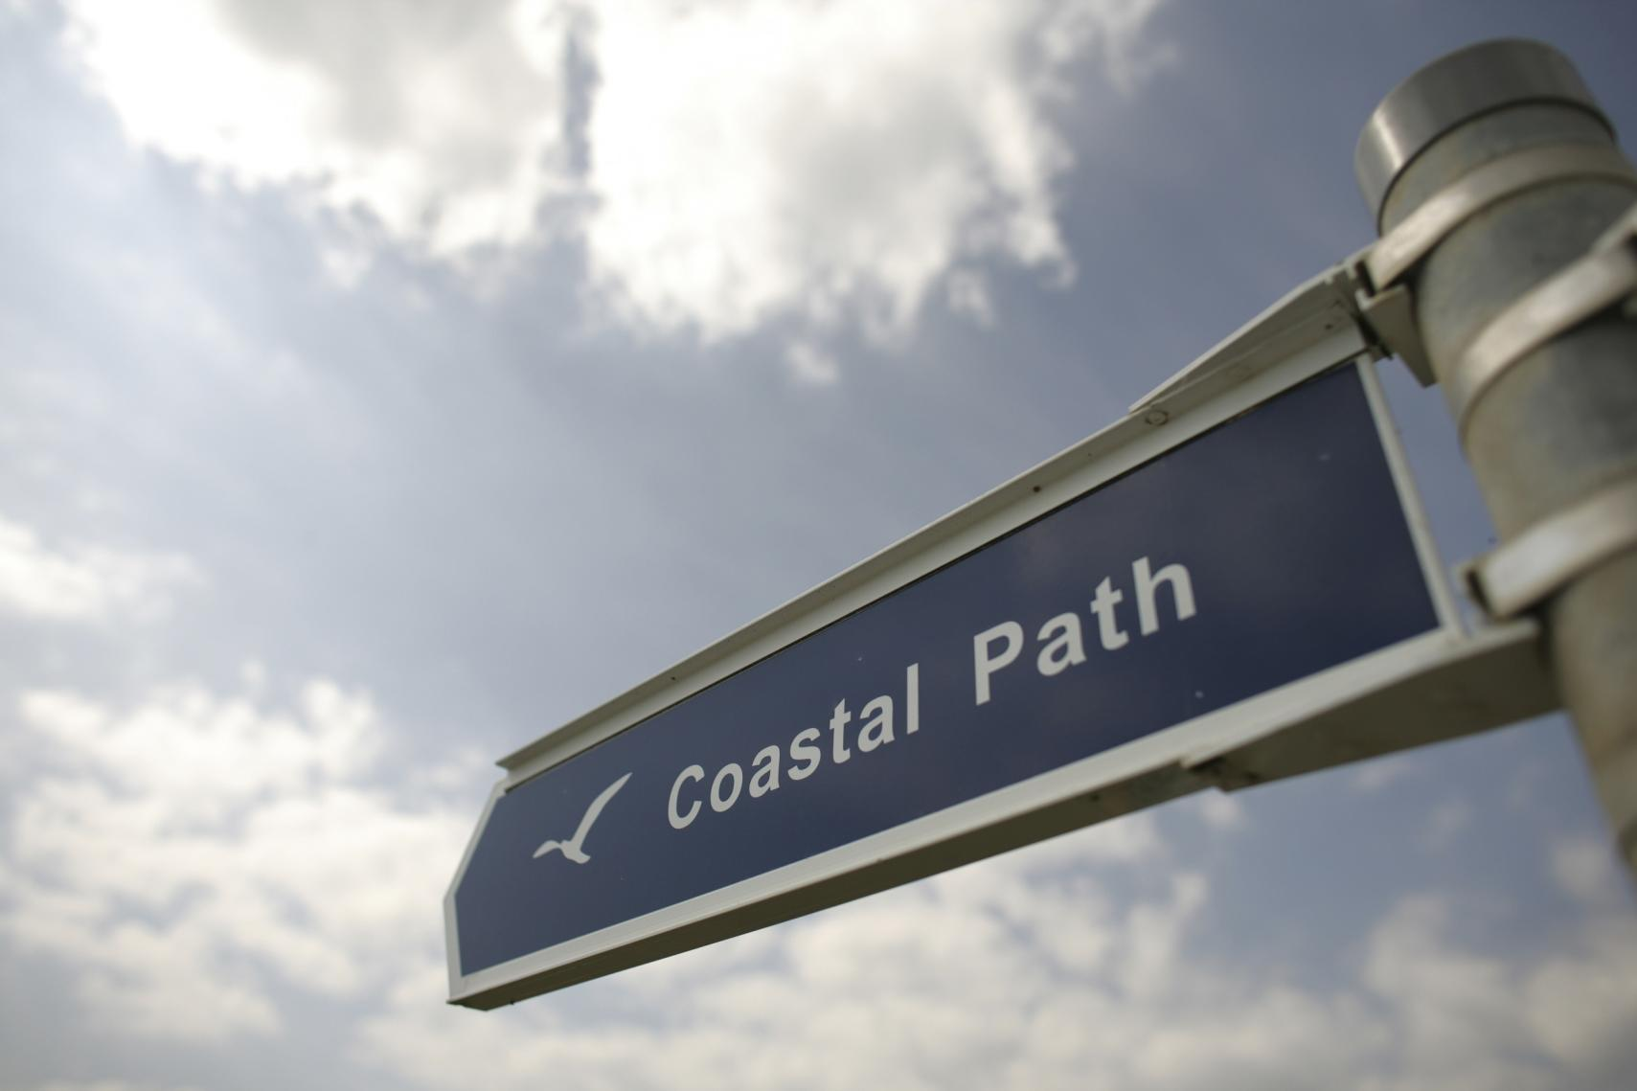
Destination Management Plans
Getting Started...
Notes:
So we know what its is, we know what it will do and we now know whats involved...
How do we get started for ourselves?

Slide 16

Principles for developing a DMP
Destination Management Plans
Describes the principles behind a DMP
Freely available to all destinations
Identifies the key stages and core elements
Not a prescriptive manual
www.visitengland.org/destinations
Notes:
VE has prepared a guiding document to help destinations of all sizes understand the process and develop a DMP of their own.
It covers all the key stages and offers advice, guidance and ideas on how to do so
However VE does recognise that every destination is different therefore it is not prescriptive in its approach and can be interpreted for all scales of destination
It can be downloaded from the VE Corporate site

Slide 17

Further Support
Destination Management Plans
Examples of completed plans
Case Studies
Research & Statistics
Thematic Briefings
Signposting to partner resources
www.visitengland.org/destinations
Notes:
Other ways VE can help.
VE encourages and supports the development of DMP’s as an essential tool in the delivery of a successful visitor economy.
Their role is to guide and advise as you compile your DMP and to that end the corporate site provides an online resource for destination managers.
The resource includes; practical examples, learning from other destinations, evidence for you to incorporate, advice and useful context on specific areas and a directory fo who else may be able to assist.
Visit the website to find out more.

Slide 18
www.visitengland.org/destinations
Name
t. Phone
e. destinations@visitengland.org
Notes:
If you have questions or require further guidance please contact the destinations team at the details on the slide.

