Slide 1
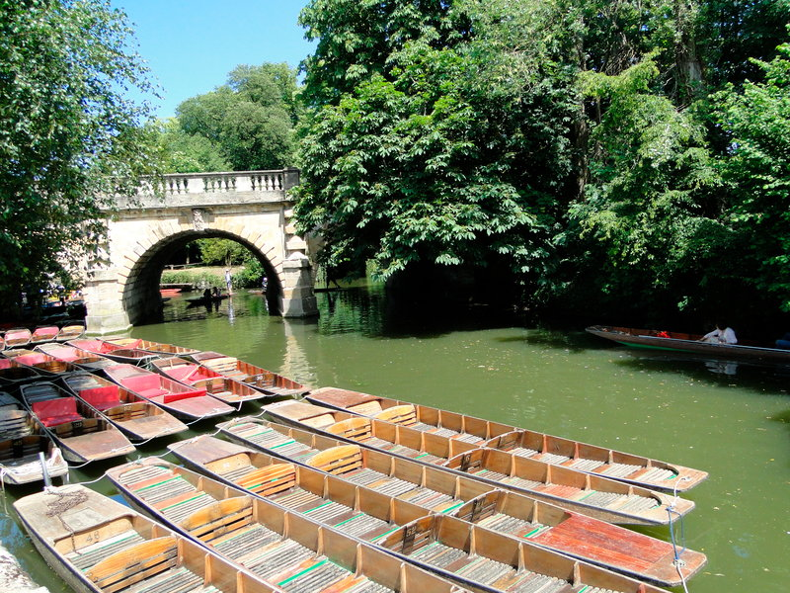

Discover England: summary insights on overseas visitors to Oxford
October 2017

Slide 2
Headline stats: Overseas visits, spend and nights to Oxford
Oxford
Total and holiday visits to Oxford have steadily increased since 2012 numbering 537,000 annual visits on average. Holiday visits, spend and nights increased significantly in 2016, each higher than in any of the previous 5 years.
Visits, Spend and Nights to Oxford 3 year average for 2014-16
Visits (000s)
Oxford Total | 537
Oxford Holiday | 200
Spend (£m)
Oxford Total | 315
Oxford Holiday | 77
Nights (m)
Oxford Total | 3.6
Oxford Holiday | 0.8
Visits, Spend and Nights 5 Year Trend
Source: IPS 2014-2016. Please note figures exclude visitors that did not stay in the UK overnight

Slide 3
Trip purpose and source markets: All visitors and holiday visitors
Oxford
Trip purpose amongst all visits to Oxford is similar to the UK average, with the largest proportion of visits recorded as holiday. When it comes to activities, holiday visitors to Oxford are more likely to visit countryside/villages than the UK average. They are also more likely to engage in cultural activities such as visiting museums/galleries, castles/historic houses and religious buildings.
Top 3 source markets for holiday visitors to Oxford (ranked by visits)
Activities conducted by holiday visitors to Oxford
France |  | Germany |  | USA
Visit (000s) | 29.0 | Visit (000s) | 23.8 | Visit (000s) | 21.5
Spend (£m) | £35.4 | Spend (£m) | £30.0 | Spend (£m) | £32.9
Source: IPS 2014-2016, Activities from IPS 2016 only

Slide 4
Demographics and holiday characteristics: Holiday visitors
Oxford
Oxford tends to attract a higher proportion of younger (0-15) visitors than the UK average. Visits are most likely to be made in July to September, significantly higher than the UK average. They are also more likely than average to be part of a package holiday. Holiday visitors stay in Oxford 4.1 nights on average.
Age
Seasonality
Holiday Duration*
Ave. duration in area
4.1
6.4
65+
55-64
45-54
35-44
25-34
Average spend**
Holiday Type
16-24
For whole trip
Per night
£644
0-15
£385
£94
£101
Source: IPS 2014-2016. *Note that duration chart refers to length of holiday overall for visitors to town, and average duration refers to duration in specified town. **Spend is for the stay in the city/town only, whereas spend for the UK covers the whole trip. UK average duration and spend is higher than town average due to cumulative visits to other areas for UK visitors.

Slide 5
Travel and destinations: Holiday visitors
Oxford
Holiday visitors to Oxford are most likely to arrive in the UK by airport although a significantly higher than average proportion arrive via a seaport. London is the top gateway region, followed by the South East. London is the leading day trip destination for holiday visitors to Oxford, followed by Hastings and Canterbury.
Mode of Travel
Top 5 Gateway Regions to Oxford* (Top 5)
Destination of day trips from Oxford **
(Top 5)
Source: IPS 2014-2016 . *‘Destination of day trips from Oxford’’ = IPS 2016 only. *Gateway Regions are defined in the introduction of this report

Slide 6
About this report

Slide 7
About this report/1
There is a large and diverse range of data available on overseas visitors to the UK. The data in this report is drawn solely from the International Passenger Survey (IPS), which includes a combination of publically available raw data and the insights generated by VisitBritain in their dedicated reports.
This report provides a summary of the demographics and behaviours of overseas visitors to 20 of England’s destinations. Each destination is given a four page summary Due to base sizes, the majority of results are based upon questions asked on the 2014, 2015 and 2016 IPS surveys. Some questions were only asked in one of these years – for example, questions on day visit were only asked in 2016. For destinations where ‘single year’ base sizes are too low, this data has not been reported.
This report defines ‘destinations’ as the 20 cities/towns in England that were most visited by overseas visitors between 2014 and 2016. The destinations featured in this report are Manchester, Manchester, Liverpool, Brighton and Hove, Oxford, Bath, Birmingham, York, Bristol, Cambridge, Canterbury, Newcastle upon Tyne, Eastbourne, Bournemouth, Windsor, Hastings, Stratford Upon Avon, Leeds, Nottingham and Exeter. Please note that although Dover is in the top 20 most visited destinations, it’s role as a ‘gateway destination’ to the UK suggests that the majority of these visitors are ‘transient’ and travelling elsewhere. Dover is therefore excluded from this analysis. The main focus of this report is overseas holiday visitors – these are predominantly referred to as ‘holiday visitors’ throughout the report.
The report also refers to ‘target markets’. These are France, Germany, USA, Spain, Italy, Netherlands, Australia and The Nordics (Sweden, Norway, Denmark, Finland and Iceland). Markets have been chosen due to their current high volume of visits to England.
Due to the way in which the IPS questionnaire for 2016 was asked, it is not possible to explicitly link where visitors were staying with their daytrip destination, if they stayed in more than one destination overnight. Daytrip data is therefore calculated by measuring the origin and destination of visitors who stayed overnight at one location only. This makes up the vast majority of overseas visitors to the UK (83% in total), so we can confidently assume that our results are representative of all overseas visitors. Day trip data that does not link origin and destination is taken from the whole dataset.
Introduction

Slide 8
About this report/2
Each town/city summary lists the top gateway regions used by visitors to these destinations. Gateways refer to the area of the country that visitors entered on arrival in the UK. Each region is defined as below:
Through this report reference is made to ‘mode of travel’ to the UK based on where visitors are exiting the UK. We have made the assumption that entry point will largely correspond with exit point, and so ‘mode of travel’ is intermittently referred to as ‘mode of arrival’ throughout the report.
Gateway Region | Gateways
London | All London airports (see Gateway Mode below), Eurostar
Scotland | Edinburgh Airport, Glasgow Airport, Aberdeen Airport, Prestwick Airport
Wales | Cardiff Airport, Pembroke Port, Fishguard Port, Holyhead Port
N.Ireland | Belfast Airport
South East | Southampton Airport, Dover Port, Folkestone Port, Southampton Port, Portsmouth Port, Other SE Ports
South West | Bristol Airport, Bournemouth Airport
East | Harwich Port, Other East Ports
West Midlands | Birmingham Airport
North West | Manchester Airport, Liverpool Airport
North East | Newcastle Airport, North East Ports
Introduction

Slide 9
About this report/3
The table below outlines the destinations featured in this report, along with base sizes for each year. Due to small base sizes, the majority of charts are reported as an average of 2014-16 data. For destinations with total 2014-16 base sizes of 300 or below, single year data should be treated indicatively only. For these destinations movements from year to year are likely to be driven by sample size, so commentary has not been provided.
Destination | Base Sizes
 | 2012 |  | 2013 |  | 2014 |  | 2015 |  | 2016 |  | 2014-16
 | All | Holiday | All | Holiday | All | Holiday | All | Holiday | All | Holiday | All | Holiday
Bath | 287 | 149 | 387 | 235 | 317 | 179 | 366 | 210 | 379 | 213 | 1,062 | 602
Birmingham | 942 | 160 | 1,059 | 185 | 907 | 168 | 961 | 174 | 957 | 147 | 2,825 | 489
Bournemouth | 211 | 70 | 187 | 71 | 169 | 57 | 181 | 66 | 186 | 77 | 536 | 200
Brighton and Hove | 348 | 151 | 412 | 197 | 384 | 188 | 428 | 191 | 398 | 166 | 1,210 | 545
Bristol | 529 | 138 | 601 | 182 | 592 | 151 | 609 | 175 | 667 | 190 | 1,868 | 516
Cambridge | 504 | 155 | 517 | 159 | 473 | 141 | 441 | 110 | 511 | 168 | 1,425 | 419
Canterbury | 182 | 92 | 199 | 106 | 174 | 90 | 175 | 92 | 157 | 73 | 506 | 255
Eastbourne | 79 | 34 | 89 | 46 | 100 | 55 | 114 | 61 | 93 | 46 | 307 | 162
Exeter | 98 | 32 | 142 | 61 | 110 | 48 | 132 | 57 | 129 | 52 | 371 | 157
Hastings | 81 | 41 | 80 | 44 | 70 | 49 | 109 | 76 | 63 | 33 | 242 | 158
Leeds | 364 | 79 | 343 | 66 | 331 | 60 | 353 | 83 | 334 | 65 | 1,018 | 208
Liverpool | 704 | 209 | 740 | 260 | 729 | 265 | 718 | 227 | 729 | 264 | 2,176 | 756
London | 20,381 | 9,034 | 21,835 | 10,131 | 20,725 | 9,536 | 20,206 | 9,107 | 19,800 | 8,931 | 60,731 | 27,574
Manchester | 1,442 | 342 | 1,490 | 345 | 1,348 | 316 | 1,501 | 361 | 1,373 | 319 | 4,222 | 996
Newcastle Upon Tyne | 261 | 103 | 249 | 104 | 280 | 108 | 295 | 103 | 320 | 104 | 895 | 315
Nottingham | 250 | 55 | 265 | 56 | 253 | 44 | 204 | 48 | 262 | 55 | 719 | 147
Oxford | 612 | 193 | 668 | 239 | 651 | 247 | 632 | 205 | 601 | 242 | 1,884 | 694
Stratford Upon Avon | 118 | 60 | 149 | 83 | 155 | 79 | 143 | 72 | 119 | 57 | 417 | 208
Windsor | 270 | 79 | 271 | 77 | 241 | 84 | 255 | 79 | 256 | 68 | 752 | 231
York | 357 | 204 | 419 | 252 | 400 | 245 | 356 | 206 | 344 | 190 | 1,100 | 641
Introduction

