Slide 1

Discover England: summary insights on overseas visitors to England’s regions
Initial summary report: volume, value, profile, motivations and barriers
August 2016

Slide 2
Report contents
Introduction: Including research sources and report rationale (Pages 3-5)
Executive summary: Key results from each chapter (Pages 6-10)
Volume, value and profile: Including trips, nights and spend per year overall, by region and market; proportion of visits to and outside London, by individual region and market; top cities/towns visited overall and by region; seasonality of visits overall, by region and market; duration of holidays overall and by market; key demographics including age and gender; accommodation stayed in during holiday (Pages 11-34)
Activities and themes as motivators: Including perceptions of the UK, motivations for holidaying in England, and activities conducted on a holiday in the UK. (Pages 35-43)
Booking and consuming travel: Including how overseas visitors hear about England, transport booking methods and accommodation booking methods (Pages 44-47)
Hooks and barriers for travelling beyond London: Includes themes illustrating barriers to, and hooks for, going beyond London (Pages 48-55)
Regional Pen Portraits: Key product insights on each of England’s regions as well as activities conducted by overseas visitors in each region, ‘dream-only’ activities and attractions admissions numbers (Pages 56-74)
Recommendations: Final product-orientated recommendations (Pages 75-77)

Slide 3
Introduction

Slide 4
Background
The three-year £40million Discover England Fund was announced by the Government last year, with the objective of ensuring that England stays competitive in the rapidly growing global tourism industry, by offering world-class English tourism products to the right customers at the right time. The fund will be awarded to external bidders, with awards for two blocks of projects.
It is vital that funding is awarded to bids which are in line with consumer and business trends, and to this end, the fund will also support additional research, to ensure that project teams and potential bidders have access to relevant market intelligence. The research will include the delivery of both broad insights (that is, with potential relevance to any project) and research into specific areas.
In considering the types of research relevant for the Discover England Fund, it became evident that much of the information that bidders might require is actually already in existence. This includes information on the VisitBritain Insights pages, the dataset from the International Passenger Survey, other research carried out in the past by VisitBritain, or other secondary data sources.
For these reasons, VisitEngland have commissioned BDRC Continental undertake a substantial programme of tailored secondary research to ensure that bidders can easily access and use existing market intelligence to shape both year 1 and years 2-3 projects. The focus of this programme is the international consumer – while the fund is also intended to stimulate domestic tourism, bids must in the first instance demonstrate their potential to generate growth from inbound markets – and therefore all analysis should be focused on inbound markets.
This first report seeks to summarise all existing information to provide bidders with an immediate source of information to work from. Subsequent in-depth reports will be produced.
Introduction

Slide 5
About this report
There is a large and diverse range of data available on overseas visitors to the UK. The data in this report is largely drawn from the International Passenger Survey (IPS), which includes a combination of publically available raw data and the insights generated by VisitBritain in their dedicated reports. As well as IPS data, the report also draws on the Anholt GfK Nations Brand Index and BDRC Continental’s Global Tourism Monitor. Research sources are cited throughout.
This report aims to draw on the most up-to-date research available. In some cases, data was several years old. For example, ‘activities’ data is based on supplementary questions added to IPS in 2011. With this in mind, some caution should be applied to results in these areas, although there is little evidence to suggest significant changes in recent years.
Although the report aims to focus on visitors to England, this is not always possible with the data available. Therefore the report interchanges between ‘England’ and ‘the UK’ where necessary. All figures reported refer to holiday visits.
The report refers to ‘target markets’ throughout. These are France, Germany, USA, Spain, Netherlands, Australia, The Nordics (Sweden, Norway, Denmark, Finland and Iceland) and China. Markets have been chosen due to their current high volume of visits to England, or (as is the case with China) their potential to visit England in the future.
Introduction

Slide 6
Executive summary

Slide 7
Executive summary/1
Volume, value and profile of overseas visitors
Since 2002, holiday trips to England by overseas visitors have increased by 83%, and nights spent in England by 46%. The lower growth in nights spent illustrates a trend towards shorter breaks in that period. The growth has largely been driven by trips to London, which have grown by 89% compared to 52% for trips outside London.
Average trip length has dropped from 7.4 nights in 2002 to 5.9 nights in 2015. Trips to London average 4.9 nights, and trips to Rest of England 6.9 nights.
Spend has gradually increased since 2002 although due to a strengthening pound has plateaued in recent years.
Overseas visitors are most likely to stay in the South East on their holiday (1.6 million visits in 2015), followed by the South West (1 million) and North West (0.7 million). These regions aside, there has been limited consistent upward movement for overseas visits outside London.
There has been significant change in the distribution of markets visiting England for a holiday since 2002. In 2015 the most visits were made from France (1.6 million visits), Germany (1.3 million), USA (1.2 million) and The Nordics (1.1 million). Positively, visits from each of these markets have grown in recent years.
Overseas holiday-makers staying outside of London are most likely to be from Germany, followed by France and the USA. Germany aside, visits from overseas markets have not increased as much as they have in the capital.
Visitors from the USA tend to spend the most money on a holiday to England, visitors from Germany the most outside of London.
There is significant variation in market representation across different regions. Of the 8 featured markets, France generates the highest number of visitors in 2 of England’s regions (London and East of England), Germany in 4 regions (North East, West Midlands, South West and South East) and USA in 3 (North West, Yorkshire and East Midlands).
Manchester, Brighton and Bath are the most visited towns/cities outside of London

Slide 8
Executive summary/2
Seasonality of visits varies by region. London has the most even spread , 30% visiting in both April to June and July to September, and around 1 in 5 visiting in both off-peak quarters. The South West is the least evenly spread, over half visiting in April to June
Hotels and guest houses tend to be the most popular type of accommodation for all markets, in particular for visitors from China, The Nordics and the USA. More than a third of visitors from Australia stayed with friends or relatives in 2015. Visitors from the Netherlands are most likely to be camping or staying at home.
Activities and themes as motivators
The Gfk Anholt Nations Brand Index survey ranks the UK as 4th in the world for tourism. In particular it is well-regarded for being rich in historic buildings/monuments and for educational qualifications. The UK is less well-regarded for its natural beauty, an attribute for which it is ranked 18th. Despite this lower ranking, perceptions have improved in recent years.
Motivations for visiting England tend to be centred around sight-seeing and experiencing local culture, areas in which England scores higher than the ‘world average’. ‘Resting mind or body’ or ‘visiting beaches/coastal areas’ tend to score lower than average, although countries that index high in this area tend to benefit from good weather.
Activities conducted in the UK tend to mirror visitor motivations – sight-seeing activities, shopping and trips to the pub indexing the highest.

Slide 9
Executive summary/3
Booking and consuming travel
Visitors tend to hear about England through media features, travel guides and peer recommendation. Direct advertising also plays an important role.
The majority of visitors book their travel (72%) and accommodation (66%) directly with their travel or accommodation providers. There is some variation by market – long haul markets such as Australia and China more likely to do so via a travel agent.
Hooks and barriers for travelling beyond London
Four main themes exist as barriers for overseas visitors travelling beyond London, as identified in VisitBritain’s 2013 London & Beyond Report:
  Lack of awareness of the offer outside London: There is a clear lack of awareness of British destinations other than London. Even where awareness exists, understanding of the experiences destinations offer is limited
  The all-encompassing London offer: The draw of London is so strong that many feel they wouldn’t have time or the need to go elsewhere. Attracting return visitors and longer stays is crucial to overcome this barrier.
  Desire and the importance of ‘experiences’: Consumers are increasingly seeking ‘experiential holidays’ encompassing culture, food, accommodation and unique experiences. Although Britain performs well with ‘culture’ it is less strong on other experiential areas.
  Transport concerns: Transport or access was identified as a key practical barrier for those that had not been beyond London. Around half said they would be nervous about driving in the UK and a quarter that it was too expensive to travel outside London. Almost a fifth thought that other places worth going to outside London would be too far to travel.

Slide 10
Executive summary/4
There were seven key themes that acted as hooks for travelling beyond London:
  Heritage: History and heritage are strongly associated with Britain’s holiday offer. The most common reason for going beyond London (given by 81%) was that Britain has history spread across the country
  Countryside: More than three quarters (78%) of those going beyond London gave Britain’s unique and beautiful countryside as a reason for travel. Amongst those that had not been outside London, 81% said Britain’s countryside would persuade them to do so.
  Uniqueness and variety: Britain’s unique and varied nature is also appealing, 80% of those that went beyond London saying they did so because of Britain’s diverse regions, and 75% because it offers unique places to stay
  British people and way of life: Over two-thirds of those who went beyond London mentioned the British people as a reason for doing so. 70% wanted to meet British people see the British way of life and 67% because they were friendly and welcoming
  Cities and culture: Britain’s fun and vibrant cities were flagged as a factor which might persuade people to outside London. Britain’s contemporary culture was also regarded as a key element of interest.
  Trains, tours and packages: Most are willing to travel 2-3 hours from their initial base (typically London) to stay in another destination. Preference is for train travel – a fifth said rail passes would help. Packaged tours and itineraries were also mentioned.

Slide 11
Volume, value and profile of overseas visitors
Data taken predominantly from International Passenger Survey (IPS) data

Slide 12
Trends in VOLUME of overseas visits to England
Source: IPS
Source: IPS
Since 2002, holiday trips to England by overseas visitors have grown by 83% and nights spent by 46%; the lower growth in nights spent illustrating the trend towards short breaks during that period.
This growth has been driven ostensibly by trips which include stays in London which have increased by 89% (nights spent in London growing by 62% in this time). The gap between trips / nights spent in London and spent in the Rest of England has grown significantly in that time: trips including stays in the Rest of England growing by only 52% and nights away by only 26%.
Only 32% of all trips to England made by overseas visitors now involve a stay outside of London compared with 38% in 2002.
Volume, value & profile

Slide 13
Trends in overseas visitor SPEND in England
Source: IPS
Overseas visitor spend in England has increased significantly since 2002. As with trips and nights spent, the increase is greater amongst visitors to London. London now accounts for 75% of spend on holiday trips compared with 70% back in 2002. Notably there has been a slight drop in overseas visitor spend since 2014, likely due to a strengthening pound in this period.
2002
2015
Volume, value & profile

Slide 14
Trends in VOLUME of overseas visits to each region
Source: IPS
Source: IPS
Driven by visits (and proximity) to London, overseas visitors are most likely to stay in the South East. Growth outside of London has largely taken place elsewhere in the South East, in the South West and the North West. Although there have been gradual increases in overseas holiday trips to other England regions, rises are not as marked as in the most visited regions.
Only the South East, South West and North West recorded a sustained increase in nights spent on holiday since 2002. There has been minimal movement in nights spent in other England regions, some experiencing recent drops.
Volume, value & profile

Slide 15
Trends in overseas visitor SPEND in each region
Source: IPS
Trends in overseas visitor spend in England’s regions follows a similar pattern to trips – general sustained increases in the South East, South West and the North West, with minimal consistent movement elsewhere.
Volume, value & profile

Slide 16
Trends in volume of overseas holiday TRIPS by target market
Source: IPS
Source: IPS
There has been significant movement in the distribution of markets visiting England for a holiday in the last 13 years. In 2002, the USA accounted for around 600,000 more trips than Germany and France (the second and third most prevalent visitors) but in 2015 most trips to England were made by residents of France (up by 107% since 2002) and Germany (up by 78% since 2002). The USA generated the third highest number of trips in 2015, but experienced a significant drop during the financial crisis in 2007. Although trip numbers from the USA are increasing, they are still 14% lower than in 2002.
Other notable movements have occurred amongst Nordic countries (Sweden, Norway, Denmark, Finland and Iceland); visitors from these markets increasing by 161% since 2002.
Outside of London, overseas visitors are overwhelmingly most likely to come from Germany and France, both of which have risen gradually since 2002.
Volume, value & profile

Slide 17
Trends in volume of overseas holiday NIGHTS by target market
Source: IPS
Source: IPS
Visitors from the USA spend the most number of nights in England, perhaps unsurprising given the time and financial investment in making a trip. Germany and France generate the second and third highest number of nights.
The pattern in the rest of England is markedly different however; Germany accounting for the most number of nights; 3.9 million compared to 2.7 million from France and 2.2 million from the USA. Clearly, the German market should be a focus for projects outside of London.
Volume, value & profile

Slide 18
Trends in overseas visitor SPEND by target market
Source: IPS
Source: IPS
The USA market generates significantly higher spend in England than any other market; at £870 million pounds in 2015, almost £300 million higher than either The Nordics (the second highest spenders), Germany and France. Outside of London there is some variation, Germany generating the highest spend followed by the USA, Australia and France.
Volume, value & profile

Slide 19
Proportion of visitors from each target market visiting outside London (2013-2015 average)
Source: IPS
Source: IPS
Visitors from the USA are the most likely to visit London, followed by The Nordic countries. Almost half (49%) of holiday-makers from China and the Netherlands visit outside London, as do 45% from Germany. Visitors from The Nordics (21%), Spain (25%) and France (31%) are the least likely to visit outside the capital.
Volume, value & profile

Slide 20
Proportion of visitors from each target market who visit each region (2013-2015 average)/1
Source: IPS
Source: IPS
Visitors from Australia and China show a higher propensity than other markets to visit Yorkshire, the North West and West Midlands
Volume, value & profile

Slide 21
Proportion of visitors from each target market who visit each region (2013-2015 average)/2
Source: IPS
Source: IPS
Visitors from Germany, Australia and the Netherlands are the most likely to visit the South West; Netherlands, Germany and China most likely to visit the South East. China, Netherlands and Australia are most likely to generate visitors to the East of England.
Volume, value & profile

Slide 22
Holiday trips to each region by market – 2013 to 2015 average (000s)
Source: IPS
 | London | North East | North West | Yorkshire | West Midlands | East Midlands | East Of England | South West | South East (excl. London)
Australia | 357 | 12 | 51 | 45 | 30 | 18 | 30 | 66 | 72
France | 1,094 | 13 | 40 | 29 | 34 | 13 | 59 | 105 | 244
Germany | 748 | 22 | 59 | 36 | 43 | 18 | 54 | 188 | 265
USA | 947 | 15 | 63 | 56 | 37 | 19 | 43 | 96 | 122
Netherlands | 332 | 17 | 32 | 22 | 25 | 16 | 43 | 75 | 136
Spain | 546 | 8 | 32 | 23 | 14 | 9 | 25 | 41 | 43
China | 72 | 3 | 14 | 6 | 7 | 1 | 8 | 9 | 19
Nordics | 920 | 12 | 55 | 24 | 22 | 9 | 30 | 51 | 77
Of the 8 featured markets, France generates the highest number of visitors in 2 of England’s regions (London and East of England), Germany in 4 regions (North East, West Midlands, South West and South East) and USA in 3 (North West, Yorkshire and East Midlands).
Despite the dominance of these 3 markets, a number of regions attract varying proportions of visitors from these and other markets. For example, the Netherlands have second highest representation in the North East, third highest in the South East and joint third highest in East of England. Similarly, The Nordics have the third highest representation in London and the North West. Despite generating the highest number of trips to England overall, France tends to be significantly less well-represented in the North of England and Yorkshire.
Volume, value & profile

Slide 23
Top English cities/towns stayed in by overseas visitors on holiday trips (2010-15)
Source: IPS
000s of visitors | 2010 | 2011 | 2012 | 2013 | 2014 | 2015
London | 7,325 | 7,616 | 7,649 | 8,509 | 8,914 | 9,210
Manchester | 184 | 211 | 215 | 222 | 229 | 268
Brighton | 157 | 143 | 167 | 210 | 212 | 211
Bath | 159 | 144 | 119 | 176 | 146 | 208
Liverpool | 145 | 188 | 173 | 193 | 222 | 198
Birmingham | 130 | 148 | 116 | 156 | 156 | 180
Oxford | 165 | 181 | 140 | 167 | 193 | 180
Bristol | 103 | 141 | 127 | 140 | 120 | 163
York | 124 | 139 | 108 | 150 | 201 | 132
Cambridge | 128 | 106 | 121 | 126 | 130 | 109
Hastings | 49 | 70 | 42 | 46 | 59 | 99
Canterbury | 96 | 112 | 96 | 99 | 100 | 99
NB. IPS measures people who have ‘stayed in’ a town rather than ‘visited’
After London, Manchester attracted the highest number of overseas holiday visitors in 2015, 268,000 in total. This represents an annual increase each year since 2010. Manchester is followed by Brighton, Bath and Liverpool.
Volume, value & profile

Slide 24
Top towns stayed in by overseas visitors on holiday trips - by region (1)
Source: IPS
SOUTH WEST (000s of visitors) | 2010 | 2011 | 2012 | 2013 | 2014 | 2015
Bath | 159 | 144 | 119 | 176 | 146 | 208
Bristol | 103 | 141 | 127 | 140 | 120 | 163
Bournemouth | 67 | 59 | 71 | 69 | 51 | 68
Exeter | 52 | 28 | 28 | 48 | 52 | 64
Salisbury | 50 | 56 | 54 | 80 | 57 | 47
Plymouth | 72 | 65 | 63 | 75 | 52 | 44
Torbay | 42 | 44 | 35 | 39 | 51 | 36
8. St Ives | 49 | 41 | 23 | 34 | 34 | 36
Newquay | 28 | 35 | 28 | 35 | 58 | 34
Penzance | 30 | 18 | 32 | 26 | 26 | 34
Falmouth | 24 | 14 | 18 | 11 | 12 | 29
Weymouth | 13 | 25 | 16 | 17 | 11 | 21
Gloucester | 13 | 10 | 4 | 19 | 23 | 20
NB. IPS measures people who have ‘stayed in’ a town rather than ‘visited’
N.B. Only towns shown are those recording 20,000 or more visitors in 2015. Generally, numbers within small towns are based on small sample sizes, so should be looked at indicatively i.e. general sizes and trends rather than year-on-year changes
Volume, value & profile

Slide 25
Top towns stayed in by overseas visitors on holiday trips - by region (2)
Source: IPS
SOUTH EAST (000s of visitors) | 2010 | 2011 | 2012 | 2013 | 2014 | 2015
Brighton | 157 | 143 | 167 | 210 | 212 | 211
Oxford | 165 | 181 | 140 | 167 | 193 | 180
Canterbury | 96 | 112 | 96 | 99 | 100 | 99
Hastings | 49 | 70 | 42 | 46 | 59 | 99
Eastbourne | 54 | 53 | 35 | 51 | 64 | 74
Windsor | 58 | 80 | 58 | 54 | 77 | 68
Southampton | 49 | 51 | 47 | 53 | 35 | 66
Portsmouth | 35 | 50 | 29 | 47 | 36 | 53
Reading | 36 | 43 | 46 | 45 | 41 | 37
Dover | 45 | 65 | 64 | 54 | 81 | 36
Maidstone | 33 | 45 | 33 | 29 | 33 | 31
Folkestone | 20 | 12 | 28 | 26 | 31 | 30
Chichester | 20 | 21 | 22 | 18 | 26 | 26
14. Tunbridge Wells | 22 | 35 | 27 | 22 | 21 | 25
Winchester | 21 | 40 | 18 | 35 | 23 | 23
NB. IPS measures people who have ‘stayed in’ a town rather than ‘visited’
N.B. Only towns shown are those recording 20,000 or more visitors in 2015. Generally, numbers within small towns are based on small sample sizes, so should be looked at indicatively i.e. general sizes and trends rather than year-on-year changes
Volume, value & profile

Slide 26
Top towns stayed in by overseas visitors on holiday trips - by region (3)
Source: IPS
NORTH EAST (000s of visitors) | 2010 | 2011 | 2012 | 2013 | 2014 | 2015
Newcastle | 73 | 86 | 71 | 68 | 80 | 91
Durham | 16 | 14 | 18 | 18 | 13 | 24
NORTH WEST (000s of visitors) | 2010 | 2011 | 2012 | 2013 | 2014 | 2015
Manchester | 184 | 211 | 215 | 222 | 229 | 268
2. Liverpool | 145 | 188 | 173 | 193 | 222 | 198
3. Chester | 51 | 54 | 52 | 45 | 39 | 42
4. Windermere | 26 | 23 | 28 | 34 | 43 | 32
YORKSHIRE (000s of visitors) | 2010 | 2011 | 2012 | 2013 | 2014 | 2015
York | 124 | 139 | 108 | 150 | 201 | 132
Leeds | 51 | 64 | 59 | 48 | 67 | 60
3. Sheffield | 30 | 24 | 15 | 20 | 23 | 32
NB. IPS measures people who have ‘stayed in’ a town rather than ‘visited’
N.B. Only towns shown are those recording 20,000 or more visitors in 2015. Generally, numbers within small towns are based on small sample sizes, so should be looked at indicatively i.e. general sizes and trends rather than year-on-year changes
Volume, value & profile

Slide 27
Top towns stayed in by overseas visitors on holiday trips - by region (4)
Source: IPS
WEST MIDLANDS (000s of visitors) | 2010 | 2011 | 2012 | 2013 | 2014 | 2015
Birmingham | 130 | 148 | 116 | 156 | 156 | 180
Stratford-upon-Avon | 28 | 72 | 44 | 55 | 73 | 61
3. Coventry | 35 | 35 | 22 | 36 | 15 | 27
EAST MIDLANDS (000s of visitors) | 2010 | 2011 | 2012 | 2013 | 2014 | 2015
Nottingham | 48 | 60 | 45 | 49 | 37 | 38
2. Leicester | 27 | 25 | 21 | 22 | 19 | 35
EAST OF ENGLAND (000s of visitors) | 2010 | 2011 | 2012 | 2013 | 2014 | 2015
Cambridge | 128 | 106 | 121 | 126 | 130 | 109
Norwich | 26 | 22 | 24 | 23 | 37 | 34
3. Ipswich | 12 | 12 | 15 | 26 | 9 | 20
NB. IPS measures people who have ‘stayed in’ a town rather than ‘visited’
N.B. Only towns shown are those recording 20,000 or more visitors in 2015. Generally, numbers within small towns are based on small sample sizes, so should be looked at indicatively i.e. general sizes and trends rather than year-on-year changes
Volume, value & profile

Slide 28
Seasonality of overseas holiday visits to England’s regions (2015)
Source: IPS 2015
Source: IPS 2015
Seasonality of visits to England tends to vary by different regions. London has the most even spread, 30% visiting in both April to June and July to September, and around 1 in 5 visiting in the off-peak seasons. The South West has the least even spread, over half (51%) visiting in July to September, its largely rural and coastal offer attracting visitors in the summer months.
Volume, value & profile

Slide 29
Seasonality of overseas holiday visits by target market (2015)
Source: IPS 2015
Seasonality of visits also varies significantly by market, although this is in-part linked to the region of England these markets tend to visit. Markets with the highest propensity to visit London (e.g. France and The Nordics) have a wider seasonal spread, whereas those that tend to visit outside the capital tend to be more focussed in the summer months. To some extent this pattern will be driven by the importance of the weather in enabling markets to enjoy their desired holiday motivations and activities.
Volume, value & profile

Slide 30
Duration of overseas holiday visits to England
Source: IPS 2015
Source: IPS
As discussed earlier in this report, the average length of overseas holidays to England has steadily declined since 2002. To an extent, this has been driven by the changing composition of short haul vs. long haul visitors i.e. of the eight target markets under consideration within this report, the three long haul markets (USA, Australia, China) represented 40% of all inbound trips in 2002. By 2015, this had fallen to just 24% - average length of stay among inbound visitors naturally declining as a result of this shift.
This pattern is consistent in holidays to London and to the Rest of England. Holidays to London, either as part of a broader holiday or as a single destination trip tend to be shorter, on average 4.9 days in 2015, holidays to the Rest of England longer at 6.9 days in 2015.
Volume, value & profile

Slide 31
Duration of overseas holiday visits to England – by target market (2015)
Source: IPS 2015
Perhaps unsurprisingly, markets from further afield tend to spend the longest amount of time in England on their holidays. In 2015, visitors from Australia spent 9.6 nights in England on average, China 8.3 nights and USA 6.1 nights.
Conversely, visitors from The Nordics spent 4.3 nights in England and France 4.5 nights.
Volume, value & profile

Slide 32
Gender profile of visitors to the UK by target market (2015)
Source: IPS 2015
Average spend per night (£)
Male | £103 | £99 | £71 | £81 | £76 | £94 | £140 | £147 | £106
Female | £96 | £94 | £78 | £79 | £77 | £71 | £111 | £218 | £117
Overseas holiday visitors to the UK tend to have a fairly balanced gender profile, with a slight skew towards females. Higher female representation is particularly obvious amongst visitors from the USA. Typically, spend per night tends to be higher amongst male visitors (spending an average of £103 per night compared to £96 per night amongst females). Although this trend is not consistent across markets.
Volume, value & profile

Slide 33
Age profile of visitors to the UK by target market (2015)
Source: IPS 2015
Average spend per night (£)
16-24yrs | £78 | £64 | £69 | £69 | £72 | £70 | £128 | £220 | £88
25-34yrs | £107 | £90 | £88 | £79 | £71 | £79 | £114 | £232 | £97
35-44yrs | £109 | £108 | £71 | £76 | £89 | £106 | £124 | £148 | £120
45-54yrs | £112 | £117 | £96 | £91 | £78 | £82 | £139 | £171 | £135
55-64yrs | £108 | £93 | £70 | £96 | £98 | £102 | £144 | £138 | £127
65yrs+ | £90 | £120 | £63 | £74 | £79 | £54 | £97 | £120 | £126
Around 1 in 5 overseas adult holiday visitors to the UK are aged 55 and over, rising to a third amongst visitors from Australia, 3 in 10 among visitors from USA and around 1 in 4 visitors from the Netherlands. France tends to generate the youngest visitors, 44% aged 34 and under, followed by China (42%), Germany (41%) and Spain (40%).
Volume, value & profile

Slide 34
Accommodation stayed in during holiday trips to the UK (2014)
Source: IPS 2014
 | Australia | France | Germany | Spain | Netherlands | USA | China | Nordics
Hotel / guest house | 62% | 56% | 62% | 61% | 60% | 73% | 82% | 79%
Free guest with relatives or friends | 35% | 17% | 11% | 16% | 12% | 18% | 12% | 10%
Bed & Breakfast | 7% | 4% | 8% | 7% | 9% | 8% | 2% | 4%
Rented house | 7% | 6% | 8% | 6% | 10% | 7% | 1% | 6%
Hostel/university/school | 4% | 4% | 6% | 10% | 5% | 4% | 3% | 2%
Camping/mobile home | 2% | 1% | 4% | 1% | 8% | 0% | 3% | 1%
Paying guest family or friends house | 0% | 14% | 6% | 1% | 0% | 0% | 3% | 0%
Other | 2% | 2% | 2% | 2% | 3% | 2% | 0% | 2%
Hotels and guest houses tend to be the most commonly used accommodation type for all markets, in particular for visitors from China, The Nordics and The USA. More than a third of visitors from Australia stayed with friends and relatives in 2015, suggesting that their tendency to travel outside of London may be driven by ancestry and social ties as much as the offer. Visitors from the Netherlands are most likely to be camping or staying in a mobile home.
Volume, value & profile

Slide 35
Activities and themes as motivators
Data based on a combination of Anholt GfK Nations Brand Index and BDRC Continental’s Global Tourism Monitor (both in 2015)

Slide 36
Overseas visitor perceptions of the UK
Source: GfK Anholt Nations Brand Index, 2015
Source: GfK Anholt Nations Brand Index, 2015
UK Rankings for Tourism Attributes, 2008- 2015
 | 2008 | 2009 | 2010 | 2011 | 2012 | 2013 | 2014 | 2015
Tourism (overall) | 4 | 5 | 5 | 4 | 4 | 4 | 3 | 4
Is rich in historic buildings and monuments | 4 | 4 | 4 | 4 | 5 | 5 | 5 | 5
Has a vibrant city life | 4 | 4 | 4 | 4 | 4 | 4 | 4 | 4
Would like to visit if money was no object | 7 | 8 | 8 | 6 | 6 | 6 | 5 | 6
Is rich in natural beauty | 23 | 24 | 22 | 22 | 22 | 20 | 20 | 18
The GfK Anholt Nations Brand Index survey asks 20,000 consumers across 20 countries to score 50 nations on an array of attributes including tourism, culture and welcome, exports, governance and immigration/investment. The scores given across all these attributes are combined to calculate an overall ‘Nation Brand’ index.
In 2015, the UK was ranked 4th for tourism, a strong position it has broadly held for a number of years. The UK had the highest ranking for tourism amongst Chinese respondents, who also ranked the UK in 1st place for culture.
The UK’s highest attribute rankings were for educational qualifications, contemporary culture, vibrant city life, and being creative with new ways of thinking. It also scored very highly for being rich in historic buildings and monuments.
The UK is less well regarded for being ‘rich in natural beauty’, an attribute for which it is ranked 18th. Despite the lower ranking, perceptions of the UK’s natural offer are improving - the 2015 ranking was the highest to date, and represents a gradual improvement in recent years.
Activities & themes

Slide 37
Motivations for taking a SHORT BREAK in England
Source: BDRC Continental Global Tourism Intentions Monitor 2015
 | ANY REASON |  | MOST IMPORTANT REASON
 | England | All World Destinations | England | All World Destinations
ANY SIGHTSEEING | 69% | 60% | 40% | 35%
See main tourist sights /places of interest | 48% | 38% | 27% | 18%
Experience scenery / natural beauty | 30% | 37% | 9% | 13%
See less well known sights / places of interest | 25% | 22% | 5% | 5%
ANY ACTIVITY / EXPERIENCES | 72% | 70% | 37% | 38%
Experience the local culture | 40% | 33% | 10% | 9%
Experience or learn something new | 30% | 25% | 7% | 7%
Go shopping | 27% | 21% | 7% | 6%
Experience some adventure or thrill | 13% | 15% | 4% | 3%
Go to a specific event | 13% | 10% | 4% | 2%
Improve physical fitness / body | 7% | 10% | 3% | 4%
Taste the local cuisine | 19% | 29% | 1% | 4%
Take part in hobby | 9% | 10% | - | 2%
ANY PEOPLE | 37% | 26% | 16% | 8%
Meet new people | 20% | 15% | 12% | 7%
Visit friends/ relatives | 22% | 14% | 4% | 2%
ANY REST / RELAXATION | 30% | 47% | 6% | 17%
Rest mind or body | 19% | 28% | 4% | 7%
Do as little as possible | 10% | 13% | 1% | 2%
Visit beaches / coastal areas | 11% | 21% | - | 5%
Guaranteed sun / good weather | 8% | 16% | - | 3%
In 2015, BDRC Continental conducted a survey of 16,800 interviews across 24 different countries to understand people’s motivations and experience of visiting a wide range of holiday destinations, of which England was included.
The data revealed some interesting trends, in part underlining the perceptions of the UK revealed by the Gfk Nations Brand Index.
Short breaks to England are more than likely than average to be motivated by ‘seeing the main sights’, outlining the country’s strong Nations Brand Index rating for ‘historic buildings and monuments’. Also scoring higher than average is the appeal of England’s local culture and shopping. Underlining England as a ‘doing holiday’ is a lower than average motivation of visiting to ‘rest mind or body’.
A holiday to England is less likely than average to be motivated by ‘scenery/natural beauty’ and ‘visiting beaches/coastal areas’, although the Nations Brand Index implies that perceptions are improving.
Activities & themes

Slide 38
Motivations for taking a LONGER HOLIDAY in England
Source: BDRC Continental Global Tourism Intentions Monitor 2015
 | ANY REASON |  | MOST IMPORTANT REASON
 | England | All World Destinations | England | All World Destinations
ANY SIGHTSEEING | 69% | 63% | 39% | 34%
See main tourist sights /places of interest | 47% | 39% | 23% | 16%
Experience scenery / natural beauty | 41% | 41% | 10% | 13%
See less well known sights / places of interest | 26% | 24% | 7% | 4%
ANY ACTIVITY / EXPERIENCES | 72% | 70% | 36% | 35%
Experience the local culture | 41% | 37% | 9% | 9%
Experience or learn something new | 28% | 28% | 2% | 4%
Go shopping | 23% | 19% | 5% | 4%
Experience some adventure or thrill | 15% | 17% | 3% | 4%
Go to a specific event | 16% | 9% | 5% | 2%
Improve physical fitness / body | 8% | 10% | 3% | 3%
Taste the local cuisine | 24% | 31% | 8% | 8%
Take part in hobby | 8% | 9% | 1% | 2%
ANY PEOPLE | 42% | 28% | 20% | 9%
Meet new people | 20% | 17% | 18% | 7%
Visit friends/ relatives | 28% | 15% | 2% | 1%
ANY REST / RELAXATION | 33% | 52% | 5% | 21%
Rest mind or body | 21% | 28% | - | 7%
Do as little as possible | 12% | 13% | 1% | 2%
Visit beaches / coastal areas | 9% | 25% | 3% | 6%
Guaranteed sun / good weather | 6% | 22% | - | 6%
‘Seeing the main sights/places of interest’ is also a leading motivation for longer holidays to England, as is ‘experiencing the local culture’ and ‘shopping’.
‘Experiencing scenery/natural beauty’ is only marginally weaker than average as a main motivation for taking a longer holiday to England.
As with short breaks, ‘resting mind or body’, ‘visiting beaches/coastal areas’ and ‘tasting local cuisine’ are lower motivations than average.
Activities & themes

Slide 39
Locations where overseas markets would like to stay in the UK
Source: GfK Anholt Nations Brand Index, 2013
According to the Nations Brand Index, overseas markets are most likely to want to stay in the capital city and historic British cities on a holiday in the UK. Respondents from France are most likely to show a desire to stay in the capital city. The China holiday market is most likely to want to stay in a historic British city, traditional English countryside and coastal areas of Britain pointing to future potential for this market.
Activities & themes

Slide 40
Desire to take part in activities among overseas markets
Source: GfK Anholt Nations Brand Index, 2014
Source: GfK Anholt Nations Brand Index, 2014
 | Australia | France | Germany | Spain | USA
Food and drink | 80% | 66% | 67% | 70% | 76%
Famous attractions | 76% | 69% | 63% | 61% | 68%
Big City | 72% | 74% | 66% | 71% | 66%
Countryside | 82% | 68% | 67% | 73% | 75%
Off beaten track | 71% | 69% | 64% | 67% | 66%
Train to travel from place to place | 65% | 50% | 44% | 58% | 66%
Rent a car | 66% | 54% | 53% | 48% | 52%
Day trips | 57% | 61% | 65% | 46% | 63%
Full guided tour | 45% | 45% | 39% | 44% | 52%
Planned itinerary | 57% | 52% | 40% | 50% | 53%
When Nations Brand Index respondents stated how interested they would be in doing a selection of activities on an imagined holiday in Britain, they were most likely to state ‘food and drink’, ‘famous attractions’, ‘big city’ and ‘off beaten track’. There was some variation by market. In line with known visitor numbers, ‘Big City’ was regarded as most appealing to visitors from France.
Activities & themes

Slide 41
Activities conducted in the UK on holiday (2011)
Source: IPS 2011
In 2011, VisitBritain added supplementary questions to the International Passenger Survey on specific activities overseas visitors conducted in the UK on their holiday.
In line with motivations and perceptions, the activities conducted centred on the UK’s sight-seeing offer. Of the activities mentioned, 4 of the top 6 were either cultural venues (castles/historic houses, museums/galleries and religious buildings) or parks and gardens. Shopping and visits to the pub also featured highly.
The UK’s rural offer, be it visits to the countryside/villages or going to the coast/beaches featured further down the list.
Activities & themes

Slide 42
Spend attributable to activities amongst overseas visitors to the UK / £m
Source: VisitEngland Valuing Activities Report 2015
In 2015, VisitEngland produced a report that placed a value against the activities overseas visitors conduct whilst in the UK. ‘Special shopping’ (purchasing items not regularly bought) was regarded as the most valuable, accounting for £2,494 million annually. ‘Visiting parks/gardens’ (£1,177), ‘historic buildings’ (£909) and ‘museums/art galleries’ (£889) are the next most valuable.
Activities & themes

Slide 43
Activities conducted on holiday in England’s regions (2011)
Source: IPS 2006-2011
 |  | All UK | South West | South East (excl. London) | London | East of England | West Midlands | East Midlands | Yorkshire | North West | North East
Shopping | Shopping | 69% | 69% | 72% | 81% | 68% | 69% | 72% | 69% | 71% | 62%
 | Shopping- clothes/accessories | 66% | 64% | 60% | 70% | 53% | 51% | 52% | 63% | 60% | 60%
 | Shopping for souvenirs | 58% | 54% | 57% | 60% | 72% | 49% | 45% | 55% | 43% | 66%
Eating, drinking, socialising | Dining in Restaurants | 79% | 71% | 59% | 83% | 69% | 58% | 80% | 70% | 68% | 79%
 | Going to pubs | 48% | 53% | 42% | 53% | 45% | 55% | 61% | 56% | 66% | 77%
 | Socialising locals | 38% | 54% | 47% | 30% | 47% | 59% | 57% | 39% | 61% | 38%
 | Going to bars/nightclubs | 15% | 7% | 6% | 17% | 8% | 15% | 11% | 23% | 30% | 36%
Visiting heritage attractions | Famous monuments/buildings | 64% | 55% | 27% | 70% | 48% | 45% | 38% | 44% | 36% | 41%
 | Parks/gardens | 52% | 59% | 52% | 64% | 48% | 37% | 46% | 38% | 25% | 23%
 | Castles | 34% | 38% | 42% | 30% | 27% | 21% | 17% | 36% | 8% | 30%
 | Religious buildings | 33% | 38% | 37% | 40% | 35% | 18% | 20% | 35% | 20% | 16%
 | Historic Houses | 29% | 36% | 34% | 30% | 28% | 23% | 18% | 28% | 15% | 12%
Visiting cultural attractions | Museums | 48% | 32% | 42% | 55% | 39% | 26% | 16% | 37% | 28% | 14%
 | Art galleries | 26% | 11% | 15% | 32% | 11% | 14% | 3% | 15% | 14% | 7%
 | Theatres | 18% | 7% | 6% | 24% | 8% | 9% | 4% | 3% | 9% | 4%
 | Live music | 11% | 8% | 6% | 11% | 7% | 7% | 9% | 9% | 19% | 14%
 | Festivals | 4% | 5% | 4% | 3% | 6% | 6% | 6% | 5% | 9% | 2%
 | Locations (e.g. lit, film) | 3% | 4% | 2% | 3% | 4% | 2% | 2% | 6% | 2% | 1%
Visiting rural/coastal locations | Countryside | 20% | 51% | 38% | 9% | 31% | 25% | 34% | 55% | 22% | 24%
 | Villages | 19% | 55% | 39% | 9% | 32% | 26% | 20% | 44% | 16% | 28%
 | Coast/beaches | 11% | 48% | 37% | 3% | 16% | 9% | 14% | 22% | 14% | 31%
 | National parks | 7% | 26% | 11% | 4% | 4% | 8% | 8% | 26% | 9% | 16%
Outdoor/sports activities | Walk in countryside | 24% | 58% | 45% | 12% | 27% | 33% | 32% | 37% | 24% | 26%
 | Walking by coast | 8% | 37% | 25% | 2% | 9% | 4% | 4% | 15% | 8% | 35%
 | Playing golf | 2% | 3% | 4% | 0% | 3% | 3% | 3% | 5% | 1% | 0%
 | Going cycling | 1% | 7% | 2% | 1% | 3% | 2% | 2% | 2% | 0% | 4%
Other activities/attractions | Going on a tour | 25% | 23% | 23% | 26% | 14% | 13% | 19% | 18% | 19% | 8%
 | Learning activities | 9% | 20% | 17% | 8% | 6% | 3% | 4% | 4% | 10% | 12%
 | Zoos, aquarium, other wildlife | 7% | 9% | 7% | 8% | 5% | 5% | 8% | 11% | 7% | 1%
 | Visiting a spa/beauty centre | 3% | 6% | 2% | 2% | 3% | 3% | 4% | 5% | 4% | 1%
 | Researching ancestry | 2% | 1% | 3% | 2% | 1% | 2% | 1% | 4% | 0% | 3%
 | Watching live football | 2% | 1% | 1% | 2% | 3% | 3% | 3% | 2% | 8% | 19%
Activities & themes

Slide 44
Booking and consuming travel
Data taken predominantly from International Passenger Survey (IPS) data and BDRC Continental’s Global Tourism Monitor

Slide 45
How overseas visitors hear about England (2015)
Source: BDRC Continental Global Tourism Monitor 2015
Source: BDRC Continental Global Tourism Monitor 2015
How recent visitors heard about England
Travel guides/features | 54%
Peer recommendations | 50%
Tourism Board | 48%
Tour operator/travel agent | 31%
Transport Carrier | 21%
Other | 16%
BDRC’s Global Tourism Monitor demonstrates the importance of features, travel guides and peer recommendations (especially via social media) in driving awareness of England as a destination. Tour operators/travel agents also have a role to play.
Advertising directly on TV, posters, radios or newspapers are of further importance.
Booking and consuming travel

Slide 46
Transport booking method for holiday trips to the UK (2012)
Source: IPS 2012
The majority (72%) of overseas holiday visitors to the UK booked their transport directly with their travel operator, around a quarter (26%) doing so through a travel agent.
Booking methods vary according to market, long-haul destinations more likely to book via a travel agent, 32% of visitors from the USA doing so, 49% from Australia and 64% from China.
NB: Data is from 2012 and trends may have changed since then.
Booking and consuming travel

Slide 47
Accommodation booking behaviour for holiday trips to GB (2012)
Source: IPS 2012
Unsurprisingly, accommodation booking behaviour follows a similar pattern to transport booking. The majority (66%) booked directly with their accommodation provider, but less so amongst visitors from the USA (62%), Australia (59%) and China (just 37%).
Booking and consuming travel

Slide 48
Hooks and barriers for travelling beyond London
This section is based upon a comprehensive 2013 VisitBritain study into why many visitors to Britain do not travel beyond London – what the barriers are and what attracts those that do go beyond London to do so.
Research was undertaken in four established markets (France, Germany, Norway and USA). Please bear in mind that findings reflect views and behaviour in these markets only which may differ to those of other markets (especially emerging markets).

Slide 49
Headline findings
Source: London and Beyond report 2013
London remains the key draw within Britain, even for those who have visited before, but many would want to see other places in Britain as well as London again when they return. ‘London Plus’ appeals to the majority.
Knowledge of destinations drives desire, but knowledge of British destinations other than London can be low, although this varies notably by market.
Those who visit London often want to ‘see’ London/ ‘do the sights’ rather than to have a particular type of holiday experience. This is different from behaviour when choosing competitor destinations, and does not reflect the growing importance of ‘experiences’.
The most common practical barriers to going outside London were concerns about transport/ access.
Most common draws for going outside of London were heritage variety, countryside, unique places to stay and the British people.
Travel agents remain important for a minority, especially in Germany and the US, but the majority in each market reported booking independently, with Britain particularly attracting independent travellers. However, there is a gap for tours, packages and agents, or at least suggested itineraries, to enable trips outside London which many lack the knowledge to make the most of.
There is no single ‘ideal’ itinerary when combining London with other destinations (‘London Plus’), but most are willing to travel 2-3 hours to/ between destinations, preferably by train.
Top Ten Tips for promoting ‘London Plus’
Do not over-estimate geographical knowledge of Britain, or assume potential visitors will be aware of even high- profile destinations outside London.
Focus on the heritage, variety and countryside outside as well as unique places to stay and the British people .
Make sure the ‘experiences’ the destination offers (e.g. luxurious, adventurous) are reflected, and indicate how people will feel (e.g. relaxed) when there, as well as the attractions/ destinations themselves.
Do the work for visitors by putting together set itineraries, illustrating the ‘packages’ they could put together themselves.
Remind of enjoyment of previous trips to London and include London in suggested itineraries but build on appeal by showing that Britain can offer more than our capital , world famous headline sights on a second visit.
Showcase opportunities to relax, enjoy good food and unique/ unusual experiences and places to stay.
Avoid inadvertently re-enforcing out of date stereotypes of destinations
Compare Britain's offer favourably with similar, well-known ‘regional’ offers in other countries (e.g. Cotswolds/ Tuscany, York/ Seville, Scottish Highlands/ Swiss Alps, Cornish coast/ Spanish Costas) . Flag unique or ‘off-the-beaten-track’ experiences in Britain, away from mass tourist hotspots.
Avoid itineraries where driving/ hiring cars is essential (although in some markets this will appeal). Facilitate rail travel, e.g. highlight that booking trains ahead reduces cost considerably, or suggest the use of a BritRail pass.
Show travel times rather than distances from London (or between destinations) by train. Remember for most visitors tolerance is 2-3 hours travel time between destinations.
Beyond London – hooks & barriers

Slide 50
Barriers to going beyond London: summary
Top reasons why recent ‘London only’ visitors have never spent nights in GB outside London
Four main themes emerged as barriers to going beyond London:
Lack of knowledge
All-encompassing London
Desire to visit and the importance of ‘experiences’
Transport concerns
Beyond London – hooks & barriers

Slide 51
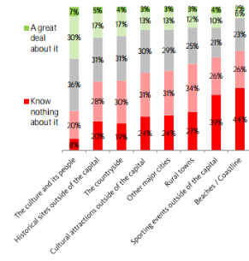
Barriers to going beyond London: themes (1)
Lack of knowledge
Two issues are clear. Firstly there is often an ignorance of British destinations other than London i.e. what areas or towns visitors could consider. Secondly, even when individual destinations are named there is frequently a fundamental lack of knowledge about the experiences on offer and an inability to imagine the type of holiday they would be able to have there.
2) All-encompassing London
The draw of London itself can, for some, deter them from going elsewhere in Britain. Two-fifths (39%) said they felt there was so much to do in London they wouldn’t have time to go elsewhere and one in six (17%) said they thought the best of Britain could be seen within London so they wouldn’t need to go elsewhere.
The issue here is perhaps length of stay and numbers on a first visit. If coming for a few days only, visitors may not feel there is time to do London ‘justice’ and go elsewhere. Attracting return visitors and longer stays is crucial to increase the nights visitors spend both in London and elsewhere. How can we change perceptions of Britain as primarily a short break destination?
Claimed knowledge of Britain amongst recent visitors who had stayed only in London
Beyond London – hooks & barriers

Slide 52
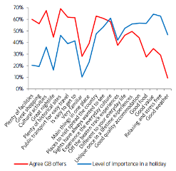
Barriers to going beyond London: themes (2)
3) Desire to visit and the importance of ‘experiences’
In attracting return and longer visits it may be that ‘experiences’ are key. Consumers report they are increasingly seeking holidays that are experiential with everyday culture, food, accommodation and unique ‘once in a lifetime’ experiences being ranked as key to making a ‘great holiday’.
Britain performs less well on the more important factors of weather, relaxation, value, food, accommodation, unique experiences, being different to everyday life and offering ‘off the beaten track’ experiences.
As outlined earlier in this report, Britain in general, is perceived as a ‘sightseeing’ destination rather than an ‘experiential’ one, which results in a short trip and not necessarily returning once they have seen the sights they wished to ‘tick off’. However, those who had been further than London were more likely to see Britain as offering experiential holidays and as such take longer trips to Britain and more frequently.
4) Transport
The most common practical barriers identified by those who had not been beyond London were related to transport or access. Almost half (46%) said they would be nervous about driving in the UK and a quarter (25%) that it was too expensive to travel outside London.
Almost a fifth (19%) thought that other places ‘worth going to’ outside London would be too far from London, or if travelling elsewhere in Britain 15% said it was too difficult to get to other regions. 17% even said they wouldn’t know how to get outside London.
Around a quarter said there were more exciting places elsewhere in Europe which were as close to London as other British regions, perhaps reflecting a greater knowledge of transport to the continent than the extent of transport available within Britain.
Importance of various holiday aspects and extent to which agree Britain offers
Beyond London – hooks & barriers

Slide 53
Appeal of going beyond London: summary
Six main themes emerged as hooks for going beyond London:
Heritage
Countryside
Uniqueness and variety
British people and way of life
Cities and culture
Trains, tours and packages
The following pages discusses these themes in more detail.
Beyond London – hooks & barriers

Slide 54
Appeal of going beyond London: themes (1)
1) Heritage
History and heritage are strongly associated with Britain’s holiday offer and the most common reason why those who went beyond London did so, given by 81%, was because Britain has history spread across the country, not just in London.
When discussing heritage, ‘awe’ and ‘amazement’ (especially those from the US) were common themes but also it seems that there was a danger it could seem a little flat if just about seeing / ticking off major sites – it is important to get across the ‘experience’ and the story behind a place.
3) Uniqueness and variety
Britain’s unique and varied nature is also appealing, with 80% of those who went beyond London saying they did so because Britain’s diverse regions make for an interesting holiday. Having unique places to stay around the country was also a draw, a reason for 75% of those who had been outside London.
Amongst those who had not been outside London, unique places to stay was the most commonly cited aspect which would persuade them to do so, given by 84%.
2) Countryside
Three-quarters (78%) of those going beyond London gave Britain’s unique and beautiful countryside as a reason for travel. Amongst those who had not been outside London, 81% said Britain’s countryside would persuade them to do so – the second most popular factor. Coastline also appealed (76%).
Countryside was a major lever to convey ‘unique, different, beautiful and relaxing. The ‘bucolic beauty’ of southern England was mentioned although there were concerns over access and how to get there. Coastline was generally less motivating, but Cornwall and South West were mentioned.
4) British people and way of life
Over two-thirds of those who went beyond London mentioned the British people as a reason for travelling outside London. 70% wanted to meet the British people and see the British way of life and 67% because they were friendly and welcoming.
Amongst those who had only been to London, 49% had ‘lots of interest’ in culture and people outside London and the idea of British people being welcoming and seeing British way of life were factors which persuade around 70%.
Beyond London – hooks & barriers

Slide 55
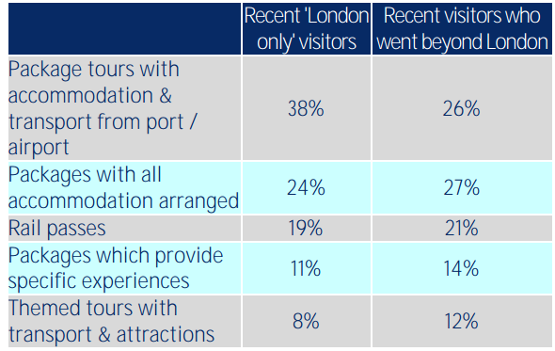
Appeal of going beyond London: themes (2)
5) Cities and culture
Of those who had been to London, a third (34%) had ‘lots of interest’ in major cities outside London and Britain’s fun and vibrant cities were flagged as a factor which might persuade people to go outside London by over three-quarters (78%).
Britain’s contemporary culture (music, art, fashion and food) also emerged as key elements of interest.
This again reflects insufficient knowledge of Britain among many visitors which inhibits their ability to independently organise multi-destination trips and highlights a potential gap for tours, packages and agents for at least suggested itineraries to facilitate trips outside London.
Useful aids to organise a ‘London Plus’ trip
6) Trains, tours and packages
Most are willing to travel 2-3 hours from their initial base (typically London) to stay in another destination. With concerns about driving for many, preference is for train travel. Train was the most popular choice of transport when going between London / elsewhere – a fifth said rail passes would help.
Packaged tours and itineraries were also mentioned by many to enable them to get the most from the trip. Amongst those who had never been outside London, almost a fifth (18%) said if they did so they would want to be on an organised tour with their transport arranged. When asked what would make a ‘London & Beyond’ trip easier they were most likely to mention package tours with accommodation and transport all arranged (38%)
Beyond London – hooks & barriers

Slide 56
Regional pen portraits – product opportunities
Data taken predominantly from Visit Britain’s ‘Inbound tourism to Britain’s nations and regions’ report (2013)

Slide 57

South West – key product insights
South West includes the counties of Bristol UA, Cornwall & Scillies, Devon, Dorset, Gloucestershire, Somerset, Wiltshire
Key Insights:
The South West is particularly popular with well-connected France. Germany, the republic of Ireland and the Netherlands are also large markets.
The area particularly attracts visits from families and children as well as older visitors.
Summer months see a clear peak in visits, tying in with the popularity of outdoor activities such as walking along the coast and visiting parks and gardens
Heritage is also a key draw with historic houses and castles visited by many. Stonehenge is perhaps the most iconic attraction in the region but being able to visit villages, pubs and meet the locals is also important.
The region has plenty to keep visitors busy and attracts longer stays than any other region, with a third staying for over a week.
Although cycling, learning activities and visiting spas are niche activities, overseas visitors in the South West are more likely to involve these on their visit than visitors staying anywhere lese in Britain.
Dream ‘only in South West’ Activities (% listing SW activities in top three - out of 18 options)
Watching sunrise at Stonehenge | 29%
Visiting Harry Potter locations e.g. Gloucester Cathedral | 10%
Watching bands play at Glastonbury | 8%
Most visited attractions 2015 (000s of visits)*
Paid admission |  | Free admission
Stonehenge | 1,367 | Bath Abbey | 400
Roman Baths | 1,045 | The Donkey Sanctuary, Devon | 320
Eden Project | 960
Bristol Zoo | 545
Source: VisitEngland Annual Attractions Survey 2015
*N.B. Attractions numbers include all visitors, not just overseas visitors
Regional Pen Portraits – product opportunities

Slide 58
South West – product themes
Charts illustrate the % of visitors to the region who experience the region’s product
N.B. Data compares overseas visitors staying only in the South West with other overseas visitors who stayed only in another region of the UK (including London).
Source: IPS
Regional Pen Portraits – product opportunities

Slide 59
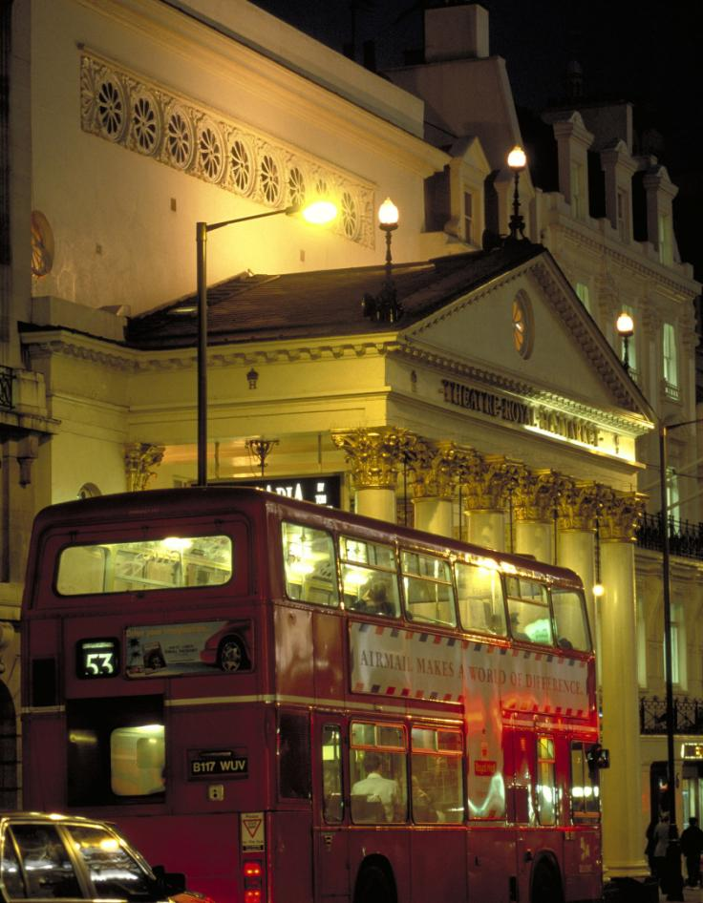
London – key product insights
Key Insights:
London is Britain’s most important draw for inbound tourists. It welcomes more holiday visits from overseas than the rest of Britain combined
The vast majority of holiday visitors to London stay only in London, and for less than a week
Perceptions of London’s offer tend to centre on built heritage, royal links and traditional iconic images, especially in emerging markets. London is also seen as dynamic and exciting.
London attracts everyone, but sees a notable higher proportion of younger people visiting for short breaks than other areas do
The long haul, high spending, US market is second largest for London
Visiting famous buildings, museums, art galleries, parks and gardens are very popular activities, with many visitors also going to the theatre
The majority of holiday visits involve shopping and eating out with London’s nightlife also important
Dream ‘only in London’ Activities (% listing London activities in top three - out of 18 options)
A tour of Buckingham Palace | 32%
Shopping in Harrods | 19%
Seeing a Shakespeare plat at the Globe | 11%
Most visited attractions 2015 (000s of visits)*
Paid admission |  | Free admission
Tower of London | 2,785 | British Museum | 6,821
Westminster Abbey | 1,664 | National Gallery | 5,908
St Paul’s Cathedral | 1,609 | Natural History Museum | 5,284
Kew Gardens | 1,270 | Tate Modern | 4,713
Source: VisitEngland Annual Attractions Survey 2015
*N.B. Attractions numbers include all visitors, not just overseas visitors
Regional Pen Portraits – product opportunities

Slide 60
London – product themes
Charts illustrate the % of visitors to the region who experience the region’s product
N.B. Data compares overseas visitors staying only in London with other overseas visitors who stayed only in another region of the UK.
Source: IPS
Regional Pen Portraits – product opportunities

Slide 61
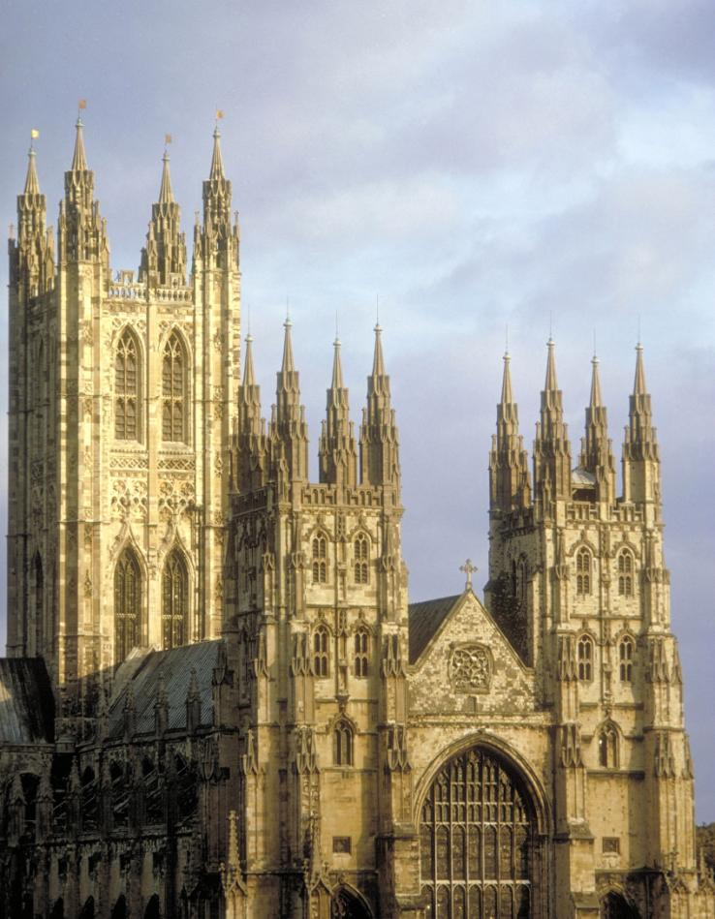
South East (excl. London) – key product insights
South East includes the counties of Berkshire, Buckinghamshire, East Sussex, Hampshire, Isle of Wight, Kent, Oxfordshire, Surrey & West Sussex
Key Insights:
Outdoor activities, parks and gardens as well as the areas coast and countryside are very popular with many going walking and minorities playing golf or cycling.
The South Easts heritage is a strong draw – it is one of the areas where overseas visitors are especially likely to visit a castle, a historic house or a religious building.
Museums are a headline draw and the South East also attracts a relatively large proportion for learning activities.
There are perhaps fewer concerns about the weather in the South East – as many visitors come in late spring/ early summer as in the usual peak season.
Shopping and eating out in restaurants are amongst the most popular activities for overseas visitors in the South East – with excellent connectivity to several European neighbours and long stays common there is scope for visitors to relax with low key activities.
The area attracts more holiday visits including children than any other – some perhaps on school coach trips taking advantage of easy ferry links.
Top of mind activities in the South East (no ‘Dream only in South East’ activities were mentioned)
The South East isn’t particularly top-of-mind, but there were some mentions of Oxford, and spontaneous mentions of the Royal Family indicating potential interest in Windsor and other attractions with royal link.
Most visited attractions 2015 (000s of visits)*
Paid admission |  | Free admission
RHS Wisley | 1088 | Ashmolean Museum | 848
Canterbury Cathedral | 957 | University Museum of Natural History | 640
Blenheim Palace | 763 | Brighton Pier | 4,600
Leeds Castle | 564 | Pitt Rivers Museum | 418
Woburn Safari Park | 490 | The Beaney, Canterbury | 326
Marwell Wildlife | 477
Source: VisitEngland Annual Attractions Survey 2015
*N.B. Attractions numbers include all visitors, not just overseas visitors
Regional Pen Portraits – product opportunities

Slide 62
South East (excl. London) – product themes
Charts illustrate the % of visitors to the region who experience the region’s product
Regional Pen Portraits – product opportunities

Slide 63
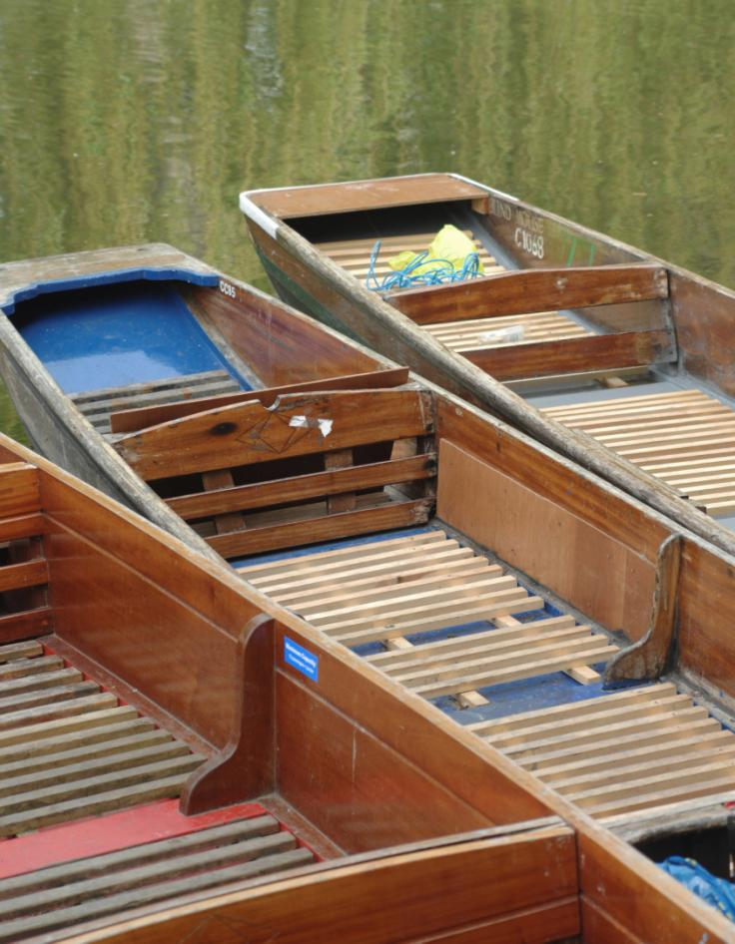
The East of England – key product insights
East England includes the counties of Bedfordshire, Cambridgeshire, Essex, Hertfordshire, Norfolk, Suffolk
Key Insights:
Near neighbours Germany and the Netherlands are important markets. Scenery and outdoor activities are often popular with these visitors and this is reflected in the relatively high proportions visiting the countryside.
Cambridge is a major draw and helps attract a high proportion of young visitors.
The area’s heritage is important with religious buildings and museums included in the trip for many.
A relatively high proportion staying with friends or relatives (and a lower proportion in hotels) may contribute to easting out being less common in this area.
Although niche activities, theatre and festivals also attract some visitors with the area seeing one of the highest propensities for theatre visits outside of London.
Top of mind activities in the East of England (no ‘Dream only in East of England’ activities were mentioned)
The East of England isn’t particularly top-of-mind, although there was some spontaneous mention of Cambridge. People had positive associations with country pubs, gardens and flowers all of which feature in the East of England.
Most visited attractions 2015 (000s of visits)*
Paid admission |  | Free admission
Colchester Zoo | 964 | Fitzwilliam Museum | 418
Whipsnade Zoo | 737 | Needham Lake | 320
Imperial War Museum, Duxford | 374
Angelsea Abbey | 333
Source: VisitEngland Annual Attractions Survey 2015
*N.B. Attractions numbers include all visitors, not just overseas visitors
Regional Pen Portraits – product opportunities

Slide 64
East England– product themes
Charts illustrate the % of visitors to the region who experience the region’s product
Regional Pen Portraits – product opportunities

Slide 65
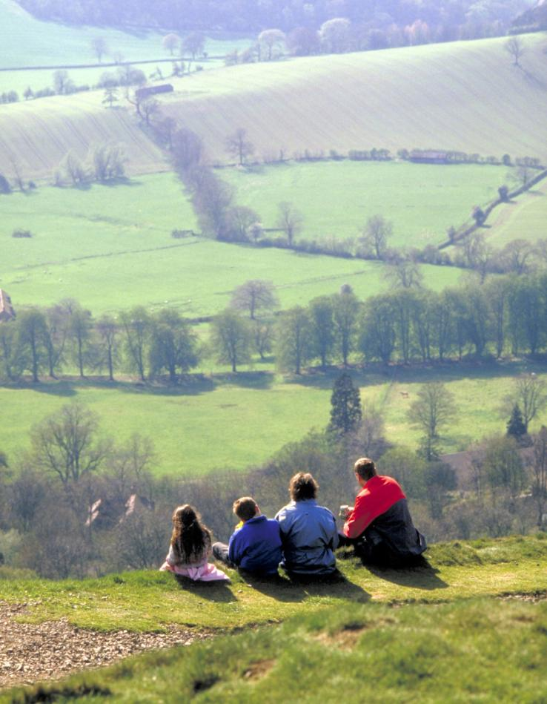
West Midlands– key product insights
West Midlands includes the counties of Hereford & Worcester, Shropshire Staffordshire, Warwickshire, West Midlands
Key Insights:
Holiday visits are particularly likely to include going to a theatre with Stratford-upon-Avon a major draw.
The West Midlands is also one of the most popular areas for watching sport, the number of visitors coming primarily for this reason behind only London and the North West.
Going to the pub and socialising with locals is popular, whilst eating out is less likely here than in many areas- probably a reflection of the high proportion of visits which involve staying as a guest with friends or relatives.
Those from the Irish Republic and France dominate overseas visits to the area, accounting for 2 in 5 holidaymakers (compared to around 1 in 5 nationally). Short travel times and event based visits may contribute to relatively few visits lasting over a week.
The West Midlands attracts holiday visits all year round, possibly boosted by non-seasonal activities such as shopping or going to the theatre.
The area sees relatively high numbers of visits from those travelling with children but also from older visitors.
Top of mind activities in the West Midlands (no ‘Dream only in West Midlands’ activities were mentioned)
The West Midlands isn’t particularly top-of-mind, but there were spontaneous mentions of Shakespeare and positive associations with country pubs, castles, gardens and flowers.
Most visited attractions 2015 (000s of visits)*
Paid admission |  | Free admission
Drayton Manor Theme Park | 1,210 | Birmingham Museum and Art Gallery | 910
West Midland Safari Park | 700 | MAC Birmingham | 1,028
Attingham Park | 402 | RAF Museum Cosford | 355
Shakespeare's Birthplace | 383 | Coventry Transport Museum | 321
Source: VisitEngland Annual Attractions Survey 2015
*N.B. Attractions numbers include all visitors, not just overseas visitors
Regional Pen Portraits – product opportunities

Slide 66
West Midlands – product themes
Charts illustrate the % of visitors to the region who experience the region’s product
Regional Pen Portraits – product opportunities

Slide 67

East Midlands– key product insights
East Midlands includes the counties of Derbyshire, Leicestershire, Lincolnshire (exc. North Lincolnshire), Northamptonshire, Nottinghamshire
Key Insights:
Eating out, socialising and going to pubs is popular here. Visitors seem to take advantage of the good value for money on offer, the amount they spend per visit and per night is relatively low.
Visiting the countryside and walking is included on around a third of visits
Shopping is also often part of the trip
The East Midlands sees notably higher proportion of visits from middle aged holidaymakers (aged 35 to 54) with the Republic of Ireland the major market.
Inbound tourism is quite seasonal in the East Midlands.
Most visited attractions 2015 (000s of visits)*
Paid admission |  | Free admission
Chatsworth House | 622 | Rufford Abbey | 452
Belton House | 382 | Sherwood Forest | 423
Wicksteed Park | 360 | Wollaton Hall / Park | 283
Calke Abbey | 311
Source: VisitEngland Annual Attractions Survey 2015
*N.B. Attractions numbers include all visitors, not just overseas visitors
Regional Pen Portraits – product opportunities

Slide 68
East Midlands – product themes
Charts illustrate the % of visitors to the region who experience the region’s product
Regional Pen Portraits – product opportunities

Slide 69
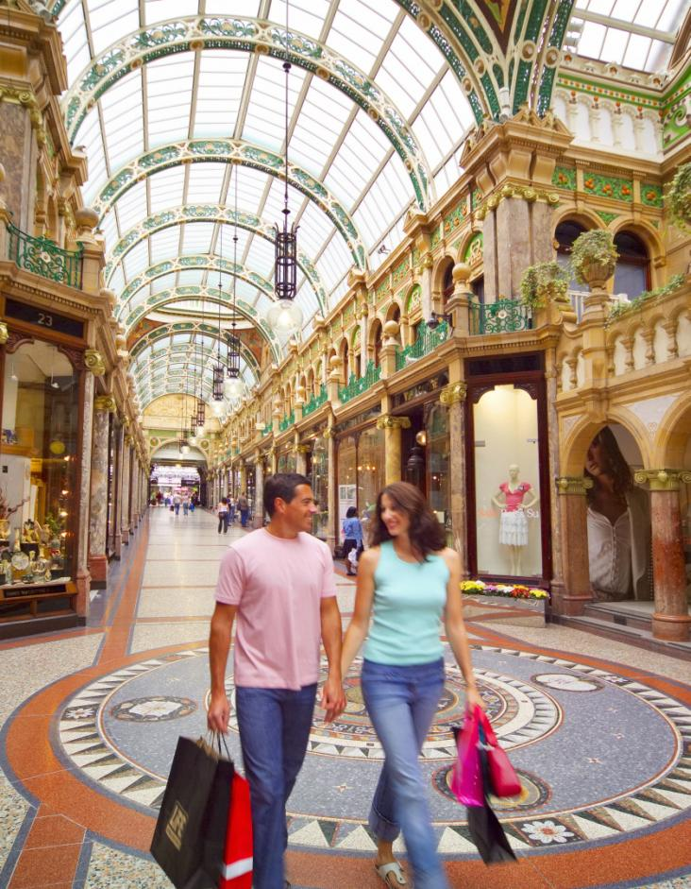
Yorkshire – key product insights
Yorkshire and the Humber includes the counties of East Yorkshire, Hull UA, North Yorkshire, Northern Lincolnshire, South Yorkshire, West Yorkshire.
Key Insights:
Yorkshire’s countryside, villages and national parks are a key draw with holidays here more likely to include these than those in most other areas
Built heritage is also important with a relatively high proportion of holiday makers visiting castles and religious buildings (perhaps abbeys).
Socialising and visiting pubs are also very popular
Yorkshire appeals to all ages but compared to other areas is not notable likely to welcome older visitors. Holidays here are often longer, with around one in six staying over a fortnight. There is a high degree of seasonality.
The Netherlands is the second highest volume market here compared to fifth across the UK. Countryside and outdoor activities are important for Dutch visitors
Top of mind activities in Yorkshire (no ‘Dream only in Yorkshire’ activities were mentioned)
Yorkshire isn’t particularly top-of-mind, but there were positive associations with country pubs which are of course a feature of Yorkshire.
Most visited attractions 2015 (000s of visits)*
Paid admission |  | Free admission
Flamingoland | 1,471 | Millennium Gallery, Sheffield | 764
Jorvik Viking Centre | 330 | National Railway Museum | 733
Yorkshire Wildlife Park | 678 | Yorkshire Sculpture Park | 639
The Deep | 398 | National Media Museum | 442
RHS Harlow Carr | 379
Fountains Abbey | 376
Tropical World, Leeds | 359
Source: VisitEngland Annual Attractions Survey 2015
*N.B. Attractions numbers include all visitors, not just overseas visitors
Regional Pen Portraits – product opportunities

Slide 70
Yorkshire – product themes
Charts illustrate the % of visitors to the region who experience the region’s product
Regional Pen Portraits – product opportunities

Slide 71
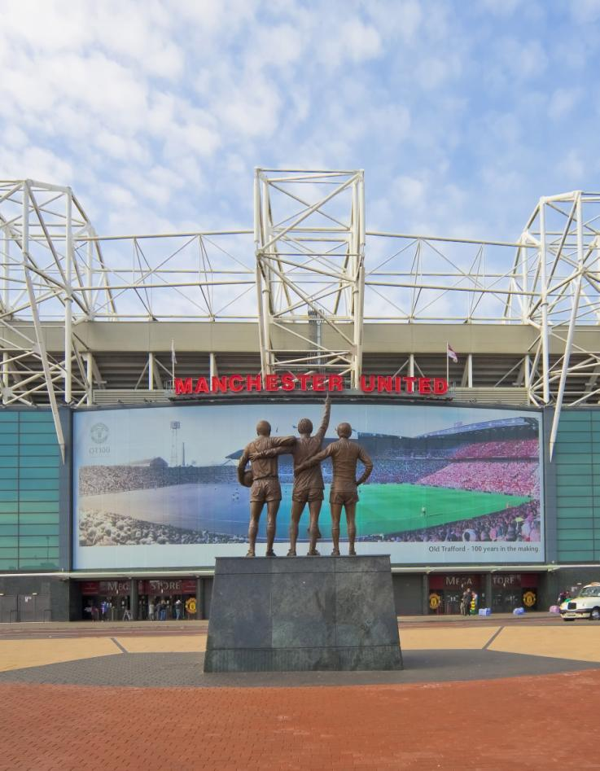
North West England– key product insights
North West includes the counties of Cheshire, Cumbria, Greater Manchester, Lancashire, Merseyside
Key Insights:
The North West sees a good spread across the seasons, with the summer not especially a peak. Football is a driver for winter visits and the North West sees a huge volume of visitors primarily to watch sport.
The North Wests culture is a major draw, especially live music but also art, theatres and festivals.
Overseas visitors to the North West typically stay for a short break, and spend is relatively low. There is perhaps opportunity to encourage longer stays.
The area is popular with young visitors who come to eat out, go to pubs, bars and clubs. Socialising with the locals is also important (perhaps reflecting personal links with the major market of the Republic of Ireland)
There is an opportunity to build awareness of the North West’s offer in terms of heritage (and regeneration) and countryside, with potential visitors perhaps unaware of the proximity of the Lake District to the areas major cities.
Dream ‘only in North West’ Activities (% listing London activities in top 3 out of 18 options)
Watching an English Premier League football match | 19%
Going on a Beatles tour in Liverpool | 11%
Most visited attractions 2015 (000s of visits)
Paid admission |  | Free admission
Chester Zoo | 1,517 | Merseyside Maritime Museum | 662
Windermere Lake Cruises | 1483 | Museum of Liverpool | 747
Tatton Park | 875 | Tate Liverpool | 626
 |  | Museum of science and industry | 697
 |  | World Museum, Liverpool | 659
 |  | National Football Museum | 468
Source: VisitEngland Annual Attractions Survey 2015
*N.B. Attractions numbers include all visitors, not just overseas visitors
Regional Pen Portraits – product opportunities

Slide 72
North West England – product themes
Charts illustrate the % of visitors to the region who experience the region’s product
Regional Pen Portraits – product opportunities

Slide 73

North East England– key product insights
North East includes the counties of Durham, Northumberland, Tees Valley/ Cleveland, Tyne & Wear
Key Insights:
The North East sees a unique mix of visitors. Whilst those from the Republic of Ireland are most numerous the area welcomes relatively high proportions from Sweden, Norway and Switzerland.
The area is popular with young visitors who come to eat out, go to pubs, bars and clubs.
This mix of visitors, and short stays, lead to high spend per night.
Castles, coast and the Northumbria national park are also popular.
With short breaks common visitors perhaps do not have opportunity to visit a range of attractions and there may be opportunity to ‘sell; a wider offer in terms of wider culture and heritage.
There is a good seasonal spread with football attracting some low season visits.
Dream ‘only in North East’ Activities (% listing London activities in top 3 out of 18 options)
Watching an English Premier League football match | 19%
Visiting Harry Potter locations (e.g. Alnwick Castle) | 10%
Most visited attractions 2015 (000s of visits)*
Paid admission |  | Free admission
Beamish | 671 | Great North Museum | 487
Cragside | 232 | BALTIC Centre | 519
Gibside | 229 | Durham Cathedral | 755
Wallington House, Gardens and Estate | 217 | Discovery Museum | 412
 |  | Sunderland Museum and Winter Gardens | 322
Source: VisitEngland Annual Attractions Survey 2015
*N.B. Attractions numbers include all visitors, not just overseas visitors
Regional Pen Portraits – product opportunities

Slide 74
North East England – product themes
Charts illustrate the % of visitors to the region who experience the region’s product
Regional Pen Portraits – product opportunities

Slide 75
Recommendations

Slide 76
Recommendations/1
This report demonstrates clear opportunities amongst the overseas holiday audience for successful bidders of the Discover England fund. Holiday trips and spend have increased for a number of years, from a mix of long-haul and short-haul markets. With economic growth likely to continue in key markets such as Germany, France and the USA, increased holiday visits should increase too.
However, although overseas visitor growth has taken place across England, the focus has been very much in London, and there are clear barriers to overseas visitors travelling further afield. The danger therefore, is that the rest of England fails to take full advantage of increased tourism.
Key barriers for winning bidders outside London
Our sections on ‘activities and themes as motivators’ and ‘hooks and barriers for travelling beyond London’ highlight clear practical and psychological barriers that need to be overcome to facilitate travel beyond the capital. A leading obstacle is a lack of ‘awareness’ of the destinations and attractions that exist outside of London. Any product funded by the Discover England Fund will need to raise awareness of its existence and offer, at a micro level and in the context of its location. Enabling visits outside London with itineraries, packages and easy-travel will help overcome existing barriers to travel.
Offering a point of difference
Central to a successful product is its ability to offer a benefit to its customers. England is viewed positively for its historic buildings and monuments, and current visits from overseas visitors tend to centre around visits to these types of attractions. Given the strength of England’s historical brand, bidders should harness this wherever relevant.

Slide 77
Recommendations/2
However, with the ‘all-encompassing London offer’ presenting a barrier to visits outside the capital, simply appealing to visitors’ desire for history and heritage is unlikely to be enough to draw them outside of the capital – at least on a first visit. In addition, destinations will need to provide a point of difference to the London cultural offer.
This point of difference could be England’s natural beauty (perceptions of which are gradually improving), the escape it offers from London’s urban environment, as well as the opportunities it provides for wellness holidays and adventure tourism. The ‘structural’ barrier of the British weather however, means that natural beauty should be combined with wet-weather alternatives.
Projects outside London may also wish to harness the rise in experiential travel. Experiential holidays tend to be identity-forming for the holiday-maker. They are typically immersive, local, authentic and adventurous - a natural point of difference to the ‘box-ticking’, sight-seeing London holiday. Should bidders opt for this route, they will need to convey their destination’s authentic history, stories and traditions, as well as local cuisine.
Further research
These findings provide an initial summary of the existing primary research on overseas visitors to England. We hope to expand on these findings and recommendations in ensuing reports, a timetable for which will be circulated. If you have any specific queries or channels of investigation, please get in touch with the contacts on the following page.

Slide 78

Further information
Jon Young: BDRC Continental:
Jon.young@bdrc-continental.com
Steve Mills: BDRC Continental:
Steve.mills@bdrc-continental.com

