Slide 1
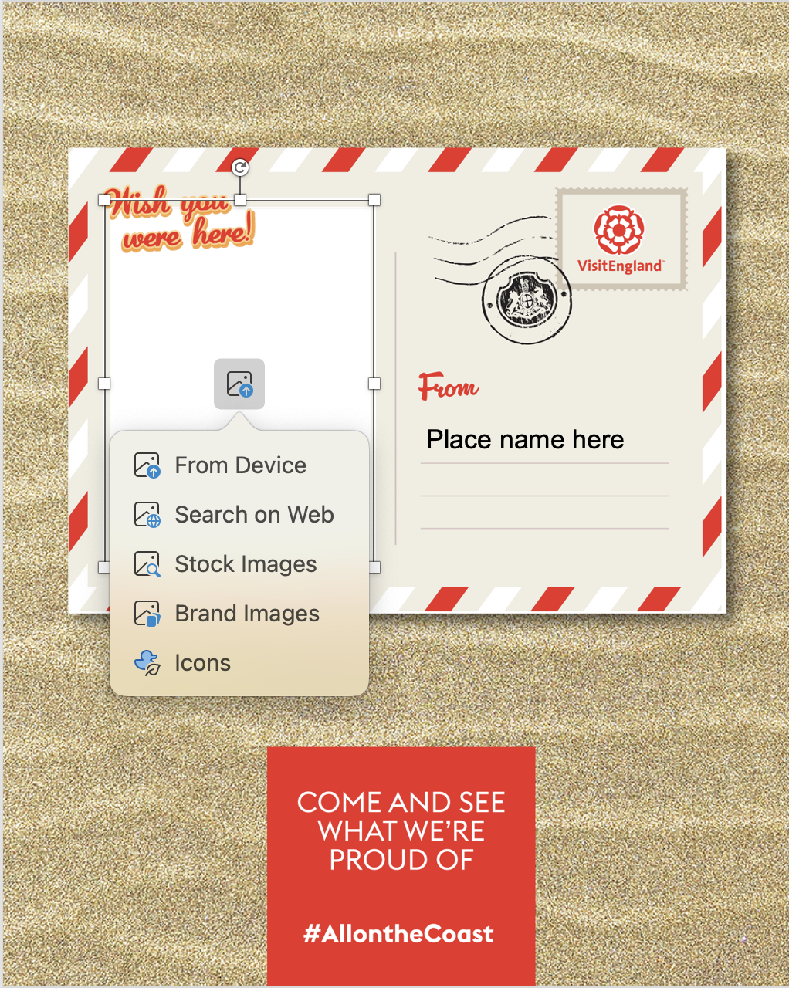
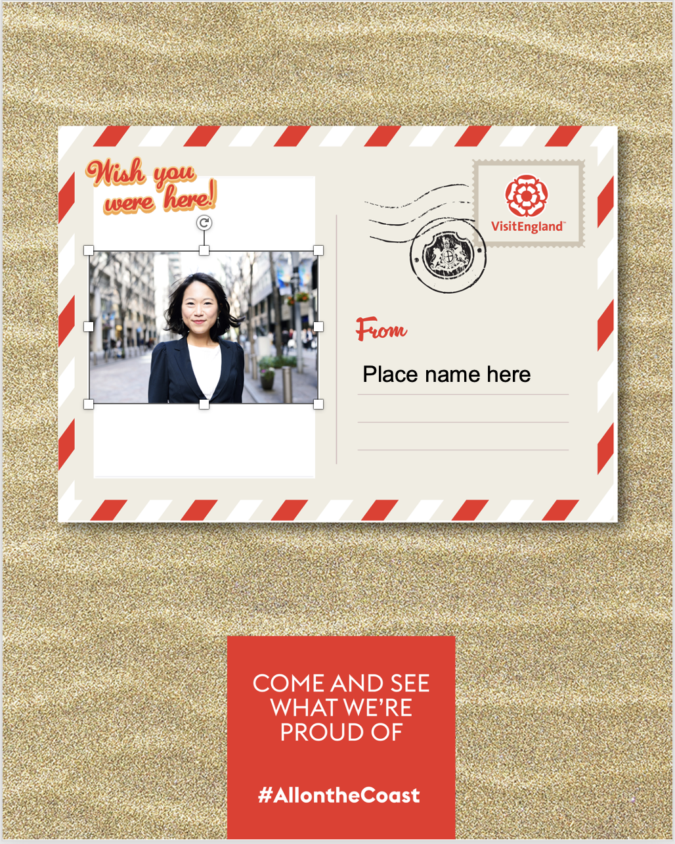
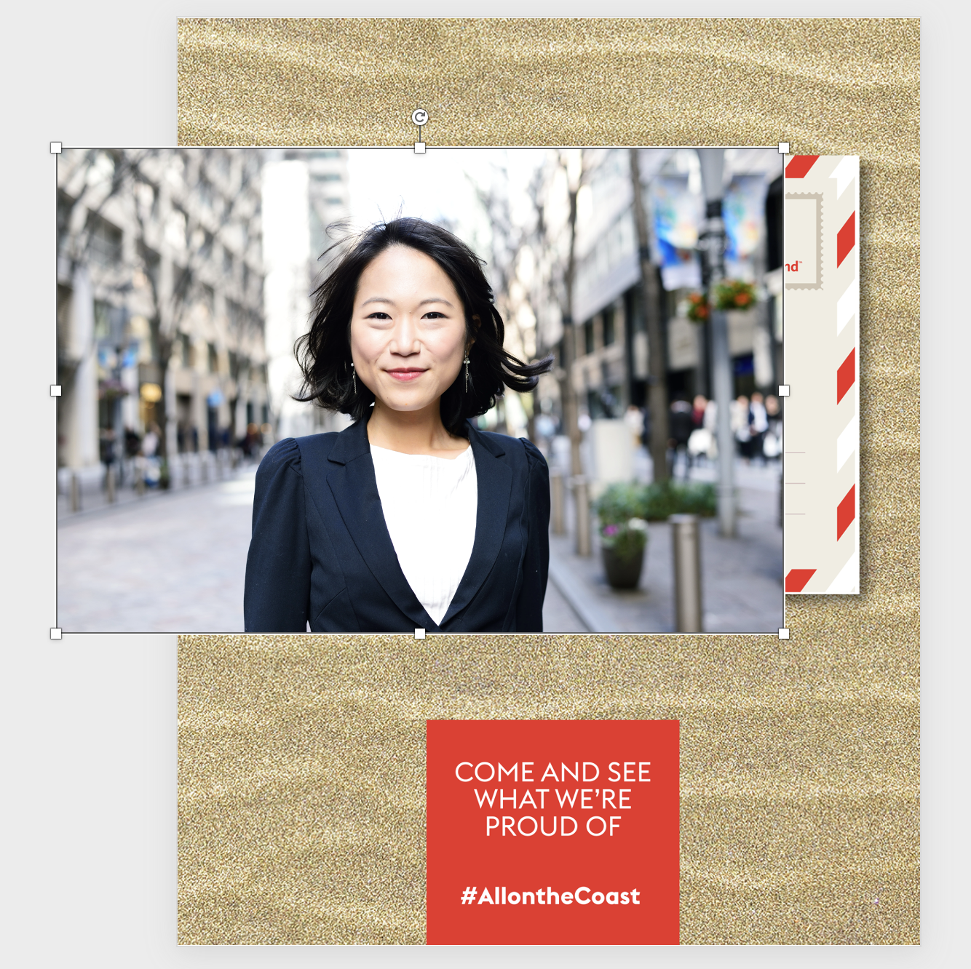
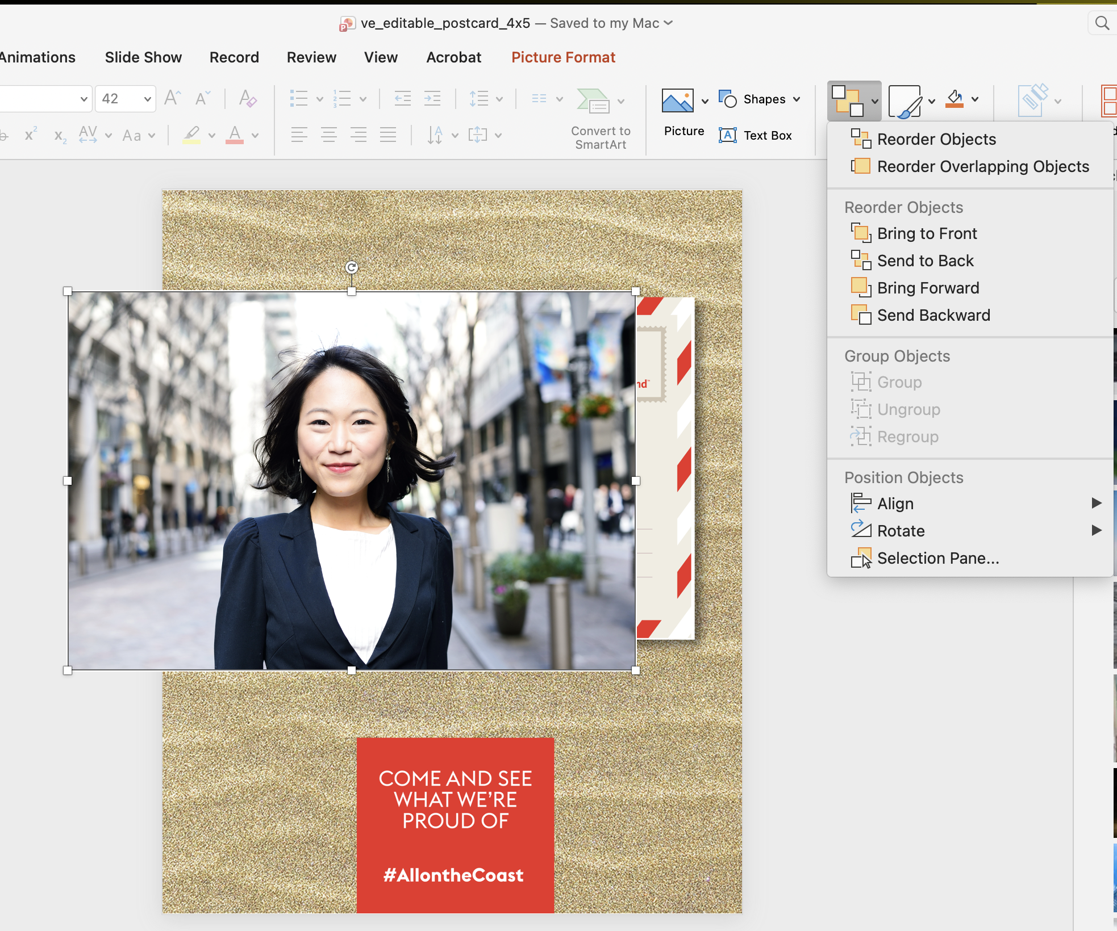
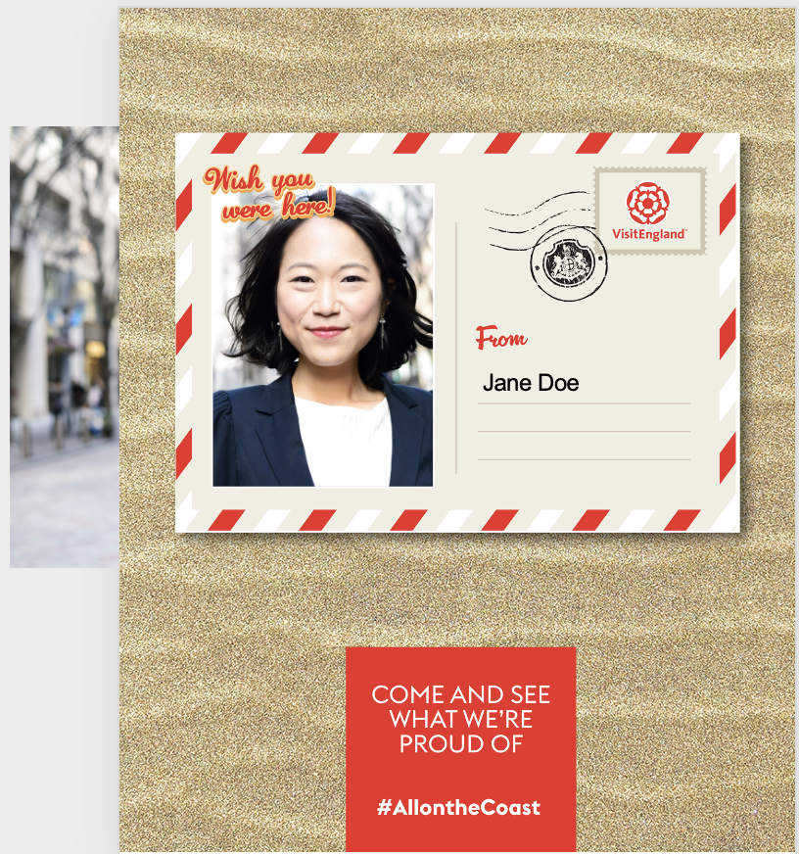
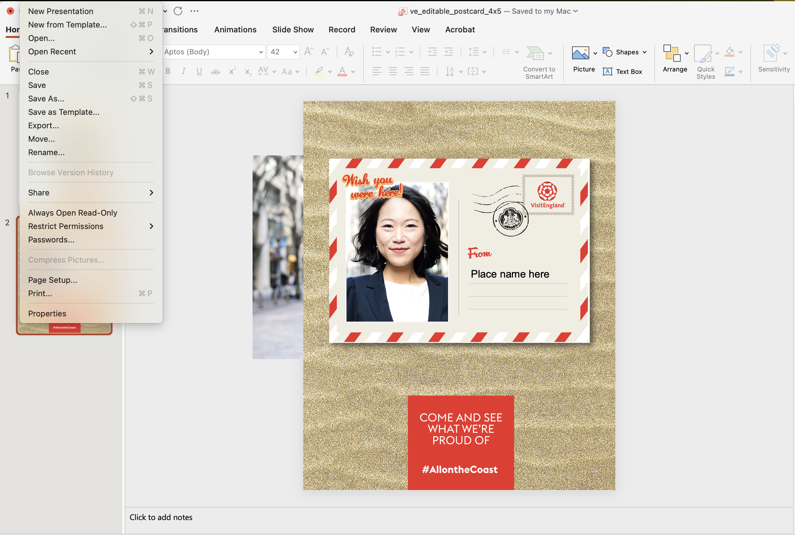
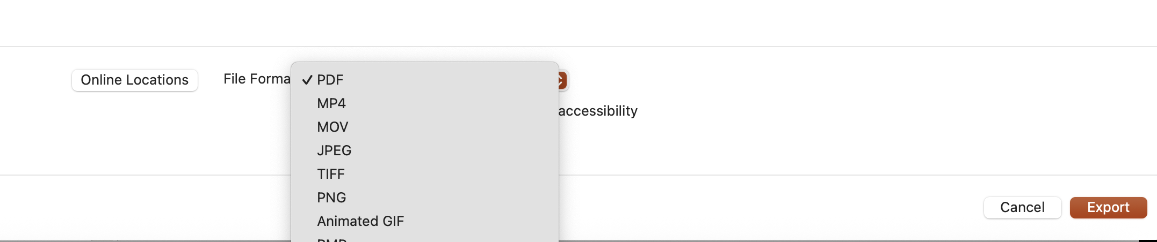
Instructions
Add image
1
2
3
To insert a picture click on the ‘image icon’
Choose an image from your files
Once in place the image can be scaled
up or down (don’t worry about overlap as we sort that in the next step)
4
5
Once the image is scaled, select the image and go ‘arrange’ in the menu and choose ‘Send to back’
This text box is editable for you then to insert your name
Export file
1
2
To export file as either PDF, JPEG or PNG,
go to File>Export

Slide 2

Place name here

