Slide 1
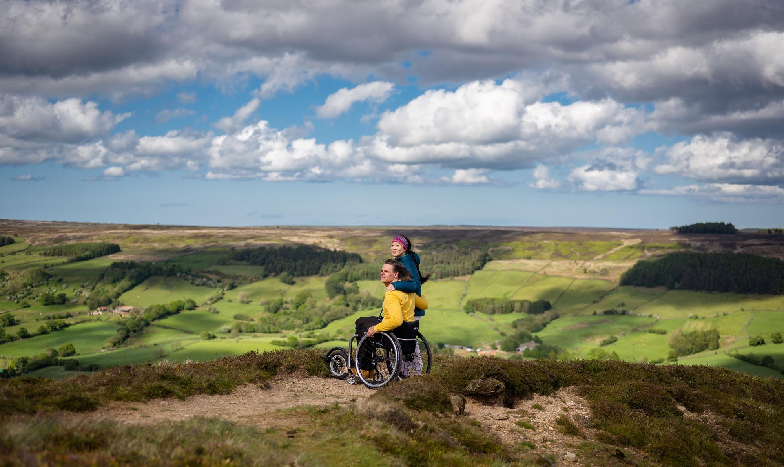

Communications toolkit:
AccessAble’s Your Accessibility Guide Portal
2026
© VisitBritain/Peter Kindersley

Slide 2
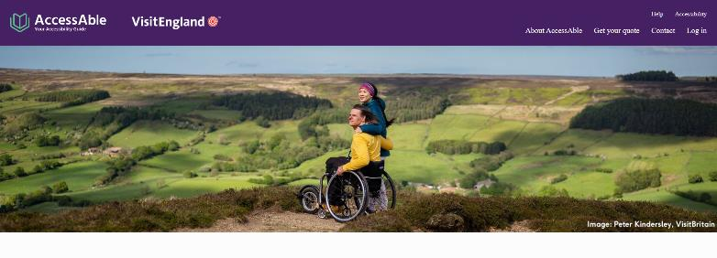
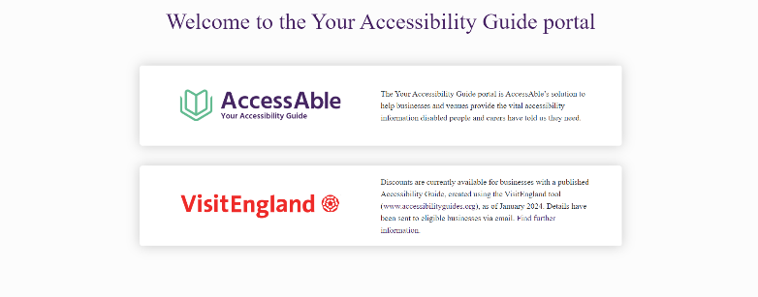
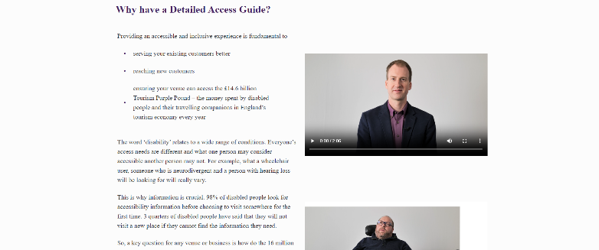

Welcome
Thank you for supporting VisitEngland in promoting AccessAble’s Your Accessibility Guide Portal and the available discounts to your network.
In this toolkit you will find a selection of communication pieces that can be copied, cut and pasted, or used as inspiration for your own promotional channels.
If you need any further materials for your communications or have questions or suggestions about how to communicate this initiative, please contact Hannah Lowe (hannah.lowe@visitengland.org).

Slide 3
Key messages for your audience
95% of disabled people in the UK (or their carers) check accessibility in advance of going to a new place and 77% have not visited a venue because they couldn't find out about accessibility.*
VisitEngland has joined forces with AccessAble to reduce this information gap and promote tourism accessibility guides.
Through AccessAble’s Your Accessibility Guide portal, businesses can get a bespoke quote for either a guided or on-site assessment of their venue, where a professional surveyor will create a quality-assured Detailed Access Guide. A Detailed Access Guide provides a comprehensive description of a venue’s accessibility, helping you to improve your welcome for the £14.6bn accessible tourism market.
The guides will be published and searchable on AccessAble’s website, currently used by over six million people a year, with businesses also receiving an Accessibility Improvement Report.
Discounts may be available – check VisitEngland’s website for more details.
*Source: AccessAble’s Accessibility and You Survey 2023/24 (1000 + respondents)

Slide 4
Short article for enewsletters (c. 65 words)
Title: Boost your accessibility with AccessAble guides
Body:
Did you know that 95% of disabled people check accessibility before visiting a new place?
These comprehensive guides help you welcome the £14.6bn accessible tourism market by providing detailed accessibility information that visitors need to plan their trip with confidence.
Professional access surveyors will survey your venue and create your guide, which will be published on AccessAble's website - used by over six million people annually.
Call to Action: Get your quote now

Slide 5
Longer article for enewsletters (c. 160 words)
Title: Boost your accessibility with AccessAble guides
Body:
Did you know that 95% of UK residents with an impairment (or their carers) check accessibility provision before visiting somewhere new and 77% have avoided venues because they couldn't find this information?
If you’re an English tourism business, having a quality-assured Detailed Access Guide will improve your welcome for the £14.6bn tourism market.
A Detailed Access Guide provides comprehensive information about your venue, from parking to toilets. This helps disabled visitors plan their trip with confidence and demonstrates your commitment to inclusive tourism.
The process is straightforward: professional access surveyors conduct either a either a Guided (via video call) or On Site survey of your venue, creating a detailed guide that covers all aspects of accessibility. Your guide will be published on AccessAble's website, which receives over six million visits annually.
By investing in a Detailed Access Guide, you're opening your doors to millions of potential visitors who value detailed accessibility information when planning their trips.
Call to Action: Get your quote now

Slide 6
Sample B2B social media posts
#DYK that the accessible tourism market in England is worth £14.6bn a year? Having an @AccessAbleUK Detailed Access Guide can help you to welcome these valuable customers
Looking to improve your accessibility information? An @AccessAbleUK Detailed Access Guide provides quality-assured information about your venue’s facilities, from parking to toilets
Want to provide quality-assured accessibility information for your customers? An @AccessAbleUK Detailed Access Guide provides factual detail about your venue and is searchable by over 6 million website users a year
Please tag VisitEngland on LinkedIn and VisitEnglandBiz on X (formerly Twitter) in any social posts.

Slide 7
Sample post for LinkedIn
Did you know that 95% of UK residents with an impairment (or their carers) check accessibility provision before visiting somewhere new and 77% have avoided venues because they couldn't find this information?
Research supported by VisitBritain/VisitEngland has also revealed that 79% of international visitors with a mobility requirement who are considering visiting the UK are more likely to book if access information is easy to find.
If you’re an English tourism business, having a quality-assured Detailed Access Guide will improve your welcome for the £14.6bn tourism market.
A Detailed Access Guide provides comprehensive information about your venue, from parking to toilets. This helps disabled visitors plan their trip with confidence and demonstrates your commitment to inclusive tourism.
The process is straightforward: professional access surveyors conduct either a either a Guided (via video call) or On Site survey of your venue, creating a detailed guide that covers all aspects of accessibility. Your guide will be published on AccessAble's website, which receives over six million visits annually.
By investing in a Detailed Access Guide, you're opening your doors to millions of potential visitors who value detailed accessibility information when planning their trips.
Get your quote now

Slide 8
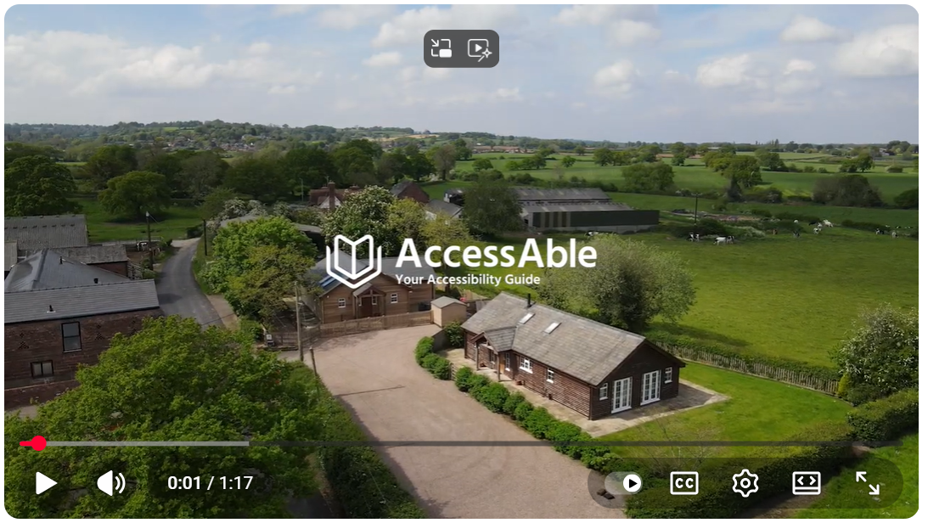
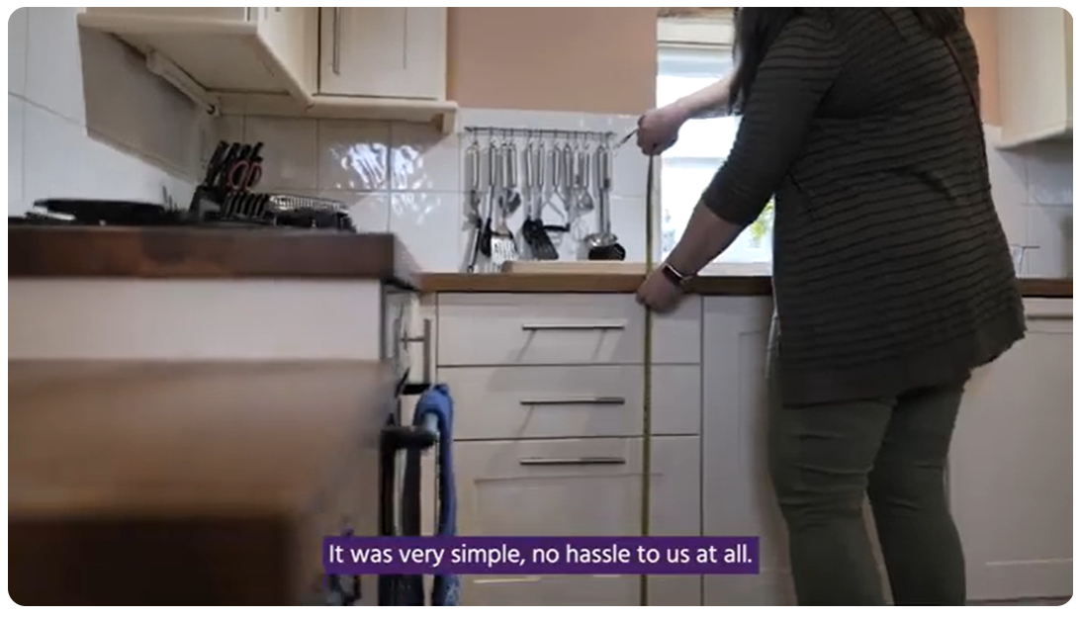
Case study videos
OnSite and Guided Assessment experience (combined)
Guided Assessment experience
OnSite Assessment experience

Slide 9
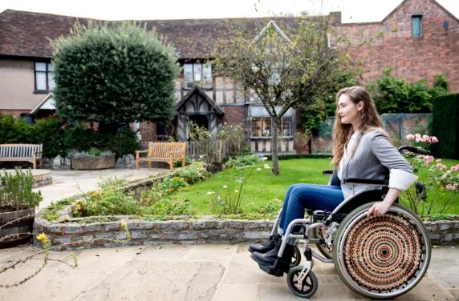
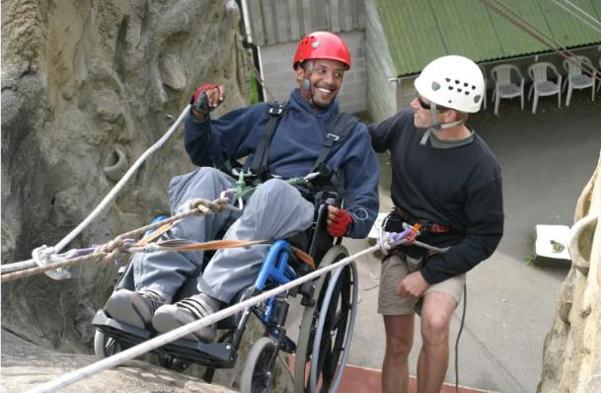
Accessibility Imagery
Relevant accompanying imagery can be downloaded from the ‘Accessibility’ collection on VisitBritain/VisitEngland’s Asset Management Library (registration required):
VisitBritain/Nemorin
VisitBritain/Calvertexmoor.co.uk
No: 608736
No: 607430

Slide 10
More information
For more information on VisitEngland’s AccessAble Detailed Access Guides and Key Accessibility Features initiatives: Update on Accessibility information initiatives
Tourism businesses can find comprehensive guidance on marketing their accessibility in Section 6 of the VisitEngland Accessible and Inclusive Tourism Toolkit for Businesses
Still have questions?
For any queries on VisitEngland’s work with AccessAble, contact: Ross.Calladine@visitengland.org or Hannah.Lowe@visitengland.org

Slide 11
Visitengland.org/access
@VisitEnglandBiz
qad@visitengland.org

