Slide 1


Domestic tourism: Q3 2025
Estimates of the volume and value of day visits taken by British residents in Great Britain and in England.
Source: Great Britain Tourism Survey / Published 18th December 2025
If you need the data in a different format, please contact Research@visitbritain.org
Image: Hot air balloons floating above the Clifton Suspension Bridge in Bristol. © VisitBritain/Eric Nathan
Notes:
Please click the icon to add image
Right click, Send to Back, Send to Back to place the picture in the background.

Slide 2
Contents
    Introduction and Summary
  England and Britain: key metrics
    Overnight trips
    Holidays
    Day visits
  England and Britain: Volume and value by month and quarter
    Overnight trips
    Holidays
    Day visits
  Appendix
    Further data
    Sample sizes
    Definitions
Explore the latest domestic tourism data and reports published on the VisitBritain website.
Latest annual (2024) data and reports are available here: overnight trips and day visits.
Historical overnight trips and day visits data can be accessed in relevant archives.
Regional and subregional data is available here.
You can also get all the latest reports by signing-up for VisitBritain's e-newsletter by contacting Research@visitbritain.org.
Great Britain Tourism Survey (commissioned by VisitEngland, VisitScotland and Visit Wales)
Release date: 18 December 2025

Slide 3
Introduction
  This report includes monthly and quarterly estimates for the volume and value of domestic overnight trips (incl. domestic holidays) and domestic tourism day visits taken by British residents in Britain and in England in July to September 2025. Quarterly reporting includes regional data, trip purpose, destination type and other top-level analysis.
  This is a short summary of recent trends in domestic overnight and day trips, and will be followed by annual reporting, incl. deep dive analysis.
  Monthly data can be volatile, especially for spending, and looking at the past three months provides a more robust view.
  The GBTS data from 2022 onwards has been published as statistics in development. More information on this can be found on the Office for Statistics Regulation website.
  Please note that during fieldwork for July to September, due to technical issues, a small number of respondents were incorrectly deleted. This led to artificially lowered estimates across the Great Britain nations. As it was not possible to recover data from the removed respondents, an uplift was applied on this data. Further information will be provided in our annual Background Quality Reports for 2025.
  Further information on the methodology and user notes (including guidance on limitations of comparability with GBTS data up until 2019) are available in the ‘Supporting documents’ (including Background Quality Reports) section on these two webpages domestic overnight trips webpage and domestic day trips webpage.
  The statistics in this release are based on a combined online survey (called Great Britain Tourism Survey), covering both, overnight trips and day visits. This survey replaces the separate Great Britain Tourism Survey (overnight trips) and Great Britain Day Visits Survey (day visits) which ran until the end of 2019. Due to the methodological changes post 2019, the data from 2022* onwards cannot be compared to the results up to 2019. (* data for 2020 and 2021 are not published, as due to Covid pandemic lockdowns, the complete calendar year data is not available.)
  This survey is conducted by an independent market research agency BMG Research Limited and sponsored by VisitEngland, VisitScotland and Visit Wales. Detailed results for Scotland and Wales are published by VisitScotland (overnight trips and day visits) and Visit Wales respectively.
Great Britain Tourism Survey (commissioned by VisitEngland, VisitScotland and Visit Wales)
Release date: 18 December 2025

Slide 4
Domestic tourism in Q3 2025: England
Domestic tourism in Q3 - overall story
Overall picture: Volume of overnight trips showed a minor decline year-on-year, while volume of tourism day visits was up. Total domestic tourism spend increased for both overnights and day visits.
Volume: In Q3 2025, Britain residents took 27 million overnight trips in England, which is slightly down 2% on Q3 2024 and below Q3 2023 and Q3 2022.
Tourism day visits volume increased by 12%, reaching 286m visits in Q3 2025; this is also above Q3 2023 and Q3 2022.
Value: Total spend on domestic tourism was up year-on-year by 11% to £25.2bn in Q3 2025, with increases noted for both overnight trips (up 5% to £9.6bn) and tourism day visits (up by 15% to £15.6bn). The value is well above Q3 2023 and Q3 2022 for both types of trips.
Domestic tourism in Q3 - detail
Trip purpose: ‘Domestic overnight stays as part of an overseas trip’ increased their share vs previous years in Q3 2025 and reached 10% share of trips (Q3 2022: 6%). Pure holidays were in line with Q3 2024, while below Q3 2022 and Q3 2023. (Indicating a shift from domestic to overseas holidays in Q3.)
Spend breakdown: As in Q2 2025, there was an increase in the share of overnight trip spend on ‘package’ trips, from 18% in Q3 2024 to 24% in Q3 2025. The share of accommodation costs slightly declined for overnight trips. The share of transport costs increased for tourism day visits, vs previous years.
Spend per trip per person: Spend per overnight trip increased in Q3 by 8% to £356 with holiday trips also increasing by 8%, to £412. Spend per day trip in Q3 was only 3% above last year.
Destination type: ‘Large towns or cities’ increased their share of overnight trips in Q3 2025 vs previous three years, while seaside declined.
Region: South West’s share of overnight trips shows a declining trend for Q3 over the past 4 years (20% in 2022 and 2023, 18% in 2024, 16% in 2025). North West increased the share of overnight trip spend in Q3 2025 vs previous years.
Activities: For overnight trips, ‘taking part in hobbies’ increased most, to 17% share of trips in Q3 2025. For day visits, ‘visiting friends and relatives’ increased its share of trips vs previous years to 38% in Q3 2025.
Transport: The share of ‘own car’ use for overnight trips declined vs 2022-24.
Party composition: Solo trips’ share is up for overnight and day trips.
Great Britain Tourism Survey (commissioned by VisitEngland, VisitScotland and Visit Wales)
Release date: 18 December 2025

Slide 5
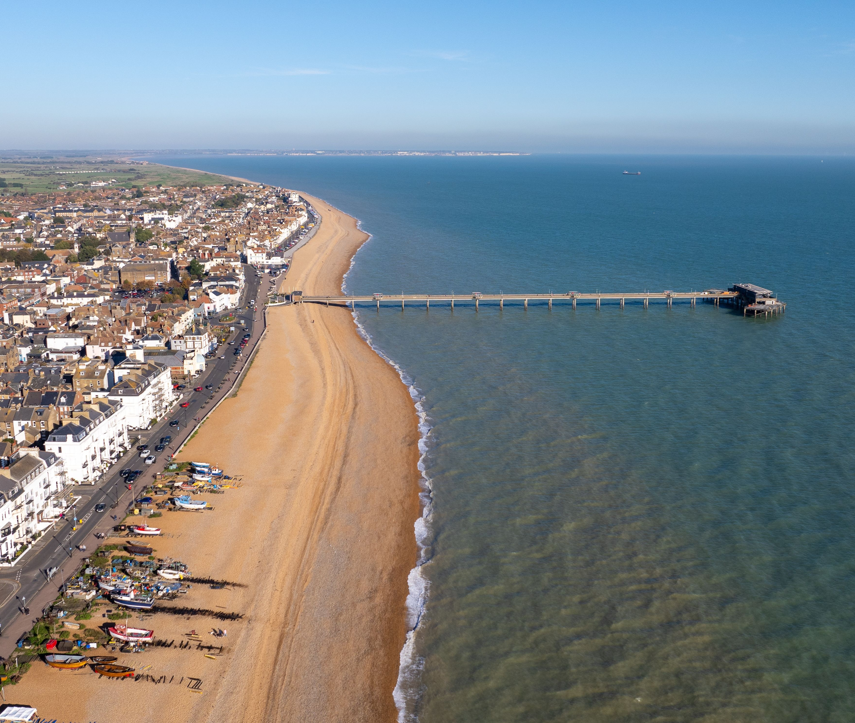
England and Britain: key metrics
Image: Aerial view of coastal town with pier, beach, boats and colourful houses lined along shoreline at sunrise. Deal, Kent, England. © VisitBritain/Robin Creative Media
Notes:
Please click the icon to add image
Right click, Send to Back, Send to Back to place the picture in the background.

Slide 6

Domestic tourism in Q3 2025
Domestic overnight trips in England
Domestic tourism day visits in England
Domestic tourism in England
£25.2bn
total spend
(up 11% vs Q3 2024)
27.0M
visits
(down 2% vs Q3 2024)
£9.6bn
total spend
(up 5% vs Q3 2024)
286M
visits
(up 12% vs Q3 2024)
£15.6bn
total spend
(up 15% vs Q3 2024)
Domestic overnight trips in Britain
Domestic tourism day visits in Britain
Domestic tourism in Britain
£29.5bn
total spend
(up 13% vs Q3 2024)
32.3M
visits
(no difference vs Q3 2024)
£11.8bn
total spend
(up 6% vs Q3 2024)
328M
visits
(up 13% vs Q3 2024)
£17.7bn
total spend
(up 17% vs Q3 2024)
Great Britain Tourism Survey (commissioned by VisitEngland, VisitScotland and Visit Wales)
Release date: 18 December 2025

Slide 7
Domestic overnight trips and day visits: England
Overnight trips (of any purpose) | Q3 2024 | Q3 2025 | Year on year change | Year-to-date 2024 | Year-to-date 2025 | Year on year change
Visits (million) | 27.6 | 27.0 | -2% | 68.1 | 64.4 | -5%
Nights (million) | 87.6 | 85.7 | -2% | 198.3 | 186.8 | -6%
Spend (£ million) | £9,143 | £9,616 | 5% | £20,062 | £21,944 | 9%
Holidays | Q3 2024 | Q3 2025 | Year on year change | Year-to-date 2024 | Year-to-date 2025 | Year on year change
Visits (million) | 9.3 | 9.3 | 0% | 21.1 | 20.2 | -4%
Nights (million) | 36.0 | 36.6 | 2% | 76.1 | 71.4 | -6%
Spend (£ million) | £3,527 | £3,840 | 9% | £7,498 | £7,886 | 5%
Tourism day visits | Q3 2024 | Q3 2025 | Year on year change | Year-to-date 2024 | Year-to-date 2025 | Year on year change
Visits (million) | 255.9 | 286.0 | 12% | 691.4 | 701.1 | 1%
Spend (£ million) | £13,497 | £15,575 | 15% | £35,544 | £35,742 | 1%
Great Britain Tourism Survey (commissioned by VisitEngland, VisitScotland and Visit Wales)
Release date: 18 December 2025

Slide 8
Domestic overnight trips and day visits: Britain
Overnight trips (of any purpose) | Q3 2024 | Q3 2025 | Year on year change | Year-to-date 2024 | Year-to-date 2025 | Year on year change
Visits (million) | 32.4 | 32.3 | 0% | 79.8 | 76.3 | -4%
Nights (million) | 104.6 | 105.8 | 1% | 237.0 | 227.2 | -4%
Spend (£ million) | £11,070 | £11,788 | 6% | £24,103 | £26,407 | 10%
Holidays | Q3 2024 | Q3 2025 | Year on year change | Year-to-date 2024 | Year-to-date 2025 | Year on year change
Visits (million) | 11.1 | 11.6 | 4% | 25.3 | 24.9 | -2%
Nights (million) | 45.1 | 47.2 | 5% | 93.7 | 90.2 | -4%
Spend (£ million) | £4,415 | £4,797 | 9% | £9,250 | £9,709 | 5%
Tourism day visits | Q3 2024 | Q3 2025 | Year on year change | Year-to-date 2024 | Year-to-date 2025 | Year on year change
Visits (million) | 290.6 | 327.9 | 13% | 784.2 | 801.9 | 2%
Spend (£ million) | 15,106 | 17,741 | 17% | £40,203 | £40,754 | 1%
Great Britain Tourism Survey (commissioned by VisitEngland, VisitScotland and Visit Wales)
Release date: 18 December 2025

Slide 9

England and Britain: Volume and value by month and quarter
Image: Person standing near lake watching a rainbow in cloudy sky. Cumbria; England. © VisitBritain/Mark Gilligan
Notes:
Please click the icon to add image
Right click, Send to Back, Send to Back to place the picture in the background.

Slide 10
Domestic tourism quarterly trend: England, volume
Overnight trips (million):
Holidays (million):
Tourism day visits (million):
Great Britain Tourism Survey (commissioned by VisitEngland, VisitScotland and Visit Wales)
Release date: 18 December 2025

Slide 11
Domestic tourism monthly trend: England, volume
Overnight trips (million):
Holidays (million):
Tourism day visits (million):
Great Britain Tourism Survey (commissioned by VisitEngland, VisitScotland and Visit Wales)
Release date: 18 December 2025

Slide 12
Domestic tourism: England, volume (million)
Overnight trips | January | February | March | April | May | June | July | August | September | October | November | December
2022 | 7.3 | 6.9 | 8.0 | 8.0 | 7.8 | 7.0 | 10.6 | 10.2 | 10.2 | 9.8 | 8.7 | 10.1
2023 | 7.8 | 7.6 | 7.0 | 9.0 | 7.2 | 7.6 | 9.3 | 10.4 | 9.6 | 7.9 | 7.0 | 9.1
2024 | 6.5 | 5.6 | 5.8 | 7.5 | 7.2 | 7.9 | 7.7 | 10.4 | 9.6 | 6.4 | 7.3 | 7.8
2025 | 6.3 | 5.7 | 6.9 | 5.9 | 6.3 | 6.3 | 7.4 | 9.2 | 10.4
Holidays | January | February | March | April | May | June | July | August | September | October | November | December
2022 | 2.0 | 2.1 | 2.8 | 2.6 | 2.4 | 2.5 | 4.3 | 4.2 | 3.6 | 3.5 | 2.4 | 2.1
2023 | 1.4 | 1.9 | 1.9 | 2.8 | 2.6 | 2.5 | 3.3 | 4.1 | 3.4 | 2.4 | 2.1 | 2.3
2024 | 1.6 | 1.4 | 1.4 | 2.4 | 2.5 | 2.5 | 2.5 | 3.6 | 3.2 | 2.0 | 1.9 | 1.8
2025 | 1.5 | 1.5 | 1.9 | 2.1 | 2.0 | 2.0 | 2.4 | 3.5 | 3.4
Tourism day visits | January | February | March | April | May | June | July | August | September | October | November | December
2022 | 62.3 | 53.4 | 63.7 | 83.0 | 68.1 | 79.4 | 100.5 | 85.2 | 85.0 | 100.0 | 74.7 | 95.8
2023 | 63.2 | 73.8 | 79.2 | 88.4 | 73.9 | 90.8 | 96.7 | 94.8 | 85.7 | 107.2 | 79.2 | 97.0
2024 | 55.6 | 74.8 | 71.3 | 62.1 | 86.0 | 85.8 | 73.9 | 108.4 | 73.6 | 69.0 | 66.6 | 79.3
2025 | 60.6 | 56.3 | 67.1 | 68.6 | 87.0 | 75.5 | 73.3 | 120.7 | 91.9
Great Britain Tourism Survey (commissioned by VisitEngland, VisitScotland and Visit Wales)
Release date: 18 December 2025

Slide 13
Domestic tourism: England, spend (£ million)
Overnight trips | January | February | March | April | May | June | July | August | September | October | November | December
2022 | £1,684 | £1,635 | £1,781 | £1,902 | £1,843 | £1,981 | £2,959 | £3,038 | £2,594 | £3,106 | £2,304 | £1,939
2023 | £1,968 | £1,842 | £2,010 | £2,144 | £2,007 | £2,049 | £2,509 | £2,910 | £2,592 | £1,982 | £1,814 | £2,220
2024 | £1,730 | £1,304 | £1,419 | £2,130 | £2,073 | £2,260 | £2,512 | £3,441 | £3,190 | £2,021 | £2,692 | £2,562
2025 | £2,411 | £1,897 | £2,331 | £1,872 | £1,976 | £1,841 | £2,840 | £3,178 | £3,598
Holidays | January | February | March | April | May | June | July | August | September | October | November | December
2022 | £695 | £673 | £724 | £787 | £703 | £886 | £1,494 | £1,411 | £1,144 | £1,338 | £883 | £549
2023 | £433 | £579 | £647 | £811 | £862 | £819 | £1,148 | £1,404 | £1,191 | £707 | £604 | £764
2024 | £607 | £425 | £500 | £812 | £817 | £810 | £804 | £1,456 | £1,267 | £717 | £729 | £696
2025 | £714 | £666 | £471 | £711 | £706 | £778 | £1,070 | £1,322 | £1,448
Tourism day visits | January | February | March | April | May | June | July | August | September | October | November | December
2022 | £2,823 | £1,987 | £2,572 | £3,406 | £2,798 | £3,681 | £3,733 | £2,954 | £4,275 | £4,245 | £3,359 | £3,690
2023 | £2,570 | £2,991 | £3,614 | £3,373 | £3,095 | £3,941 | £4,234 | £4,077 | £3,834 | £5,121 | £3,883 | £4,847
2024 | £2,915 | £3,619 | £3,824 | £2,722 | £4,769 | £4,197 | £3,888 | £5,429 | £4,180 | £4,523 | £3,496 | £4,841
2025 | £3,387 | £2,684 | £3,147 | £3,491 | £3,744 | £3,714 | £3,683 | £6,017 | £5,875
Great Britain Tourism Survey (commissioned by VisitEngland, VisitScotland and Visit Wales)
Release date: 18 December 2025

Slide 14
Domestic tourism: England, average spend per trip
Overnight trips | January | February | March | April | May | June | July | August | September | October | November | December
2022 | £231 | £238 | £223 | £238 | £237 | £281 | £278 | £297 | £254 | £318 | £265 | £193
2023 | £254 | £243 | £286 | £240 | £279 | £268 | £270 | £280 | £270 | £250 | £258 | £244
2024 | £266 | £235 | £246 | £283 | £288 | £287 | £326 | £332 | £333 | £316 | £368 | £329
2025 | £384 | £333 | £338 | £316 | £315 | £291 | £382 | £347 | £345
Holidays | January | February | March | April | May | June | July | August | September | October | November | December
2022 | £344 | £320 | £260 | £304 | £289 | £355 | £349 | £333 | £315 | £381 | £371 | £268
2023 | £304 | £313 | £348 | £286 | £332 | £328 | £344 | £346 | £354 | £298 | £287 | £326
2024 | £389 | £310 | £355 | £332 | £333 | £319 | £323 | £403 | £399 | £352 | £387 | £391
2025 | £480 | £453 | £251 | £340 | £359 | £397 | £451 | £375 | £422
Tourism day visits | January | February | March | April | May | June | July | August | September | October | November | December
2022 | £45 | £37 | £40 | £41 | £41 | £46 | £37 | £35 | £50 | £42 | £45 | £39
2023 | £41 | £41 | £46 | £38 | £42 | £43 | £44 | £43 | £45 | £48 | £49 | £50
2024 | £52 | £48 | £54 | £44 | £55 | £49 | £53 | £50 | £57 | £66 | £52 | £61
2025 | £56 | £48 | £47 | £51 | £43 | £49 | £50 | £50 | £64
Great Britain Tourism Survey (commissioned by VisitEngland, VisitScotland and Visit Wales)
Release date: 18 December 2025

Slide 15
Domestic tourism quarterly trend: Britain, volume
Overnight trips (million):
Holidays (million):
Tourism day visits (million):
Great Britain Tourism Survey (commissioned by VisitEngland, VisitScotland and Visit Wales)
Release date: 18 December 2025

Slide 16
Domestic tourism monthly trend: Britain, volume
Overnight trips (million):
Holidays (million):
Tourism day visits (million):
Great Britain Tourism Survey (commissioned by VisitEngland, VisitScotland and Visit Wales)
Release date: 18 December 2025

Slide 17
Domestic tourism: Britain, volume (million)
Overnight trips | January | February | March | April | May | June | July | August | September | October | November | December
2022 | 8.6 | 8.0 | 9.4 | 9.3 | 9.4 | 8.5 | 12.5 | 12.2 | 11.8 | 11.8 | 10.2 | 11.9
2023 | 9.1 | 8.9 | 8.2 | 10.5 | 8.3 | 9.0 | 11.1 | 12.4 | 11.5 | 9.3 | 8.3 | 10.7
2024 | 7.8 | 6.6 | 6.7 | 9.0 | 8.3 | 9.1 | 9.2 | 12.0 | 11.2 | 7.9 | 8.7 | 9.2
2025 | 7.4 | 6.7 | 7.9 | 7.2 | 7.3 | 7.5 | 8.7 | 11.0 | 12.6
Holidays | January | February | March | April | May | June | July | August | September | October | November | December
2022 | 2.4 | 2.6 | 3.3 | 3.2 | 3.2 | 3.0 | 5.2 | 5.3 | 4.3 | 4.4 | 3.0 | 2.5
2023 | 1.8 | 2.2 | 2.2 | 3.5 | 3.0 | 3.0 | 4.2 | 5.1 | 4.2 | 2.9 | 2.4 | 2.7
2024 | 2.0 | 1.6 | 1.6 | 3.1 | 2.9 | 2.9 | 3.1 | 4.2 | 3.8 | 2.6 | 2.3 | 2.2
2025 | 1.9 | 1.7 | 2.3 | 2.7 | 2.3 | 2.5 | 2.8 | 4.5 | 4.3
Tourism day visits | January | February | March | April | May | June | July | August | September | October | November | December
2022 | 70.7 | 62.1 | 73.1 | 94.3 | 78.6 | 95.0 | 116.3 | 101.4 | 93.1 | 110.4 | 84.4 | 115.9
2023 | 73.9 | 84.0 | 90.8 | 100.1 | 85.1 | 105.8 | 111.6 | 108.8 | 97.0 | 115.9 | 88.7 | 109.8
2024 | 63.6 | 86.2 | 81.0 | 70.8 | 97.6 | 94.3 | 84.1 | 121.9 | 84.6 | 77.9 | 76.1 | 90.3
2025 | 68.0 | 63.4 | 78.1 | 80.1 | 98.5 | 86.0 | 84.2 | 140.2 | 103.5
Great Britain Tourism Survey (commissioned by VisitEngland, VisitScotland and Visit Wales)
Release date: 18 December 2025

Slide 18
Domestic tourism: Britain, spend (£ million)
Overnight trips | January | February | March | April | May | June | July | August | September | October | November | December
2022 | £1,954 | £1,953 | £2,128 | £2,259 | £2,262 | £2,349 | £3,466 | £3,629 | £3,024 | £3,738 | £2,795 | £2,426
2023 | £2,306 | £2,195 | £2,383 | £2,578 | £2,290 | £2,471 | £3,116 | £3,535 | £3,082 | £2,400 | £2,171 | £2,726
2024 | £2,125 | £1,527 | £1,639 | £2,681 | £2,430 | £2,627 | £3,001 | £4,097 | £3,972 | £2,629 | £3,151 | £3,034
2025 | £2,802 | £2,220 | £2,736 | £2,252 | £2,296 | £2,313 | £3,293 | £3,977 | £4,517
Holidays | January | February | March | April | May | June | July | August | September | October | November | December
2022 | £789 | £789 | £877 | £971 | £893 | £1,058 | £1,792 | £1,782 | £1,357 | £1,640 | £1,116 | £705
2023 | £552 | £712 | £742 | £1,030 | £985 | £1,016 | £1,475 | £1,739 | £1,465 | £898 | £692 | £968
2024 | £740 | £489 | £574 | £1,122 | £966 | £942 | £1,021 | £1,805 | £1,589 | £1,025 | £875 | £857
2025 | £884 | £751 | £613 | £873 | £838 | £953 | £1,218 | £1,785 | £1,795
Tourism day visits | January | February | March | April | May | June | July | August | September | October | November | December
2022 | £3,109 | £2,462 | £2,953 | £3,908 | £3,260 | £4,326 | £4,389 | £3,522 | £4,574 | £4,849 | £3,779 | £4,612
2023 | £3,006 | £3,349 | £4,348 | £3,874 | £3,550 | £4,718 | £4,868 | £4,574 | £4,263 | £5,446 | £4,431 | £5,557
2024 | £3,318 | £4,252 | £4,317 | £3,206 | £5,366 | £4,637 | £4,349 | £6,024 | £4,733 | £5,039 | £4,119 | £5,481
2025 | £3,809 | £3,019 | £3,741 | £3,951 | £4,366 | £4,127 | £4,228 | £6,927 | £6,587
Great Britain Tourism Survey (commissioned by VisitEngland, VisitScotland and Visit Wales)
Release date: 18 December 2025

Slide 19
Domestic tourism: Britain, average spend per trip
Overnight trips | January | February | March | April | May | June | July | August | September | October | November | December
2022 | £227 | £243 | £227 | £243 | £242 | £276 | £278 | £298 | £257 | £317 | £275 | £204
2023 | £254 | £246 | £292 | £245 | £278 | £274 | £280 | £285 | £268 | £257 | £261 | £254
2024 | £273 | £232 | £245 | £299 | £292 | £290 | £326 | £342 | £355 | £334 | £361 | £329
2025 | £377 | £333 | £346 | £312 | £315 | £308 | £378 | £362 | £359
Holidays | January | February | March | April | May | June | July | August | September | October | November | December
2022 | £330 | £308 | £264 | £302 | £282 | £348 | £348 | £336 | £316 | £374 | £373 | £284
2023 | £312 | £317 | £342 | £292 | £334 | £336 | £354 | £344 | £347 | £305 | £290 | £356
2024 | £376 | £299 | £348 | £359 | £332 | £326 | £332 | £427 | £413 | £387 | £378 | £395
2025 | £469 | £442 | £271 | £329 | £357 | £389 | £436 | £394 | £416
Tourism day visits | January | February | March | April | May | June | July | August | September | October | November | December
2022 | £44 | £40 | £40 | £41 | £41 | £46 | £38 | £35 | £49 | £44 | £45 | £40
2023 | £41 | £40 | £48 | £39 | £42 | £45 | £44 | £42 | £44 | £47 | £50 | £51
2024 | £52 | £49 | £53 | £45 | £55 | £49 | £52 | £49 | £56 | £65 | £54 | £61
2025 | £56 | £48 | £48 | £49 | £44 | £48 | £50 | £49 | £64
Great Britain Tourism Survey (commissioned by VisitEngland, VisitScotland and Visit Wales)
Release date: 18 December 2025

Slide 20


Appendix
Further data, sample sizes and definitions
Image: A couple sitting outside the pub on a bench having a drink. Perthshire, Scotland. © VisitBritain/Andrew Pickett
Notes:
Please click the icon to add image
Right click, Send to Back, Send to Back to place the picture in the background.

Slide 21
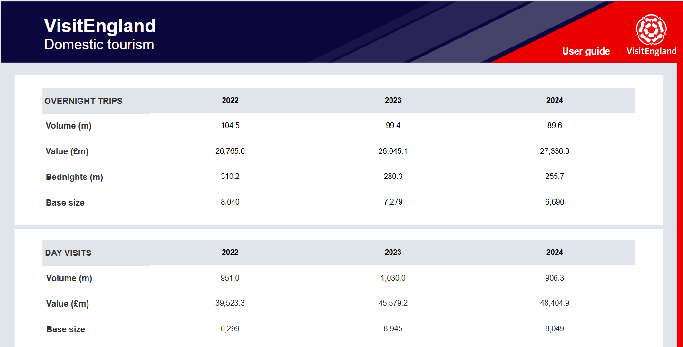

Tables Q3 2025
Tourism day visits and overnight trips characteristics
These are available in our new Domestic Tourism Data Viewer, where you can access volume and value statistics by a selection of variables:
Time series (year, quarter, month)
Destination area (region, LVEP)
Destination type
Overnight trip purpose
Activities
Life stage
Regional data
In this data set, you can find domestic volume and value data for each England region, including:
Domestic tourism day visits volume and spend
Domestic overnight trips volume and spend
Total spend by region (adding up spend on day visits and spend on overnight trips)
To download and view the Excel file, please open this PDF report in Adobe Acrobat Reader and then double click on the paper clip image.
These tables are also available here:
Domestic Tourism, regional and subregional data | VisitBritain.org
Great Britain Tourism Survey: Day Visits (commissioned by VisitEngland, VisitScotland and Visit Wales)
Release date: 18 December 2025
21

Slide 22
Sample sizes
Overnight trips | July 2025 | August 2025 | September 2025 | Q3 2024 | Q3 2025 | Year-To-Date 2024 | Year-To-Date 2025
Britain | 526 | 714 | 1088 | 2718 | 2328 | 6442 | 5696
England | 415 | 569 | 852 | 2195 | 1836 | 5193 | 4473
Holidays | July 2025 | August 2025 | September 2025 | Q3 2024 | Q3 2025 | Year-To-Date 2024 | Year-To-Date 2025
Britain | 163 | 279 | 361 | 853 | 803 | 1925 | 1774
England | 127 | 204 | 265 | 670 | 596 | 1499 | 1324
Tourism day visits | July 2025 | August 2025 | September 2025 | Q3 2024 | Q3 2025 | Year-To-Date 2024 | Year-To-Date 2025
Britain | 735 | 886 | 706 | 2902 | 2327 | 7757 | 6491
England | 551 | 691 | 587 | 2392 | 1829 | 6279 | 5016
Sample Guidance:
If sample size between less than 30 - it is not recommended to use this data.
If sample size is between 30 and 100 - it is recommended to only use this data as indicative, it is not very reliable
If sample size is 100 or more - this is the recommended level of data to use

Slide 23
Definitions (1/3)
Great Britain Domestic Overnight Trip
To qualify as an eligible Great Britain Domestic Overnight Trip the following criteria must be met:
involved a stay of at least one night in one or more of the GB nations
trip is not taken on a frequent basis – takes place less often than once a week
Definition of an overnight trip: all trips where someone stays away from home for at least one night, meeting the above criteria, for whatever purpose.
Key Measures
Volume - an estimate of what the grossed-up number of overnight trips undertaken by the population would be if the quota sample is representative of the whole GB population. Estimates include adult and child trips.
Value - an estimate of what the total expenditure relating to the volume of overnight visits undertaken by the population would be if the quota sample is representative of the whole GB population.
Nights - an estimate of what the grossed-up number of nights spent on overnight trips undertaken by the population would be if the quota sample is representative of the whole GB population.
Journey Purpose
Holiday – the main purpose of the trip was for holiday, pleasure or leisure
VFR - Visiting Friends and Relatives (VFR) - the main purpose of the trip was for visiting friends and relatives, including VFR trips that were combined with a holiday.
Business – the main purpose of the trip was for business
UK stay, part of outbound – an overnight stay in the UK as part of an overseas trip
Miscellaneous – the main purpose of the trip was for another type of trip taken not covered by the above classifications including personal events, public events, or for study, medical, religious purposes
Great Britain Tourism Survey (commissioned by VisitEngland, VisitScotland and Visit Wales)
Release date: 18 December 2025

Slide 24
Definitions (2/3)
Great Britain Domestic Tourism Day Visit
To qualify as an eligible Great Britain Domestic Tourism Day Visit the following criteria must be met:
Lasted 3 hours or more (including travel time)
Undertake 1 or more eligible leisure activities
Must not have been over night
Is undertaken less often than once a week
Includes a visit to a place outside of the local authority where the trip started.
  With the exception of visits where the main activity is a visitor attraction, attending a public event or to watch live sport. In these cases, the need to have visited outside of the starting local authority is removed.
Key Measures
Volume - an estimate of what the grossed-up number of day visits undertaken by the population would be as the survey sample is representative of the whole GB population. Estimates include adult and child visits.
Value - an estimate of what the total expenditure relating to the volume of day visits undertaken by the population would be as the survey sample is representative of the whole GB population.
Great Britain Tourism Survey (commissioned by VisitEngland, VisitScotland and Visit Wales)
Release date: 18 December 2025

Slide 25
Definitions (3/3)
England regions
For geographical classification standard GB regions are used, as defined by the Office for National Statistics.
A trip might include overnight stays in more than one regions. In this report, the regional data (volume and value) is based on all regions stayed in overnight or visited on a day trip. The current approach to volume and value is as follows:
  Region’s overnight trip volume is based on trips, which included an overnight stay in that region
  Region’s day visits volume is based on visits, which included a visit to that region
  Region’s nights volume is based on nights stayed in that region
  Region’s overnight trips total spend is based on proportional spend allocated based on a proportion of nights stayed in that region
  Region’s day visits total spend is based on spend reported for each region and re-proportioned to the total spend post-calculations of spend estimate
Trip dates
The trips are allocated to each calendar month based on the trip return date.
(NB: The trip allocation to calendar months was improved in the methodological review, providing data more accurately assigned to each calendar month.)
Great Britain Tourism Survey (commissioned by VisitEngland, VisitScotland and Visit Wales)
Release date: 18 December 2025

Slide 26
For more information, please click on the link below
Get in touch | VisitBritain.org

