Slide 1



Creating an accessible destination
Introduction to the 'Kick Start' Programme
Getty images

Slide 2

Objectives
By the end of this workshop you will have:
Understood more about the Kick-Start Programme, its purpose, aims and objectives
Understood the important role which information plays in the programme
Had the opportunity to explore the Kick-Start Programme section of the toolkit
Considered the tasks needed to complete the Kick-Start Programme
Identified an owner for each activity, along with a timeline for completion of the process as a whole
Developed a list of stakeholders within the process and how they might be included
Considered any risks within the process and identified ways to mitigate these
Determined how to measure the effectiveness of our Kick-Start Programme

Slide 3

Kick-Start Programme
Low-cost, high-impact approach to accessible destination development
Designed to work with what you already have
Builds on the ‘Foundations’ of Accessible Tourism Development
Uses information as a key lever
Supports you to identify, enhance and market your existing accessible tourism products
Visit Hertfordshire / Rebecca Douglas

Slide 4
Why do this?
Accessible Tourism supports your destination, its businesses, visitors, and local communities by:
Tapping into the growth of 3G family holidays and break
Ensuring that valuable business is not lost
Contributing to regenerative and responsible tourism development i.e. the health and well being of our local communities
Supporting resilience, creating job opportunities, boosting a destination’s image
Improving customer service and the visitor experience for everybody
Growing visitor numbers / increasing spend
Meeting the needs of underserved markets e.g. disabled people
Responding to changing markets e.g. an ageing population
Notes:
Developing Accessible Tourism across the destination should be viewed in the context of an improvement programme, helping to addressing untapped, changing and growing markets, tapping into the business opportunities these offer and improving competitiveness at business and destination level.
This is an area of development which other major tourism destinations across Europe and elsewhere are actively looking to do more and win business across the leisure, business, conference and events markets.

Slide 5
The Purple Pound
16 million disabled people in the UK
= total spending power of £265 billion*
Only 7% are wheelchair users
Attracts the whole travelling party
Loyal customers who return year on year
Accessible tourism worth £14.6 billion in England alone**
* https://wearepurple.org.uk/the-purple-pound-infographic
VisitBritain / Zut Media
** The value of the Purple Pound | VisitBritain.org
Notes:
Many older people will not identify as being disabled but will nevertheless have accessibility requirements.
The majority of people who are disabled will have non-visible impairments.
Many will also have more than one impairment, this reflects the intersectionality of this market e.g a wheelchair user may also be deaf or have hearing loss. The range of accessibility requirements is wide and includes dietary requirements, a significant and growing group within the context of accessible tourism.

Slide 6

The Grey Pound
Total spending power of
£320 billion
VisitBritain / Polly Baldwin
https://www.thedrum.com/news/2020/09/28/brands-warned-not-ignore-grey-pound-over-65s-embrace-e-commerce
Notes:
Many older people will not identify as being disabled but will nevertheless have accessibility requirements.
The majority of people who are disabled will have non-visible impairments.
Many will also have more than one impairment, this reflects the intersectionality of this market e.g a wheelchair user may also be deaf or have hearing loss. The range of accessibility requirements is wide and includes dietary requirements, a significant and growing group within the context of accessible tourism.

Slide 7
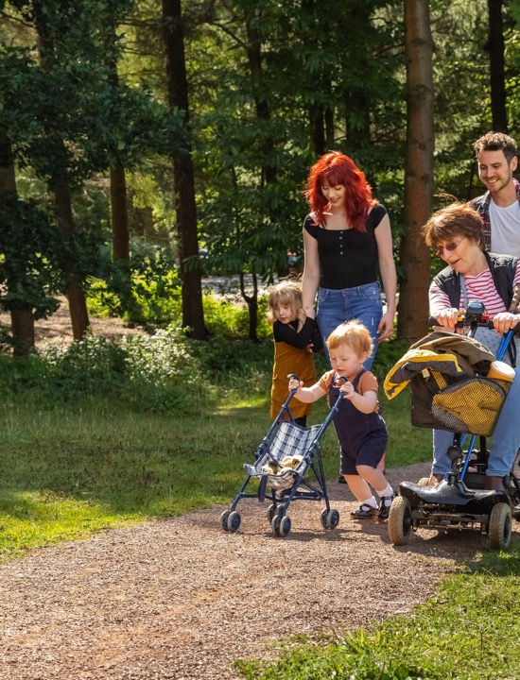
3G Multigenerational Travel
“With families increasingly spread across different cities – and even continents – travel has become a way to reconnect across generations.
Grandparents are playing a bigger role in family holidays, sometimes footing the bill to bring everyone together.
By offering interconnecting rooms, accessible features and experiences designed for all generations, the industry will see continued growth.”
Forestry England / Crown Copyright
Travel Weekly 19 Mar 2025
Notes:
Travel Weekly: Multigenerational travel
https://travelweekly.co.uk/in-depth/comment-five-key-family-holiday-trends-to-look-out-for
This market we also made up of visitors with a range of access requirements including significant groups such as people with dietary requirements.

Slide 8

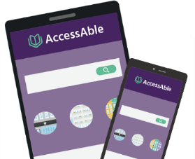
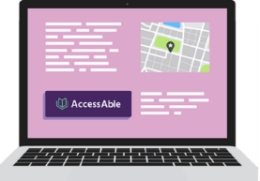
The Information Barrier (1)
95%
90%
87%
95% check accessibility in advance of going to a new place.
90% said it was important or extremely important to know about accessibility before visiting a place for the first time.
87% expect accessibility information to be on a venue's website.
Source: AccessAble’s Accessibility and You Survey 2023/24 (1000 + respondents)

Slide 9


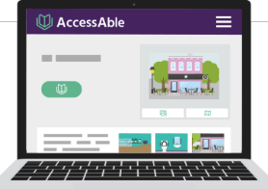
The Information Barrier (2)
77%
73%
96%
73% said they'd had to leave a venue as it wasn't accessible to them. The top cause was that the facilities people had been told were there, weren't (75%).
96% said having accessibility information available in advance would make them more likely to visit somewhere.
77% had not visited a venue because they couldn't find out about accessibility.
Source: AccessAble’s Accessibility and You Survey 2023/24 (1000 + respondents)

Slide 10
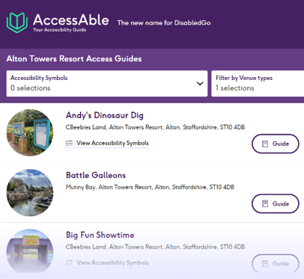
VisitEngland Accessibility Information Projects
Improving the holiday planning experience for visitors with a wide range of accessibility requirements
Key Accessibility Features
Identifying key accessibility features
Helping tourism businesses and tourism distributors to provide more consistent information
Accessibility Guides
VisitEngland has joined forces with AccessAble
Driving forward the provision of robust, publicly available Detailed Access Guides for tourism venues across England.
Businesses can use the AccessAble booking portal
Notes:
VisitEngland’s accessibility information projects support the outcomes of the Kick-Start programme, and engaging businesses in these is therefore key.

Slide 11
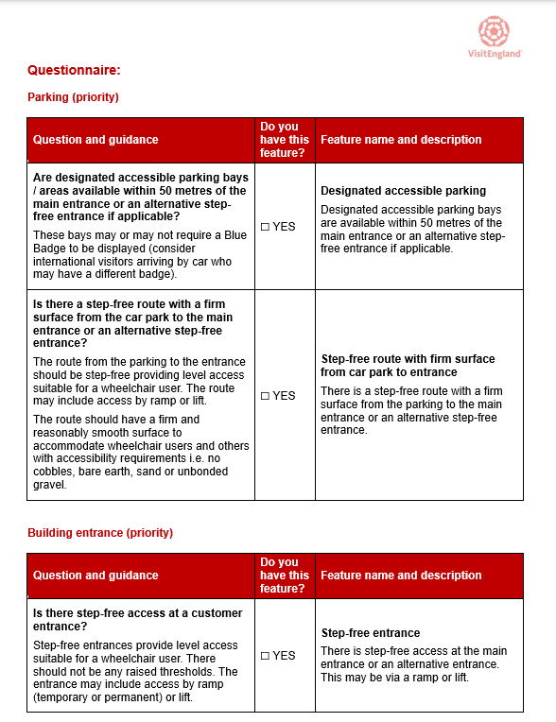
Key Accessibility Features
Helping businesses and distributors to provide more consistent information
Project identified the top features that users look for when researching trips
Gather this data from venues in your destination using the questionnaires (distributor version)
Display it as part of venue listings on your own destination consumer website(s)
Businesses can use the questionnaires in the Toolkit (business website version) to list features on their own website
Notes:
- To save time and energy when researching a trip, people with accessibility requirements want to easily find out what key accessibility features are available at tourism venues.
- In 2024, VisitEngland led a UK and Ireland-wide project to identify the features people with accessibility requirements search for when looking for places to stay and visit.
- The project created a list of key accessibility features that would drive greater consistency in how top-level accessibility information is presented on both tourism listing websites and tourism business websites. The list was informed by new robust consumer research, with 800 disabled travellers in Britain.
- Gather this data from venues in your destination
- Display it as part of venue listings on your own destination consumer website(s)
- If your website is powered by either Simpleview or Destination Core contact your account manager
- If your website is powered by a different provider, please contact us so we can share specific guidance and questionnaires: qad@visitengland.org.
- There are questionnaires for six common business types: serviced accomm, self-catering accomm, attractions and experiences, camping, glamping and holiday parks, food and drink, events, festivals and shows.
- Businesses can use the questionnaires in the Toolkit to list features on their own website (extended list – includes additional features which are not deal-breakers for a sufficiently large market, but improve inclusivity for those with less common accessibility needs)

Slide 12
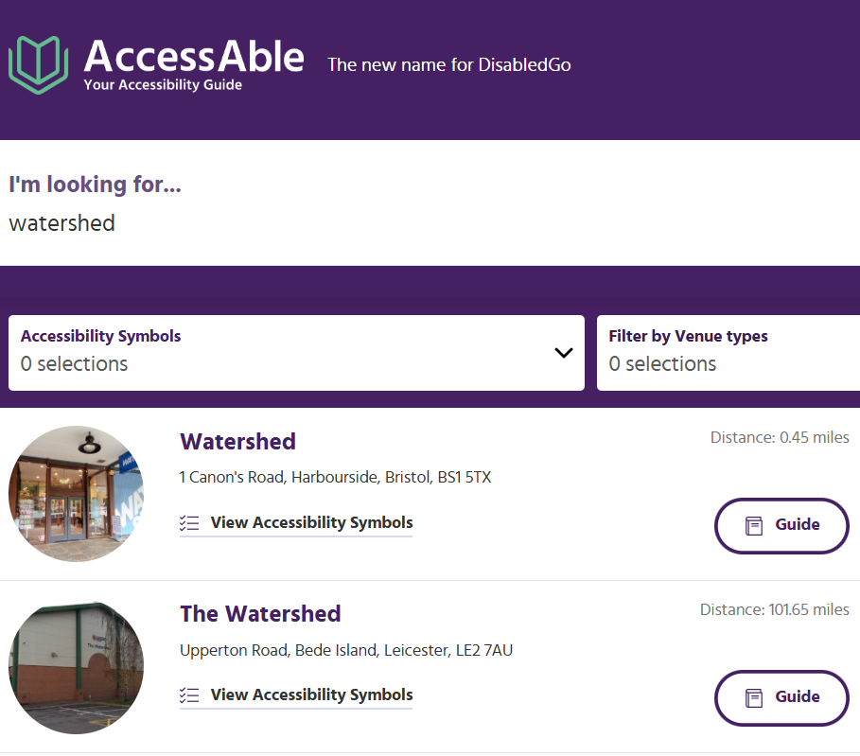
AccessAble Detailed Access Guides
Partner with AccessAble to support the VisitEngland-led drive for more Detailed Access Guides.
Branded version of the Your Accessibility Guide portal.
LVEP Landing page on AccessAble.co.uk with venue guides from across your destination.
AccessAble support with engagement, promotion and content creation.
20% discount when co-ordinating and booking 5+ On Site Assessments in your destination.
Notes:
Many people also require more detailed information to decide where to stay or visit. So, in addition to outlining your key accessibility features, businesses are to be encouraged to provide an Accessibility Guide.
An Accessibility Guide describes and visually shows the layout of each area of the business, following the route a visitor will typically take from arrival, entering and getting around. ​
The recommended format is an AccessAble Detailed Access Guide, which describes all areas of a venue, giving 100s of pieces of accessibility information, including measurements and photographs.
VisitEngland has joined forces with AccessAble to driving forward the provision of robust, publicly available Detailed Access Guides for tourism venues across England.
LVEPs can partner with AccessAble to support the VisitEngland-led drive for more Detailed Access Guides and receive:
A branded version of the Your Accessibility Guide portal.
LVEP Landing page on AccessAble.co.uk with venue guides from across your destination.
AccessAble support with engagement, promotion and content creation.
20% discount when co-ordinating and booking 5+ On Site Assessments in your destination.
Should you not be able to partner with AccessAble, you should signpost businesses to the VisitEngland version of the portal:
visitengland.youraccessibilityguide.co.uk

Slide 13

The ‘Asks’ of Businesses
Complete the Key Accessibility Features questionnaire for their business
Return this information to the DMS provider or LVEP
Add the Key Accessibility Features to their own website
Consider commissioning an AccessAble Detailed Access Guide
Consider undertaking Accessibility Awareness training
Visit Leicester / Mynt Communications Ltd

Slide 14
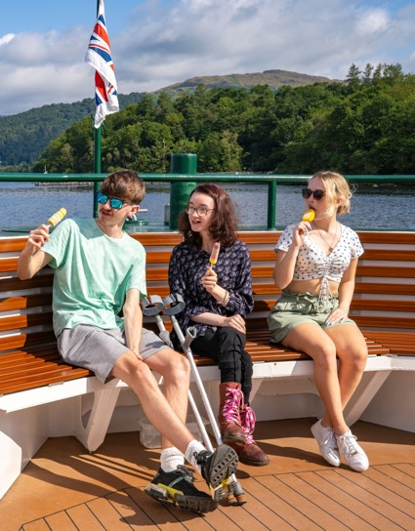
Information
Accessibility information is key to supporting informed choice and visit planning
The Kick-Start Programme will help us to:
Identify the accessibility information we need to gather
Help us to present it effectively on our LVEP website so that it can be easily found and used by visitors and local communities.
Visit Lake District / Paul Mitchell

Slide 15
Every Step We Take…
Takes Us Closer to Welcoming Everybody
Programme overview:
Step 1: Prepare – Set Aims and objectives
Step 2: Identify Stakeholders
Step 3: Identify existing accessible tourism products and services
Step 4: Provide accessibility information on your LVEP website
Step 5: Initiate a B2B engagement campaign
Step 6: Initiate a B2C promotion campaign
Step 7: Review and Evaluation

Slide 16
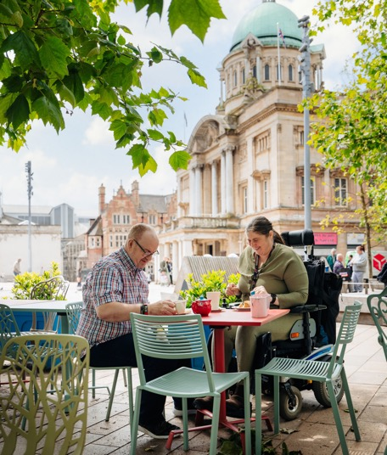
Step 1: Prepare
The purpose of this workshop is to help us with this stage of the process
The key elements of this first step are to:
Agree aims and objectives
Identify a Project Manager
Create a project plan which identifies:
  Tasks
  Timeline
  Risks
  Resources required
  Budget required
Visit Hull and East Yorkshire / Tom Arran

Slide 17
Kick-Start Programme Objectives
Identify existing accessible and inclusive products across the tourism value chain working with our stakeholders, including visitors and local communities, to achieve this.
Provide clear, consistent, relevant and accurate information about these products on our destination website.
Ensure that consumers can find this information easily and that our website is accessible for all potential visitors.
Initiate a B2B marketing campaign to engage more businesses and grow our accessible tourism offering.
Launch a B2C marketing campaign to showcase our accessible tourism products and engage visitors.
Review this process and our offering to continuously improve.

Slide 18
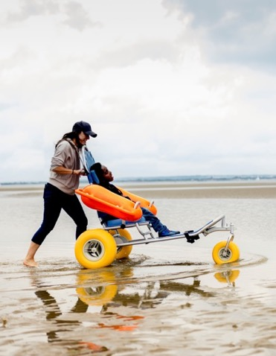
Step 2: Identify Stakeholders
We need to identify and work with stakeholders to achieve shared goals. Stakeholders are:
Individuals or groups who have an interest in accessible tourism development in the region e.g:
  Local authorities
  National Parks
  Businesses
  Transport providers
  Community groups
  Health services e.g. social prescribing
  Neighbouring LVEPs
  VisitEngland
Visit Isle of Wight

Slide 19
Step 3: Identify Existing Accessible Products and Services
We need to find accessibility information that is already available to us, such as:
AccessAble Guides for businesses across our destination
Businesses listing their Key Accessibility Features on our LVEP website
Information on third party websites, including transport companies
Information from other sources
An Accessibility Information Checklist in the VisitEngland LVEP Toolkit is available to help

Slide 20
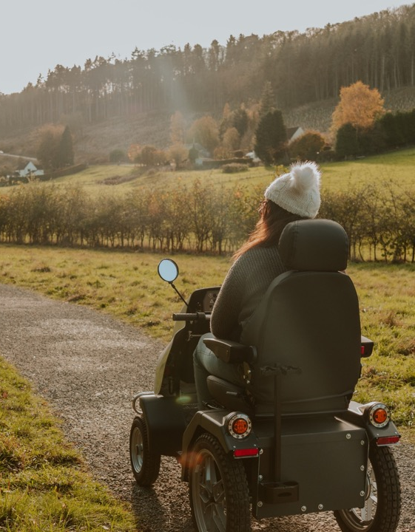
Step 4: Provide Accessibility Information on our LVEP Website
To ensure that we promote our region’s existing accessible tourism products effectively, we need to:
Ensure that our LVEP website itself is accessible
Create an Accessibility section on the website which visitors can find easily
Populate this section with the information we have found in step 3
There are examples within the destination toolkit to support us
VisitBritain / Isobel Greenhalgh

Slide 21
Step 5: Initiate a B2B Engagement Campaign
We need to create a B2B engagement campaign which:
Has a clear and meaningful identity (consider using the 'Everybody Welcome' brand)
Provides an easy way for businesses to become involved
Highlights the opportunities offered by inclusive tourism
Encourages businesses to identify their Key Accessibility Features to support visit planning and consider commissioning an AccessAble Detailed Access Guide
Signposts businesses to appropriate customer service training. Alternatively, we need to provide this as part of the Kick-Start programme
Notes:
The 'Everybody Welcome' brand was developed by Destination North East England Destination Development Partnership and has been made available to LVEPs via VisitEngland.

Slide 22

Step 6: Initiate a B2C Promotional Campaign
We need to create a B2C promotion campaign which:
Highlights our destination’s accessible tourism offering
Incorporates inclusive imagery
Includes information on the minimum criteria businesses need to have met to be included in the campaign e.g. each business has:
  Identified their Key Accessibility Features and provided these to the LVEP
  Provided accessibility information on their website, such as Key Accessibility Features and/or an AccessAble Detailed Access Guide
  Trained front-line staff in providing an inclusive welcome
VisitBritain / Herewegoagain

Slide 23
Step 7: Review and Evaluate
We need to measure the success of our programme by gathering:
Quantitative data e.g achievement of:
  Aims
  Objectives
  Milestones
Qualitative data e.g:
  Case studies
  Quotes
Notes:
The VisitEngland Kick-Start KPIs tool will provide some suggested measures to help you monitor and evaluate your programme.

Slide 24

Project Planning – Let’s Get Started
To help us create a project plan we will:
Consider each of the Kick-Start programme objectives in turn
Identify the tasks needed to achieve each objective using post-its
Consolidate these
Create a timeline of activities
Identify an owner for each task
Identify our stakeholders
Consider risks within the project
Identify next steps
VisitBritain / Zut Media

Slide 25
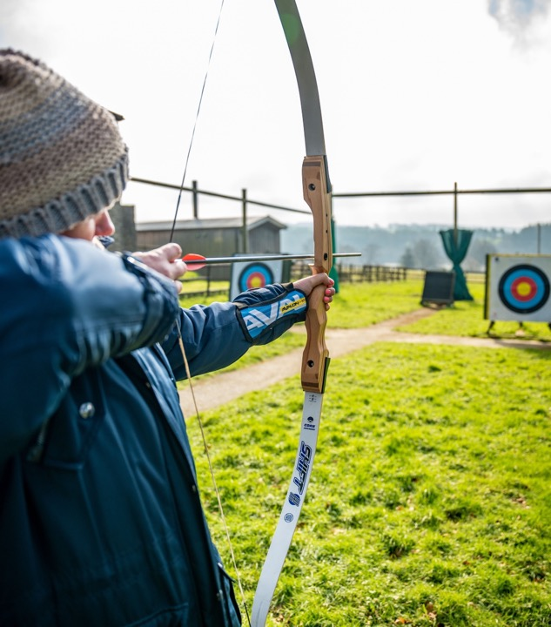
Over to you!
Step 1:
Identify the tasks needed to meet the programme objectives
Calvert Devon – Kentisbury, Devon
Notes:
We are now going to look at each of the programme objectives in turn
ACTIVITY – Option 1; looking at each objective in turn
Write the first objective of the Kick-Start Programme on a flipchart
Ask team members to think of the tasks needed to achieve that objective
Write each response on a separate post-it and place this on the flipchart underneath the first objective
Stick this flipchart to the wall so that it can be seen throughout the rest of the process
Repeat the steps above for each of the remaining objectives.
ACTIVITY – Option 2; breaking into small groups who move between flipcharts
Write each objective onto a flipchart, splitting attendees into small groups each assigned an objective
Ask team members to think of the tasks needed to achieve that objective
Write each response on a separate post-it and place this on the flipchart
Each group then rotates to the next objective and repeats, until all groups have contributed to all objectives
By the end of this stage, you will have at least six pieces of flipchart paper, one for each objective, plus one for each additional objective you have identified. You may want to photograph the contents of each page before moving on to the next step.

Slide 26

Feedback
Visit Bristol / Frank Beaumier – Weston-Super-Mare, Somerset

Slide 27
Step 2:
Group related tasks together
Plan the timeline
Identify owners for each task
Calvert Devon – Kentisbury, Devon
Notes:
ACTIVITY
Invite team members to look at the tasks on the flipcharts and to group any elements which they feel belong together, for example some tasks may be smaller actions within a bigger task
Transfer the tasks, whether these are on individual sticky notes or grouped, onto a large table or wall area
Invite the team to move the tasks and arrange them into a time sequence. This will also help to identify interdependencies between tasks. As a rough guide, the Kick-Start Programme is likely to take around six months to complete. Putting an intended start and end date on the process will help you to create your project timeline
Identify an ‘owner’ for each task
Photograph the timeline you have created so that you have a record and agree who will type up the information as part of your project plan

Slide 28
Step 3:
Identify stakeholders
Identify risks and mitigation
Select KPIs
Calvert Devon – Kentisbury, Devon
Notes:
ACTIVITY
Identify your stakeholders. This will support you in developing a communication and engagement plan
Identify any potential risks within the programme and consider how you can mitigate these
Ensure that these details are added to the other information you have created to form your project plan
Review the VisitEngland Kick-Start KPIs tool and determine which of these measures you will use to monitor and evaluate your Kick-Start Programme.
numbers should be indented as previous lists are
Linked to above comment

Slide 29
Thank you
Getty images

