Slide 1
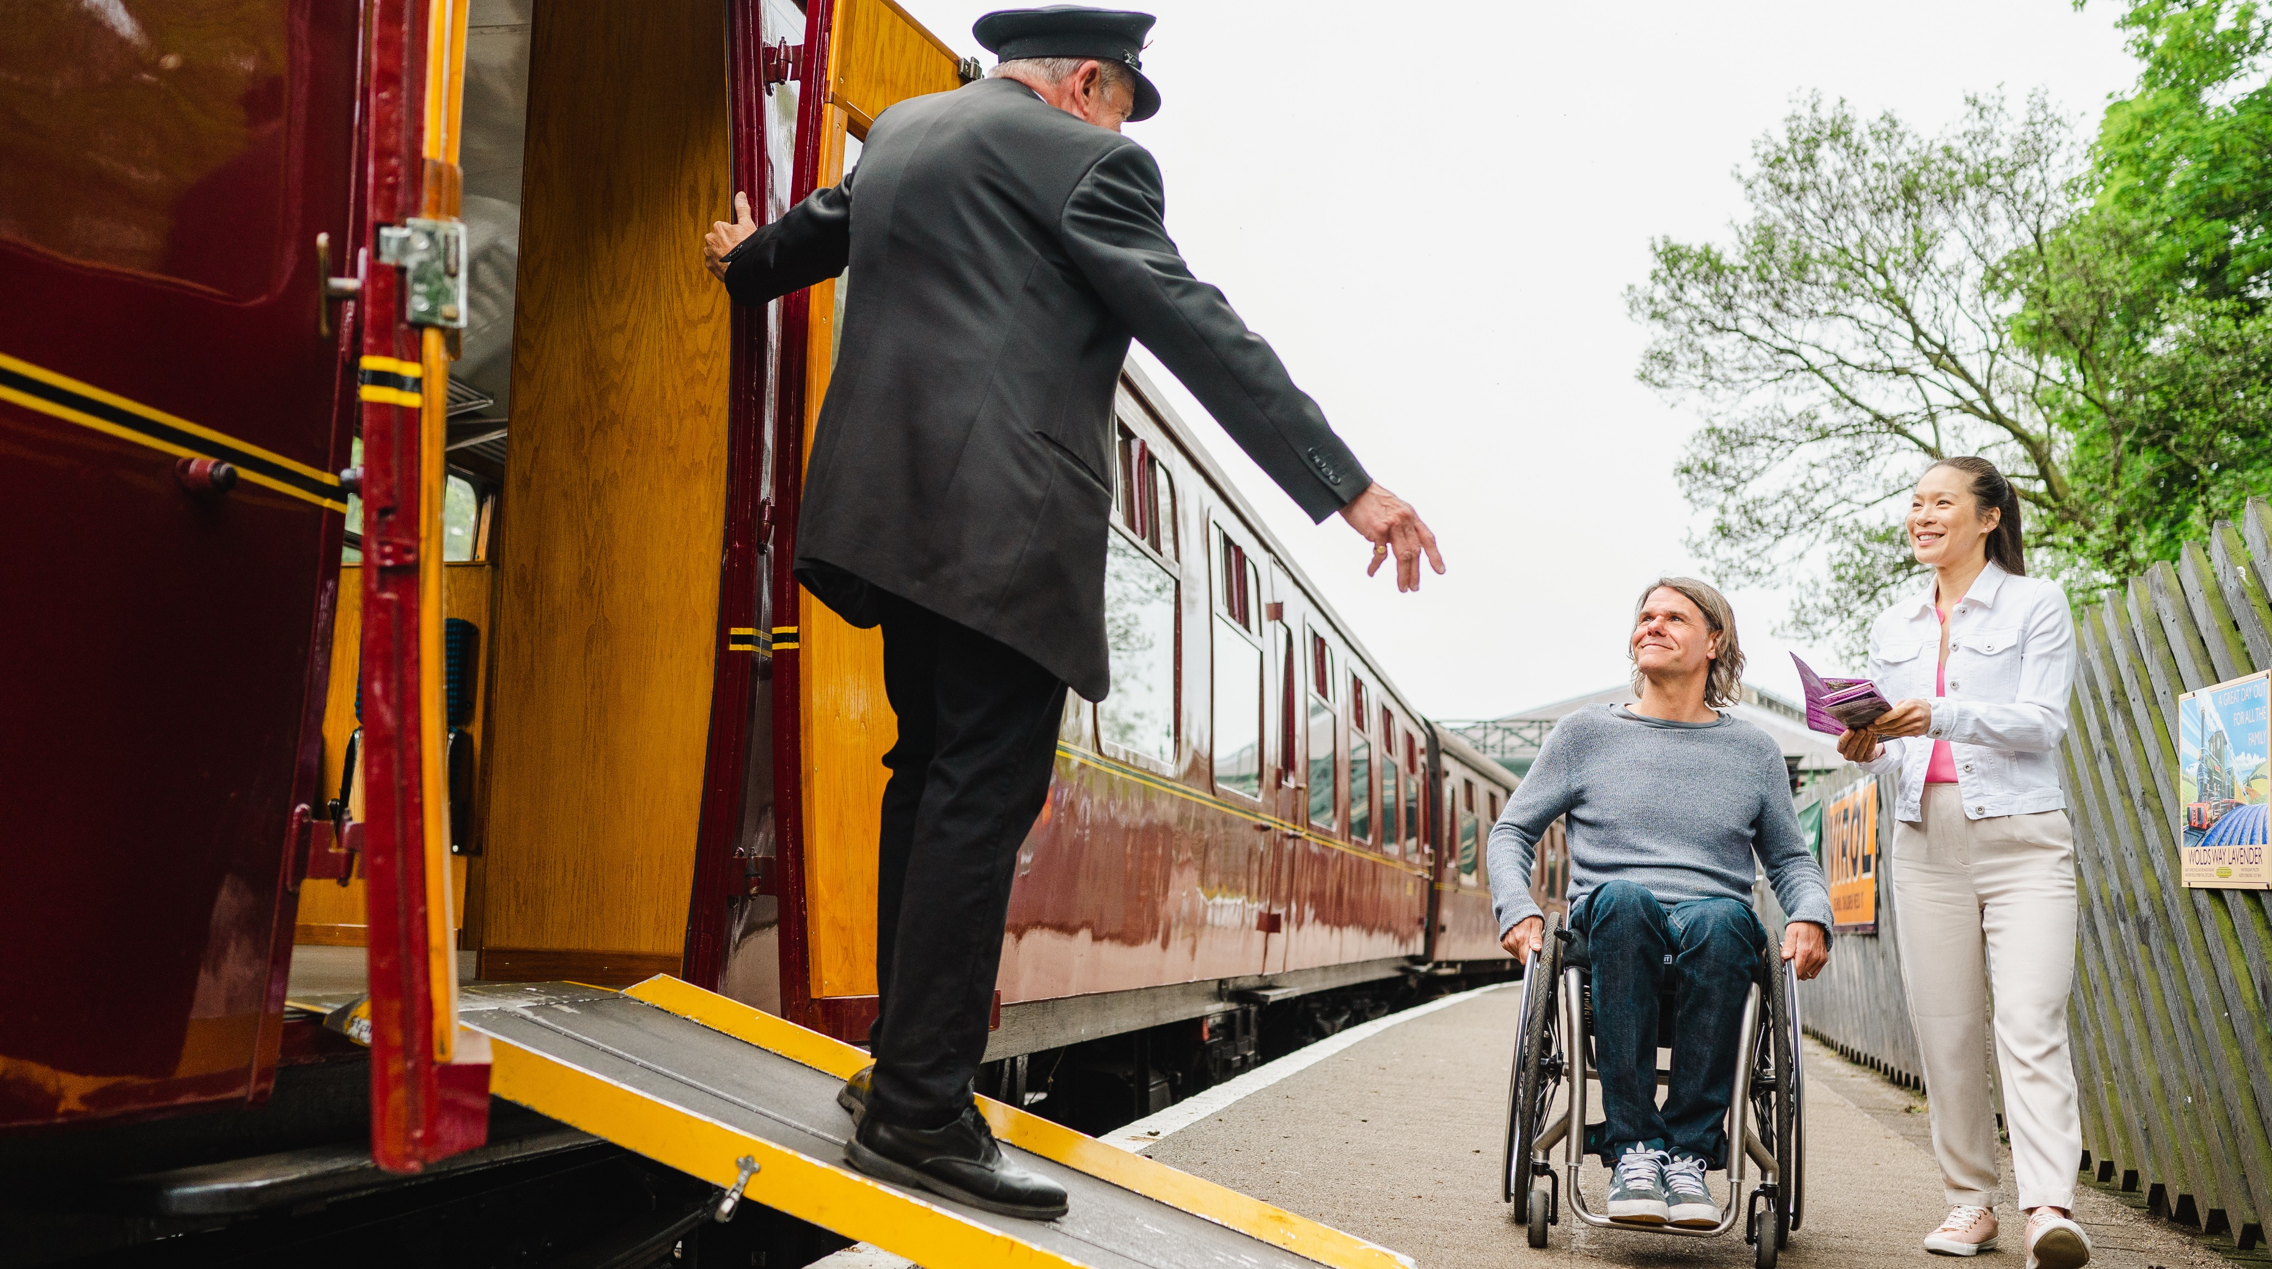

Communication toolkit:
Accessible and Inclusive Tourism Toolkit for Businesses
Updated summer 2025
© VisitBritain/Peter Kindersley

Slide 2
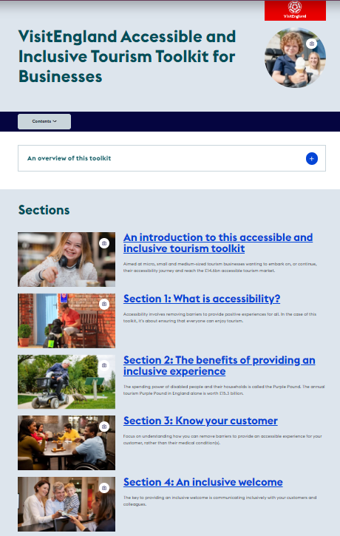
Welcome
Thank you for supporting VisitEngland in promoting the Accessible and Inclusive Tourism Toolkit for Businesses.
In this toolkit you will find a selection of communication pieces that can be copied, cut and pasted, or used as inspiration for your own promotional channels.
If you need any further materials for your communications or have questions or suggestions about how to communicate this initiative, please contact Hannah Lowe (hannah.lowe@visitengland.org).

Slide 3
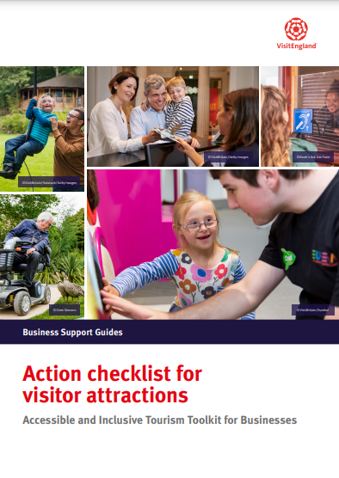
Key messages for your audience
VisitEngland provides a comprehensive accessibility toolkit for tourism businesses
The Accessible and Inclusive Tourism Toolkit is a best-in-class resource to help tourism businesses from all sectors improve their welcome for customers with accessibility requirements
It includes top 20 tips, practical action checklists by business type, accessibility personas, technical guidance for the built environment and more
The toolkit is freely available on VisitEngland’s Business Advice Hub
A course is now available on the VisitEngland Academy Learning Platform to take businesses through the structure & tools in the toolkit (summer 2025)

Slide 4
NEW summer 2025
VisitEngland Academy Course:
Exploring VisitEngland’s Accessible and Inclusive Tourism Toolkit for Businesses

Slide 5
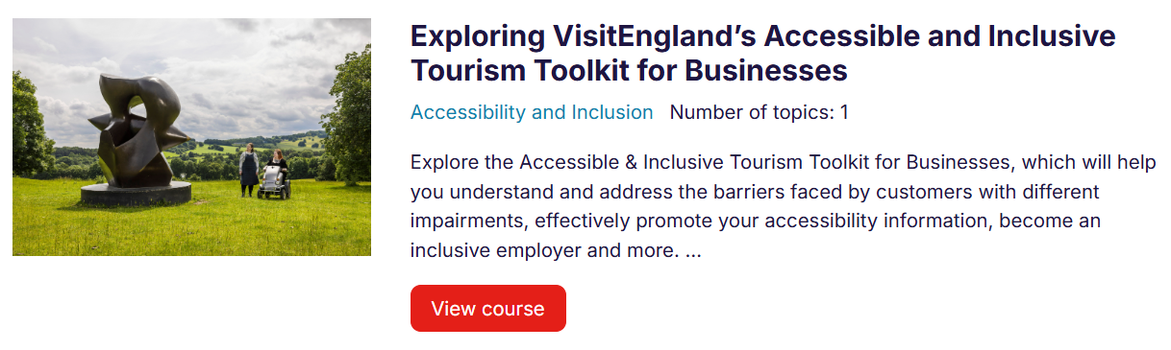
Course: Exploring VisitEngland’s Accessible and Inclusive Tourism Toolkit for Businesses
Free e-learning course on the VisitEngland Academy, launched summer 2025
Top-level introduction designed to take businesses through the structure and practical tools of the toolkit
3 videos covering different sections of the toolkit
View the course: Exploring VisitEngland’s Accessible and Inclusive Tourism Toolkit for Businesses | VisitEngland Academy

Slide 6
Article for enewsletters
Title: : Exploring VisitEngland’s Accessibility Toolkit for Tourism Businesses
Body:
New introductory videos to VisitEngland’s popular Accessible and Inclusive Tourism Toolkit for Businesses are available on the VisitEngland Academy Learning Platform.
Recorded by toolkit author Emily Yates, the short videos take you through the structure and practical tools within the toolkit, to help you focus on the sections most relevant to you, no matter where you are on your accessibility journey.
The toolkit can help you understand and address the barriers faced by customers with different impairments, effectively promote your accessibility information, become an inclusive employer and more.
Call to Action: Watch the videos now – Course: An introduction to VisitEngland’s Accessible and Inclusive Tourism Toolkit for Businesses | VisitEngland Academy

Slide 7
Sample B2B social media posts
.@VisitEnglandBiz have just launched new videos on the VisitEngland Academy Learning Platform to help tourism businesses easily navigate the popular Accessibility Toolkit and make the most of its practical tools http://tiny.cc/w6in001
Not sure where to start in making your tourism business more accessible? Check out these videos from @VisitEnglandBiz to learn about their free Accessibility Toolkit #AccessforAll http://tiny.cc/w6in001
Calling all tourism businesses! Find out how the @VisitEnglandBiz Accessibility Toolkit can help you improve your welcome for disabled customers with this free course on the VisitEngland Academy Learning Platform http://tiny.cc/w6in001

Slide 8
Ongoing Toolkit promotion

Slide 9
Short article for enewsletters (c. 60 words)
Title: Improve your welcome for disabled customers for free
Body:
Learn how to be more inclusive with VisitEngland’s popular Accessible and Inclusive Tourism Toolkit for Businesses.
This free and comprehensive resource can help businesses understand and address the barriers faced by customers with different impairments, effectively promote their accessibility information, become an inclusive employer and more.
Content includes top 20 tips, downloadable business-specific action checklists and technical guidance for the built environment.
Call to Action: Explore the toolkit now - https://www.visitbritain.org/business-advice/make-your-business-accessible-and-inclusive/visitengland-accessible-and-inclusive

Slide 10
Long article for enewsletters (c. 100 words)
Title: Improve your welcome for disabled customers for free
Body:
Learn how to be more inclusive with VisitEngland’s popular Accessible and Inclusive Tourism Toolkit for Businesses.
This comprehensive resource can help businesses understand and address the barriers faced by customers with different impairments, effectively promote their accessibility information, become an inclusive employer and more.
Content includes top 20 tips, real-life case studies and downloadable business-specific action checklists. Technical guidance for the built environment is also provided to aid new-build and refurbishing businesses in creating inclusive physical spaces.
Around 30 organisations, including some of the leading disability charities and tourism and hospitality trade associations, were involved in its development.
Call to Action: Explore the toolkit now - https://www.visitbritain.org/business-advice/make-your-business-accessible-and-inclusive/visitengland-accessible-and-inclusive

Slide 11
Sample toolkit B2B social media posts
This free @VisitEnglandBiz Accessibility Toolkit can help make your business more accessible, with guidance on providing an inclusive welcome, creating accessibility information, designing accessible spaces and employing disabled people #AccessforAll https://brnw.ch/21wF77W
#DYK that accessible tourism is worth £14.6bn in England alone? Get practical guidance on how to tap into this market with @VisitEnglandBiz’s free Accessibility Toolkit #AccessforAll https://brnw.ch/21wF77W
Calling all tourism businesses! @VisitEnglandBiz has a free Accessibility Toolkit to help you improve your welcome for customers with accessibility requirements, with practical tips and action checklists #AccessforAll https://brnw.ch/21wF77W
Don’t know where to start in making your tourism business more accessible? Check out @VisitEnglandBiz’s free Accessibility Toolkit for step-by-step guidance and practical tips #AccessforAll https://brnw.ch/21wF77W
#DYK that 70% of disabled people will not return to a business after receiving poor customer service? Learn how to provide an inclusive welcome to all your customers with @VisitEnglandBiz’s free Accessibility Toolkit #AccessforAll https://brnw.ch/21wF77W

Slide 12
Sample post for LinkedIn
Learn how to be more inclusive with VisitEngland‘s popular Accessible and Inclusive Tourism Toolkit for Businesses
This comprehensive resource can help businesses understand and address the barriers faced by customers with different impairments, effectively promote their accessibility information, become an inclusive employer and more.
Content includes top 20 tips, real-life case studies and downloadable business-specific action checklists. Technical guidance for the built environment is also provided to aid new-build and refurbishing businesses in creating inclusive physical spaces.
Around 30 organisations, including some of the leading disability charities and tourism and hospitality trade associations, were involved in its development.
Explore the toolkit now - https://www.visitbritain.org/business-advice/make-your-business-accessible-and-inclusive/visitengland-accessible-and-inclusive

Slide 13
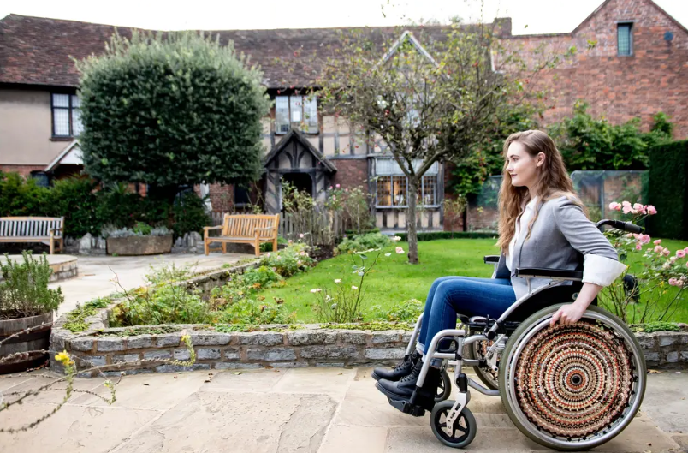
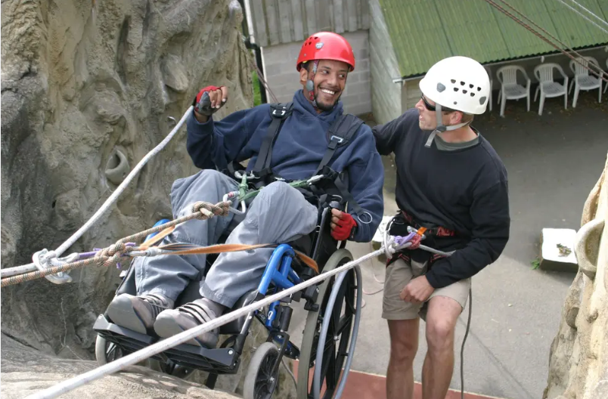
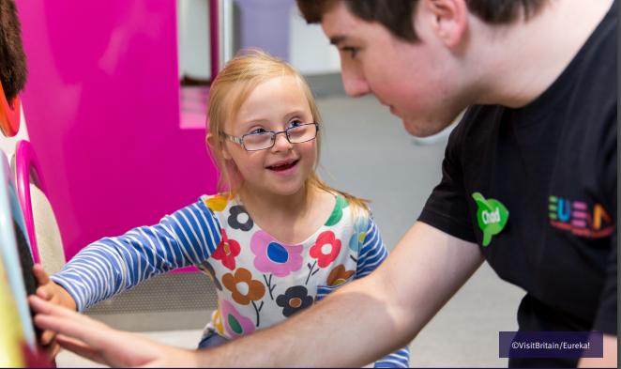
Imagery
Relevant accompanying imagery can be downloaded from the ‘Accessibility’ collection on VisitBritain/VisitEngland’s Asset Management Library (registration required):
VisitBritain/Nemorin
VisitBritain/Calvertexmoor.co.uk
No: 608736
No: 607430
VisitBritain/Eureka!
No: 607725

Slide 14
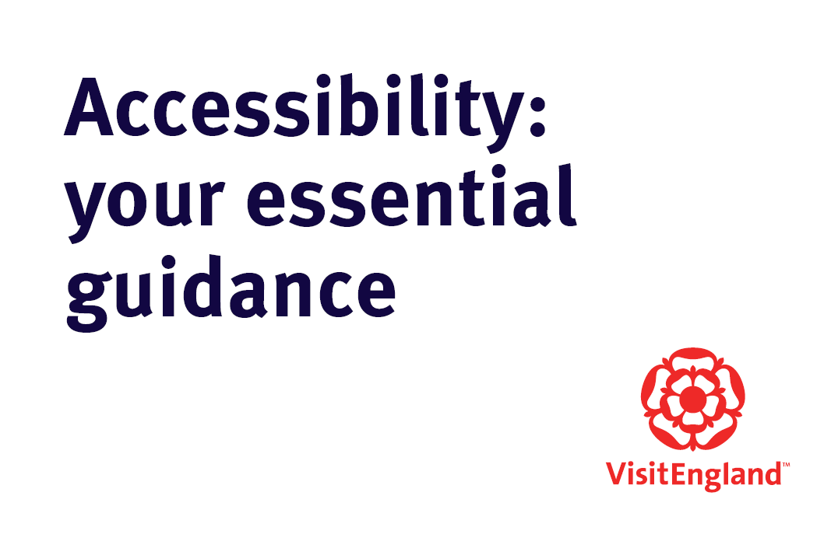
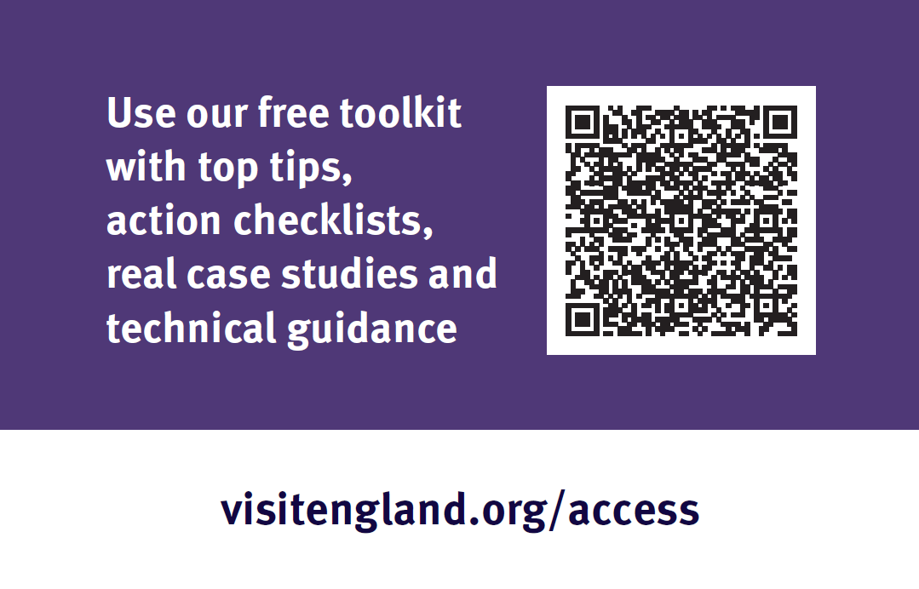
Printed promotional material
Promotional business cards are available (c. 125 cards per box)
Please contact hannah.lowe@visitengland.org for copies

Slide 15
Visitengland.org/access
@VisitEnglandBiz

