Slide 1
Creating an accessible destination
An Introduction to the
‘Enhanced’ Programme

Slide 2
Objectives
By the end of the workshop you will have:
understood more about the Enhanced Programme, its purpose, aims and objectives
considered the tasks needed to complete the Enhanced Programme
identified an owner for each activity, along with a timeline for completion of the process as a whole
developed a list of stakeholders within the process and how they might be included
considered any risks within the process and identified ways to mitigate these
Notes:
2
2
In 'Groundrules' include 'Car Park' flipchart for great tips gathered throughout the day as well as the usual information on turning off mobile phones and feeling free to ask questions as we go along etc.

Slide 3
The Enhanced Programme
The Enhanced programme
is designed to build on the Kick-Start programme – gathering existing accessibility information
supports the development of businesses to offer an enhanced level of accessibility provision to add to our accessible tourism portfolio
aims to increase the skills, knowledge and confidence of participating businesses, improving their customer offer and growing visitor numbers
is designed to engage additional businesses, stakeholders and the local community in our accessible tourism initiatives
allows for increased marketing opportunities

Slide 4
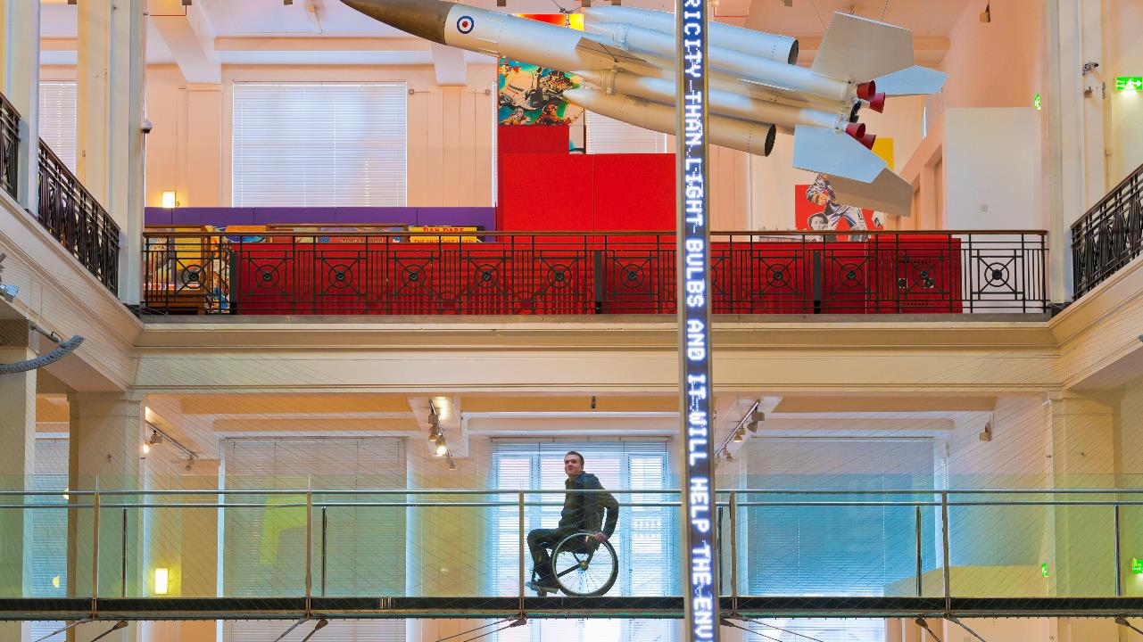
The UK aims to be the most accessible tourism destination in Europe by 2025. The Enhanced Programme will help ensure our destination plays a key role in making that vision a reality.

Slide 5
Why do this?
Accessible Tourism supports our destination, its businesses, visitors, and local communities by:
improving customer service and the visitor experience
growing visitor numbers
meeting the needs of underserved markets e.g. disabled people
responding to changing markets e.g. an ageing population
tapping into the growth of 3G family holidays and breaks
ensuring valuable business is not lost
contributing to sustainable and responsible tourism development
supporting resilience, creating job opportunities, boosting our destination’s image

Slide 6
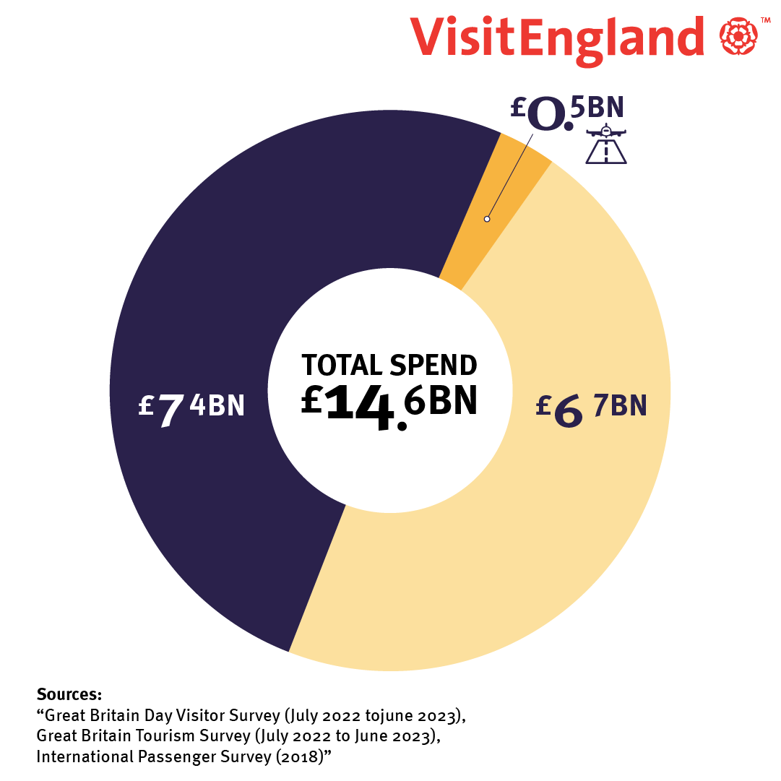
The size of the market
Notes:
6
6

Slide 7
Every step we take…. Takes us closer to welcoming everybody
Programme overview:
Step 1: Prepare
Step 2: Engage Businesses and stakeholders, then launch the Programme
Step 3: Provide a business support and development package
Step 4: Host a celebration and networking event
Step 5: Launch a B2C marketing campaign
Step 6: Review

Slide 8
Step 1: Prepare
The key elements of this first step are to:
Agree aims and objectives
Identify a Project Manager
Create a project plan which identifies:
Tasks
Timeline
Risks
Resources required
Budget required
The purpose of this workshop is to help us with this stage of the process

Slide 9
Step 1: Prepare
Enhanced Programme Aim: To further improve our destination’s accessible tourism offering
Enhanced Programme Objectives:
To achieve this we will:
provide a programme of professional support and guidance to a selection of business across the tourism value chain. This support will enable those businesses to understand and improve the information, facilities and customer services they provide for visitors with accessibility requirements.
engage other businesses and stakeholders across the region through destination wide conferences.
enhance the online accessibility information we provide for potential visitors at destination level, encouraging more people to look and book with confidence.
launch a B2C marketing campaign through owned, earned and paid channels to showcase the accessible tourism products across our destination, with the aim of increasing visitor numbers.

Slide 10
Step 2: Engage businesses and launch the programme
To achieve this we need to:
identify and engage with businesses across the tourism value-chain who may be suitable to be involved
target the ‘must go to’ venues in our destination
select businesses which already have a good level of accessibility
choose businesses who are motivated to take part
allow a reasonable lead time to help businesses plan and prepare for their involvement
host a destination wide conference to help launch the programme

Slide 11
Step 3: provide a business support and development package
The support and development package includes, for each business:
an accessibility audit
the development of an improvement plan
the creation of a Detailed Access Guide
guidance on providing good quality access information on their website
‘mystery shopping’ visit(s)
peer mentoring
Accessibility Champion training
online training for front-line staff

Slide 12
Step 4: Host a celebration and networking event
This second, destination wide event provides an opportunity to:
share what has been achieved
celebrate success
enable businesses to learn and network
plan next steps
engage other businesses in accessible tourism

Slide 13
Step 5: launch a B2C marketing campaign
To achieve this we need to:
determine what we are trying to achieve
select our target market(s):
determine which channels we should utilise
factor in ‘lead time’ for content creation
allocate an appropriate budget

Slide 14
Step 7: Review and evaluation
We need to measure the success of our programme by gathering:
Quantitative data e.g achievement of:
aims
objectives
milestones
key performance indicators
Qualitative data e.g:
case studies
quotes

Slide 15
Project Planning – Let’s get started
To help us create a project plan we will:
consider each of the Enhanced programme objectives in turn
identify the tasks needed to achieve each objective using ‘sticky notes’
consolidate these
create a timeline of activities
identify an owner for each task
identify our stakeholders
consider risks within the project
identify next steps

