Slide 1


Communication toolkit:
Accessible and Inclusive Tourism Toolkit for Businesses
© VisitBritain/Peter Kindersley

Slide 2
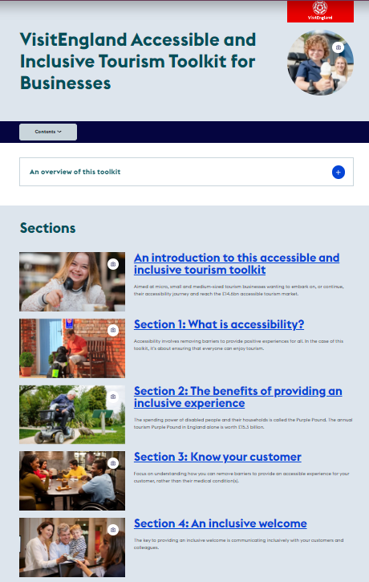
Welcome
Thank you for supporting VisitEngland in promoting the Accessible and Inclusive Tourism Toolkit for Businesses.
In this toolkit you will find a selection of communication pieces that can be copied, cut and pasted, or used as inspiration for your own promotional channels.
If you need any further materials for your communications or have questions or suggestions about how to communicate this initiative, please contact Hannah Lowe (hannah.lowe@visitengland.org).

Slide 3
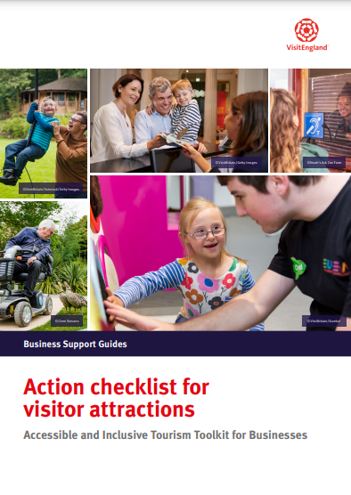
Key messages for your audience
VisitEngland has published a new, comprehensive accessibility toolkit for tourism businesses
The Accessible and Inclusive Tourism Toolkit is a best-in-class resource to help tourism businesses from all sectors improve their welcome for customers with accessibility requirements
It includes top 20 tips, practical action checklists by business type, accessibility personas, technical guidance for the built environment and more
The toolkit is freely available on VisitEngland’s Business Advice Hub

Slide 4
Short article for enewsletters (c. 60 words)
Title: New Accessibility Toolkit for Tourism Businesses
Body:
A new Accessible and Inclusive Tourism Toolkit for Businesses is now available on VisitEngland’s Business Advice Hub.
This comprehensive resource can help businesses understand and address the barriers faced by customers with different impairments, effectively promote their accessibility information, become an inclusive employer and more.
Content includes top 20 tips, downloadable business-specific action checklists and technical guidance for the built environment.
Call to Action: Explore the toolkit now - https://www.visitbritain.org/business-advice/make-your-business-accessible-and-inclusive/visitengland-accessible-and-inclusive

Slide 5
Long article for enewsletters (c. 100 words)
Title: New Accessibility Toolkit for Tourism Businesses
Body:
A new Accessible and Inclusive Tourism Toolkit for Businesses is now available on VisitEngland’s Business Advice Hub.
This comprehensive resource can help businesses understand and address the barriers faced by customers with different impairments, effectively promote their accessibility information, become an inclusive employer and more.
Content includes top 20 tips, real-life case studies and downloadable business-specific action checklists. Technical guidance for the built environment is also provided to aid new-build and refurbishing businesses in creating inclusive physical spaces.
Around 30 organisations, including some of the leading disability charities and tourism and hospitality trade associations, were involved in its development.
Call to Action: Explore the toolkit now - https://www.visitbritain.org/business-advice/make-your-business-accessible-and-inclusive/visitengland-accessible-and-inclusive

Slide 6
Sample B2B social media posts
This free @VisitEnglandBiz Accessibility Toolkit can help make your business more accessible, with guidance on providing an inclusive welcome, creating accessibility information, designing accessible spaces and employing disabled people #AccessforAll https://brnw.ch/21wF77W
#DYK that accessible tourism is worth £14.6bn in England alone? Get practical guidance on how to tap into this market with @VisitEnglandBiz’s free Accessibility Toolkit #AccessforAll https://brnw.ch/21wF77W
Calling all tourism businesses! @VisitEnglandBiz has published a free Accessibility Toolkit to help you improve your welcome for customers with accessibility requirements, with practical tips and action checklists #AccessforAll https://brnw.ch/21wF77W
Don’t know where to start in making your tourism business more accessible? Check out @VisitEnglandBiz’s free Accessibility Toolkit for step-by-step guidance and practical tips #AccessforAll https://brnw.ch/21wF77W
#DYK that 70% of disabled people will not return to a business after receiving poor customer service? Learn how to provide an inclusive welcome to all your customers with @VisitEnglandBiz’s free Accessibility Toolkit #AccessforAll https://brnw.ch/21wF77W

Slide 7
Sample post for LinkedIn
Title: New Accessibility Toolkit for Tourism Businesses
Body:
VisitEngland has published a new Accessible and Inclusive Tourism Toolkit for Businesses on their Business Advice Hub.
This comprehensive resource can help businesses understand and address the barriers faced by customers with different impairments, effectively promote their accessibility information, become an inclusive employer and more.
Content includes top 20 tips, real-life case studies and downloadable business-specific action checklists. Technical guidance for the built environment is also provided to aid new-build and refurbishing businesses in creating inclusive physical spaces.
Around 30 organisations, including some of the leading disability charities and tourism and hospitality trade associations, were involved in its development.
Explore the toolkit now - https://www.visitbritain.org/business-advice/make-your-business-accessible-and-inclusive/visitengland-accessible-and-inclusive

Slide 8
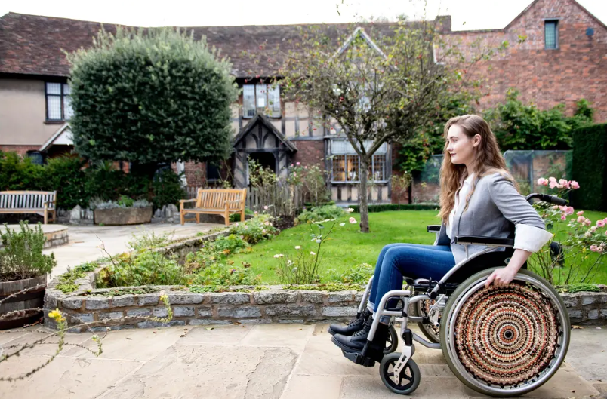
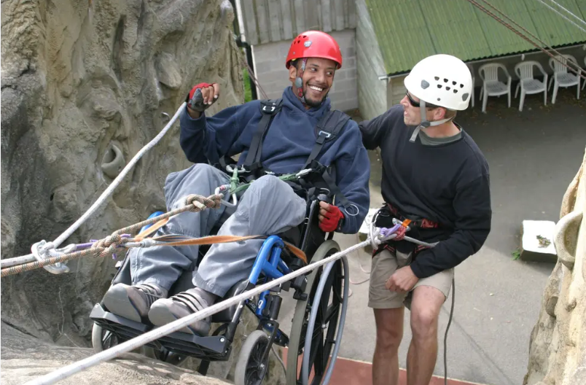
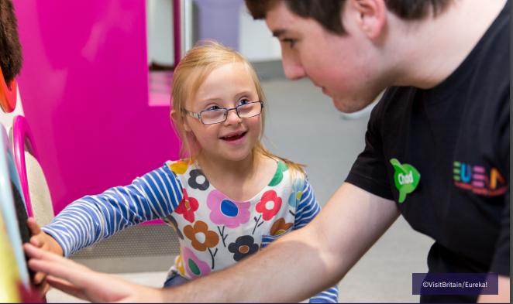
Imagery
Relevant accompanying imagery can be downloaded from the ‘Accessibility’ collection on VisitBritain/VisitEngland’s Asset Management Library (registration required):
VisitBritain/Nemorin
VisitBritain/Calvertexmoor.co.uk
No: 608736
No: 607430
VisitBritain/Eureka!
No: 607725

Slide 9
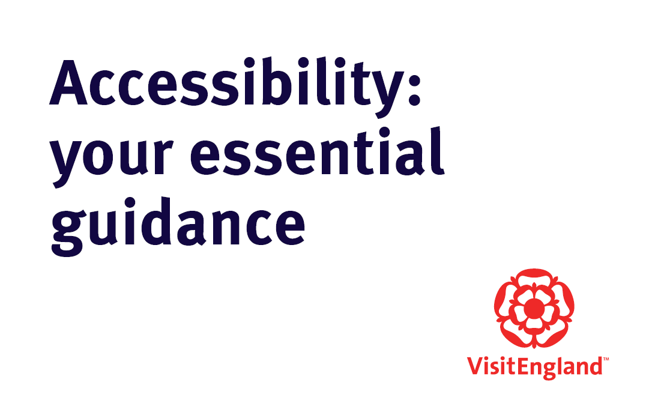
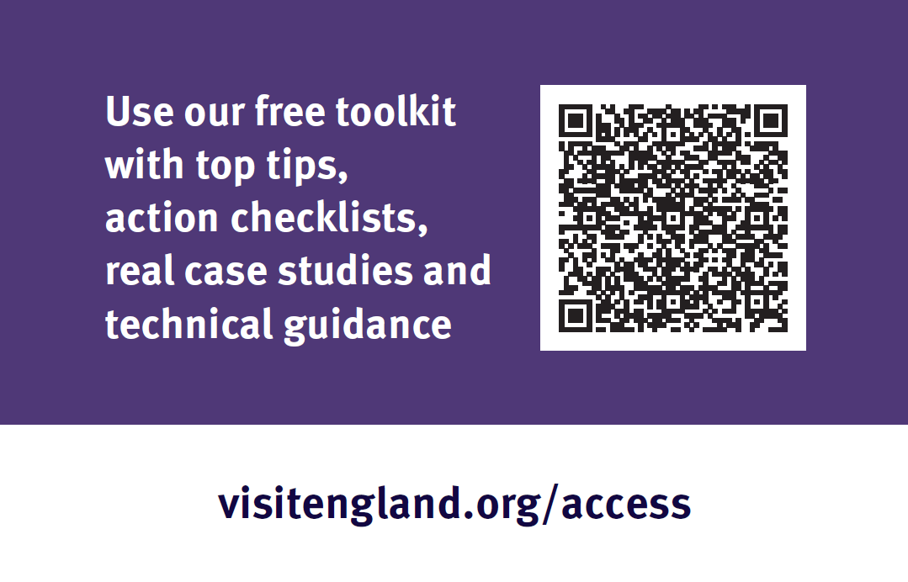
Printed promotional material
Promotional business cards are available (c. 125 cards per box)
Please contact hannah.lowe@visitengland.org for copies

Slide 10
Visitengland.org/access
@VisitEnglandBiz

